Slide 1
PERCOLATION
Alireza Abrehforoush
Kavyan Zare
Ava Moknatjoo
Summer 2023

Slide 2
What is percolation?
Percolation theory in statistical physics describes the behavior of a network when nodes or links are added with a definite probability and we want to explore how a signal spreads through the network. We will explore phase transition in this model in what follows (In particular, site percolation in a 2D lattice).
Models of percolation

Slide 3
Examples of percolation:
Fire
Oil
Coffee
Spread of diseases
Diffusion of information in social media
….

Slide 4
Percolation, a brief study
A question that is studied in percolation is whether there exists a cluster of connected sites of infinite size in an infinite network.
In percolation theory we can prove that this probability is either 0 or 1 and that the probability is an increasing function of density. This suggests there must be a critical density below which the probability is 0 and above which the probability is 1. Though when we don’t take the limit of the size of the network to infinity, we have a continuous phase transition.

Slide 5
Percolation, a brief study
Critical exponents describe the behavior of physical quantities near continuous phase transitions. It can be shown that percolation clusters become a fractal at values of density sufficiently close to the critical density. It can also be shown that the dimension of the fractal is $M≅L^{df}$For large network sizes where M is the size of the giant cluster. It is also shown that the dimension of the fractal is less that 2 when density is less that the critical density and equal to 2 otherwise.

Slide 6
Simulation of percolation
NetLego: NetLogo is an open source, cross-platform tool that enables users to model a wide variety of natural and social phenomena (including biology, chemistry, computer science, economics, physics, psychology, art, and much more).

Slide 7
Fire example
This model simulates the spread of a fire through a forest. It shows that the fire’s chance of reaching the right edge of the forest depends critically on the density of trees. This is an example of a common feature of complex systems with some adjustable parameter like probability of spread,west wind speed,south wind speed and Big Jump.

Slide 8
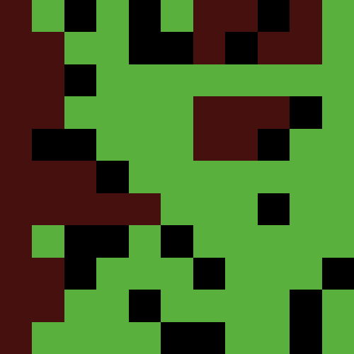

Slide 9
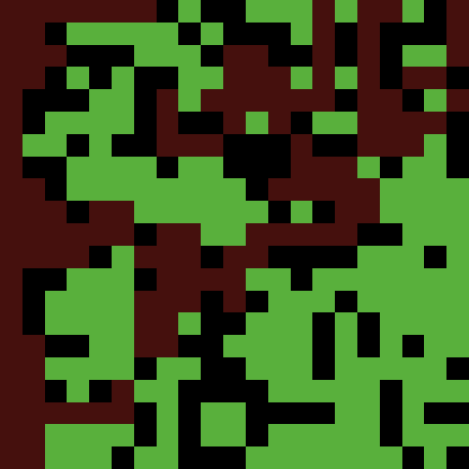

Slide 10
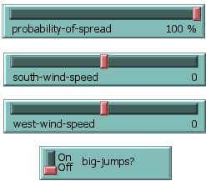
adjustable parameters
Default mode:
Density
Size of network
Probability of spread
West wind speed
South wind speed
Big jump

Slide 11
Our simulation
In this simulation, we have investigated the critical density and how it changes when different features are added to the model. We have also used the model to make an estimation of the dimension of the fractal.

Slide 12
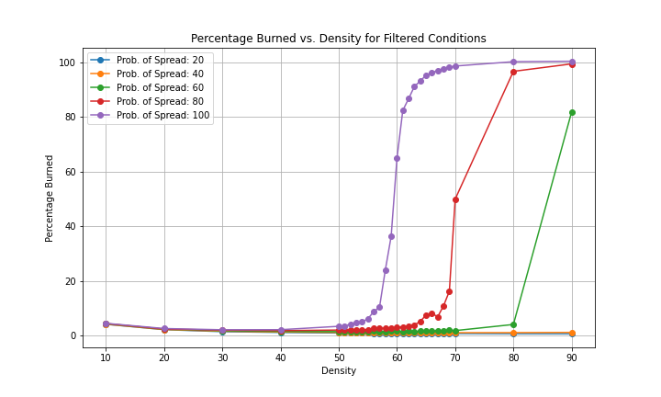
Graph of burnt percentage according to density with grid of size 901*901 (by changing probability of spread)

Slide 13
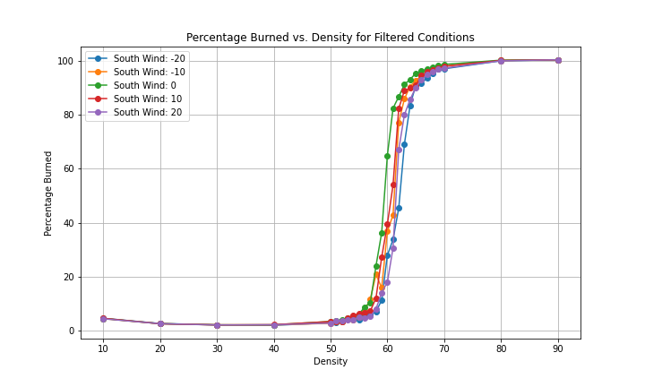
Graph of burnt percentage according to density with grid of size 901*901 (by changing south-wind speed)

Slide 14
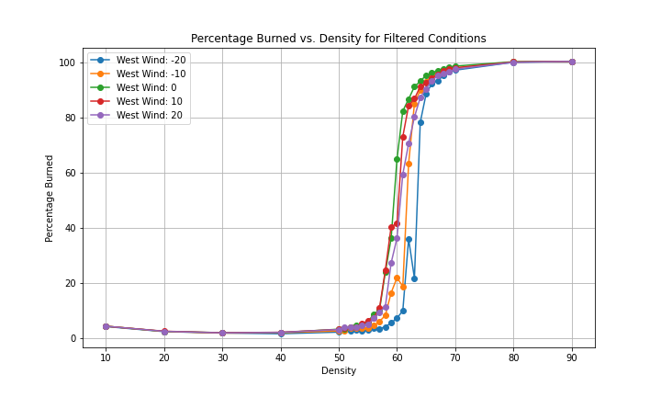
Graph of burnt percentage according to density with grid of size 901*901 (by changing west-wind speed)

Slide 15
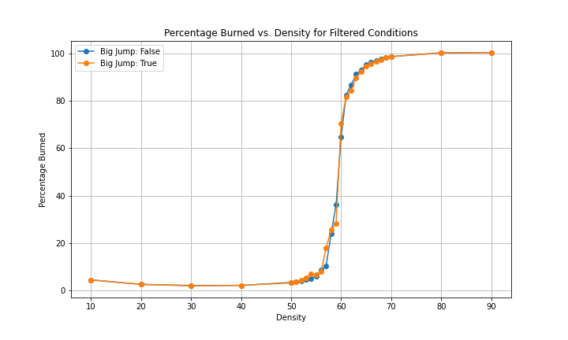
Graph of burnt percentage according to density with grid of size 901*901 (by changing big-jump)

Slide 16
An Approximation of the Fractal dimension

Slide 17
Fractal dimension

Slide 18
references
Wikipedia contributors. (2023, June 22). Percolation. In Wikipedia, The Free Encyclopedia. Retrieved 20:14, August 26, 2023, from https://en.wikipedia.org/w/index.php?title=Percolation&oldid=1161443767
Bak, P., Tang, C., & Wiesenfeld, K. Self-organized criticality: an explanation of 1/f noise, 1987. Phys. Rev. Lett, 59, 381.
Broadbent, S. R., & Hammersley, J. M. (1957, July). Percolation processes: I. Crystals and mazes. In Mathematical proceedings of the Cambridge philosophical society (Vol. 53, No. 3, pp. 629-641). Cambridge University Press.
Wikipedia contributors. (2023, August 3). Percolation theory. In Wikipedia, The Free Encyclopedia. Retrieved 20:15, August 26, 2023, from https://en.wikipedia.org/w/index.php?title=Percolation_theory&oldid=1168497132
Wikipedia contributors. (2023, August 22). Kolmogorov's zero–one law. In Wikipedia, The Free Encyclopedia. Retrieved 20:15, August 26, 2023, from https://en.wikipedia.org/w/index.php?title=Kolmogorov%27s_zero%E2%80%93one_law&oldid=1171645280
Wikipedia contributors. (2023, July 19). Critical exponent. In Wikipedia, The Free Encyclopedia. Retrieved 20:16, August 26, 2023, from https://en.wikipedia.org/w/index.php?title=Critical_exponent&oldid=1166036689
Wikipedia contributors. (2023, August 22). Percolation critical exponents. In Wikipedia, The Free Encyclopedia. Retrieved 20:16, August 26, 2023, from https://en.wikipedia.org/w/index.php?title=Percolation_critical_exponents&oldid=1171736502

Slide 19
THANKS
FOR YOUR
ATTENTION

