Slide 1
Medical Applications of synchrotron Radiation Medical Imaging, Radiation Therapy, Structural biology, X-ray microscopy and microfluorescence
Ehsan Salimi
Head, ILSF Users’ Development Division
Institute for Research in Fundamental Science (IPM)
Salimi.ehsan@ipm.ir
26 June 2023

Slide 2
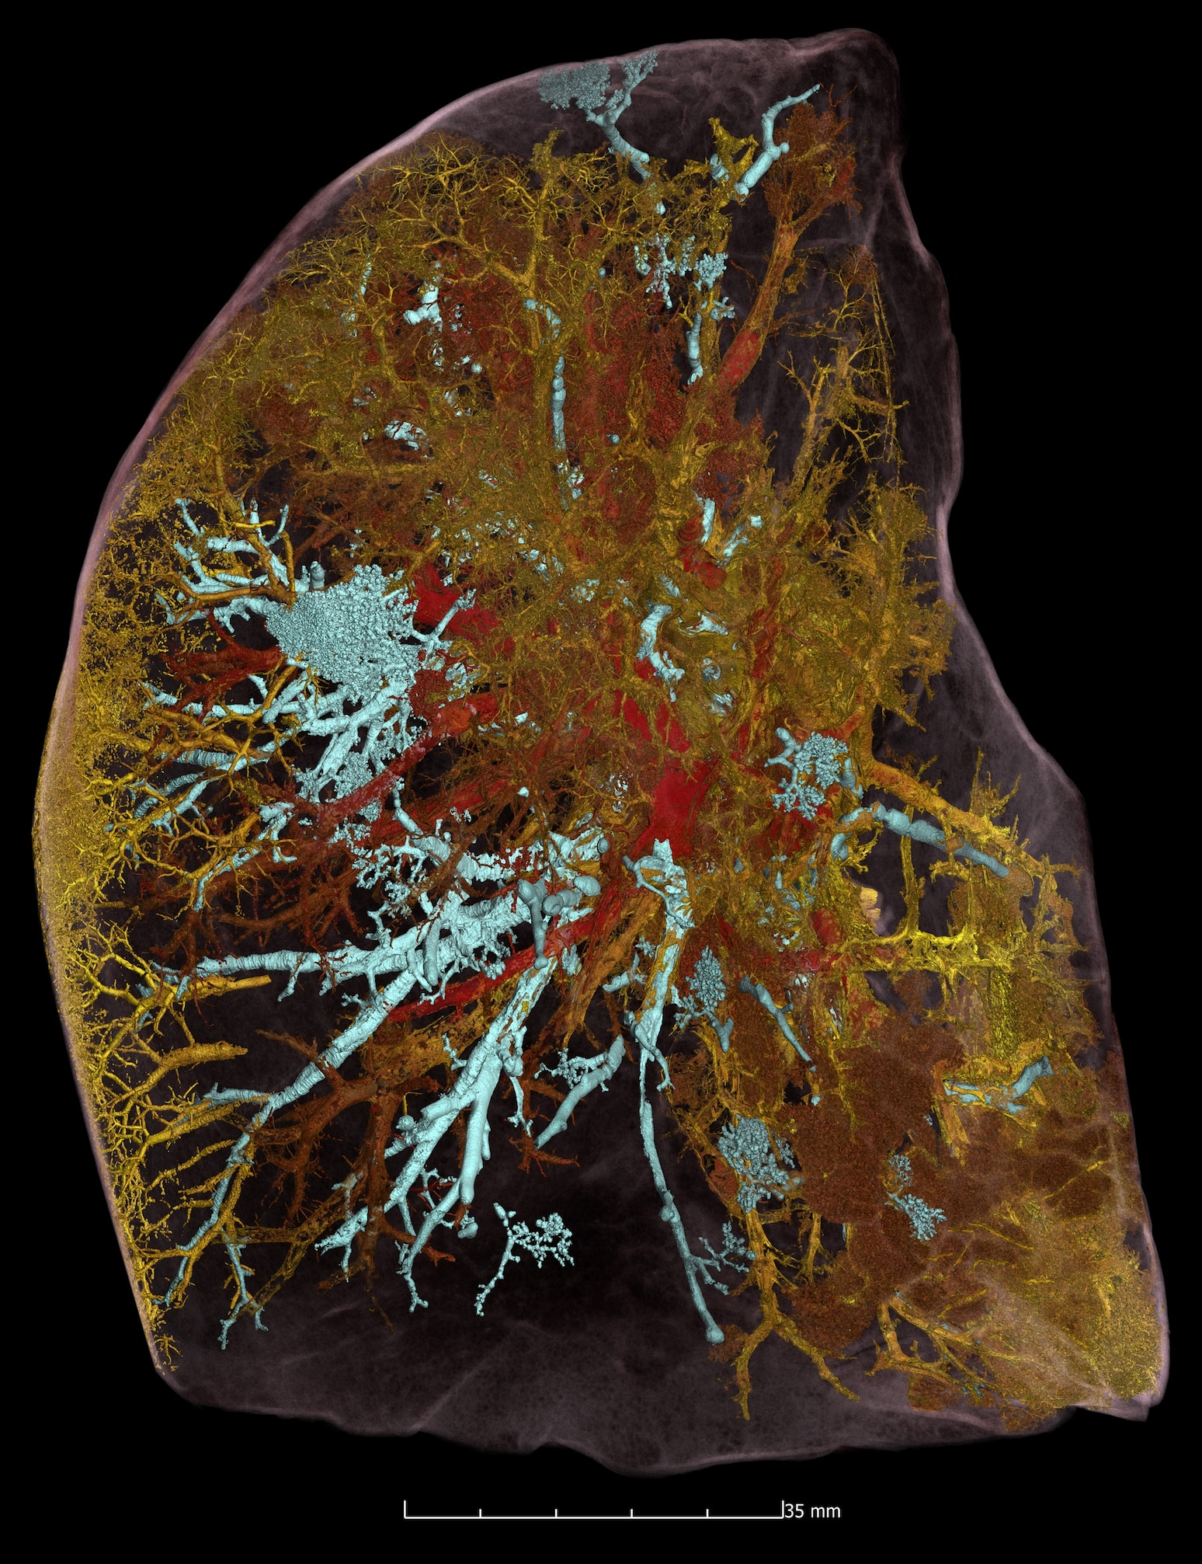
… an example!
© ESRF, Human Organ Atlas
Notes:
آبی مجاری تنفسی قرمز رگ‌های خونی باز و سالم و زرد عروق بسته و تخریب شده

Slide 3
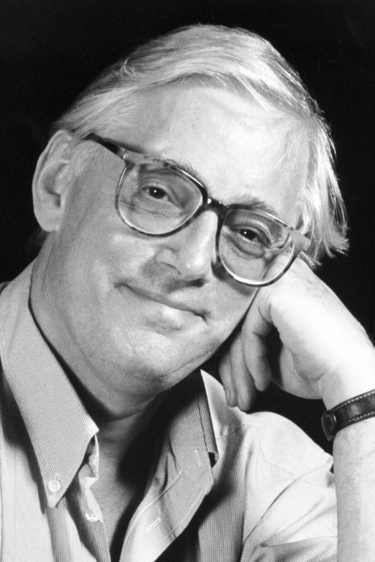
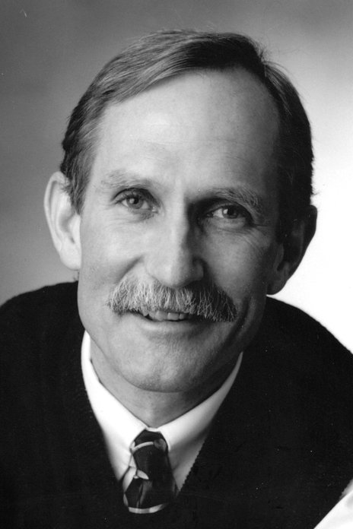
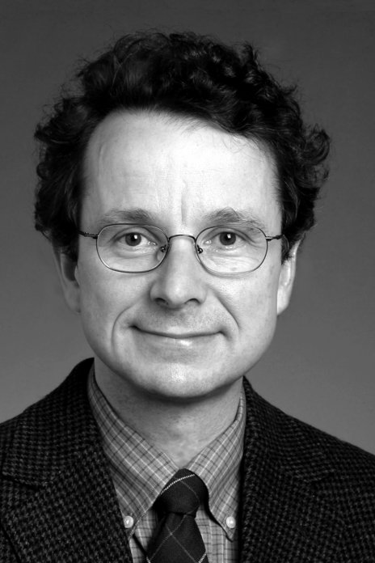
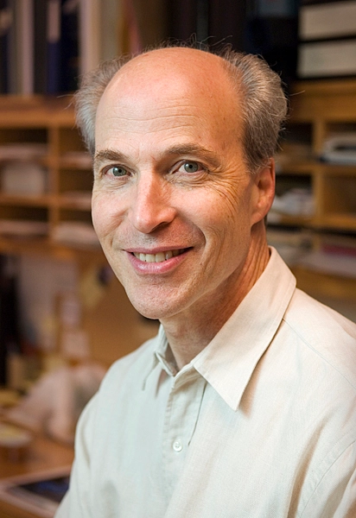
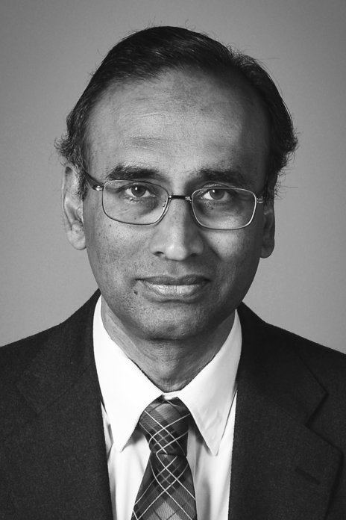
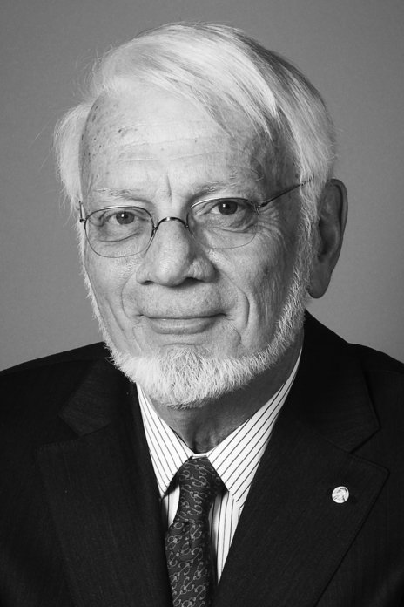
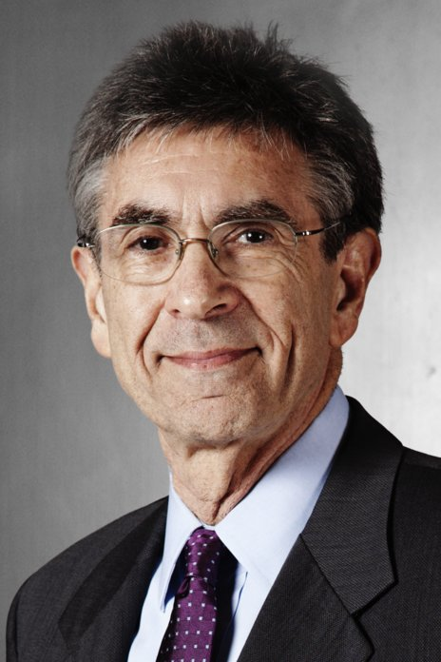
Nobel laureates with Synchrotron Radiation
Paul D. Boyer
John E. Walker
Peter Agre
Roderick MacKinnon
for their elucidation of the enzymatic mechanism underlying the synthesis of adenosine triphosphate (ATP)
1997, SRS
Roger Kornberg
for discoveries concerning channels in cell membranes
2003, ESRF
for understanding how DNA is converted into RNA, a process known as transcription
2006, SSRL
Venkatraman
Ramakrishnan
Thomas A Steitz
Brian Kobilka
Ada E Yonath
Robert J. Lefkowitz
for studies of the structure and function of the ribosome
for studies of G-protein-coupled receptors
2012, ESRF. APS
2009, ESRF. APS

Slide 4
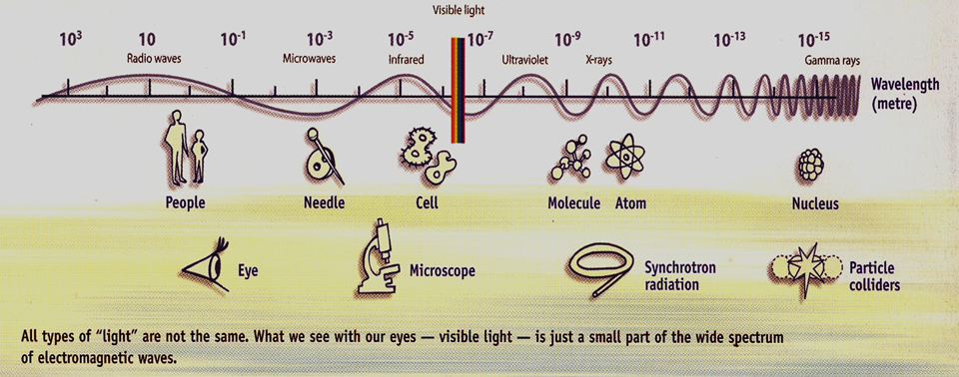
Synchrotron radiation sources properties (1/2)
Broad Spectrum which covers from microwaves to hard X-rays;
the user can select the wavelength required for experiment;
either with a monochromator or adjusting the emission wavelength of insertion devices

Slide 5
Synchrotron radiation sources properties (2/2)
High Flux
high intensity photon beam, allows rapid experiments or use of weakly scattering crystals;
Flux = Photons / ( s • BW)
High Brilliance (Spectral Brightness)
highly collimated photon beam generated by a small divergence and small size source
Brilliance = Photons / ( s • mm² • mrad² • BW )
Polarisation
both linear and circular (with IDs)
Pulsed Time Structure
pulsed length down to 10s ps in SRs / 10s fs in FELs
High Stability
Submicron source stability in SR
Partial coherence in SRs
Full T coherence in FELs

Slide 6
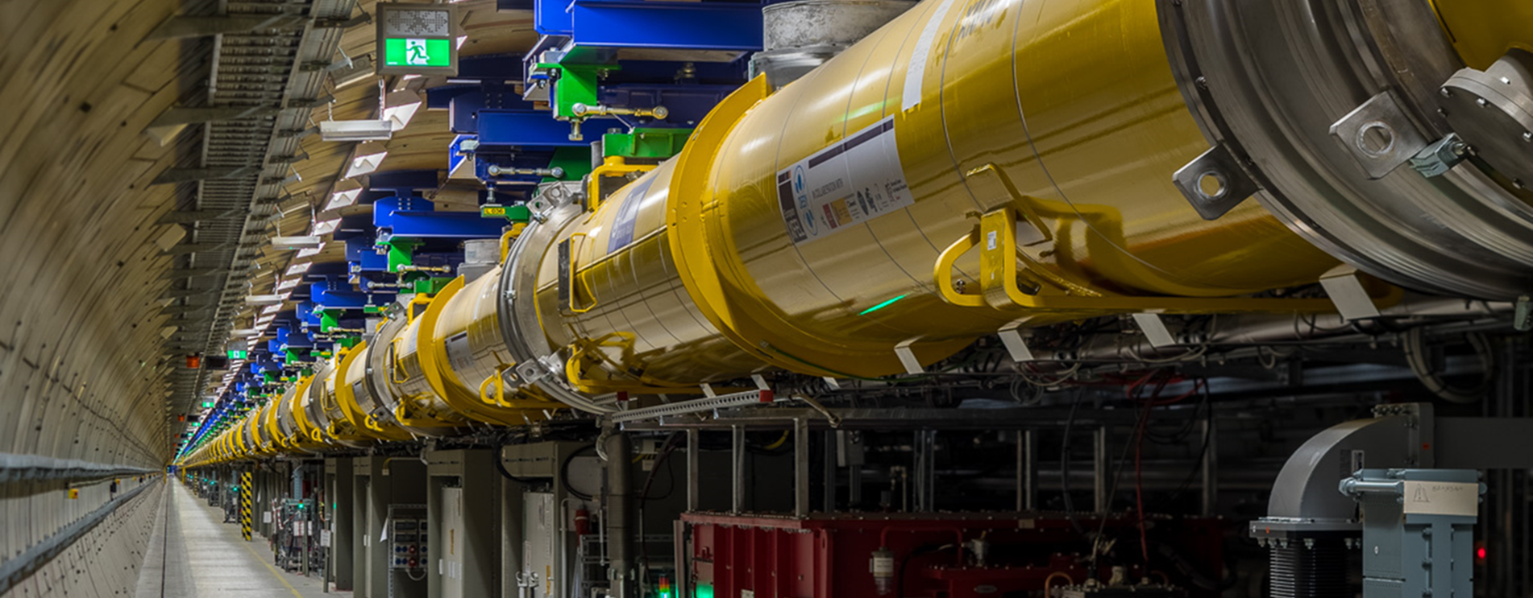
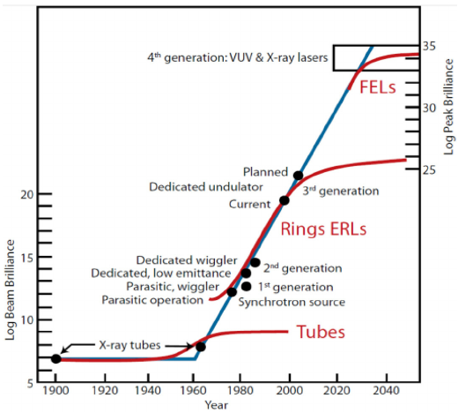
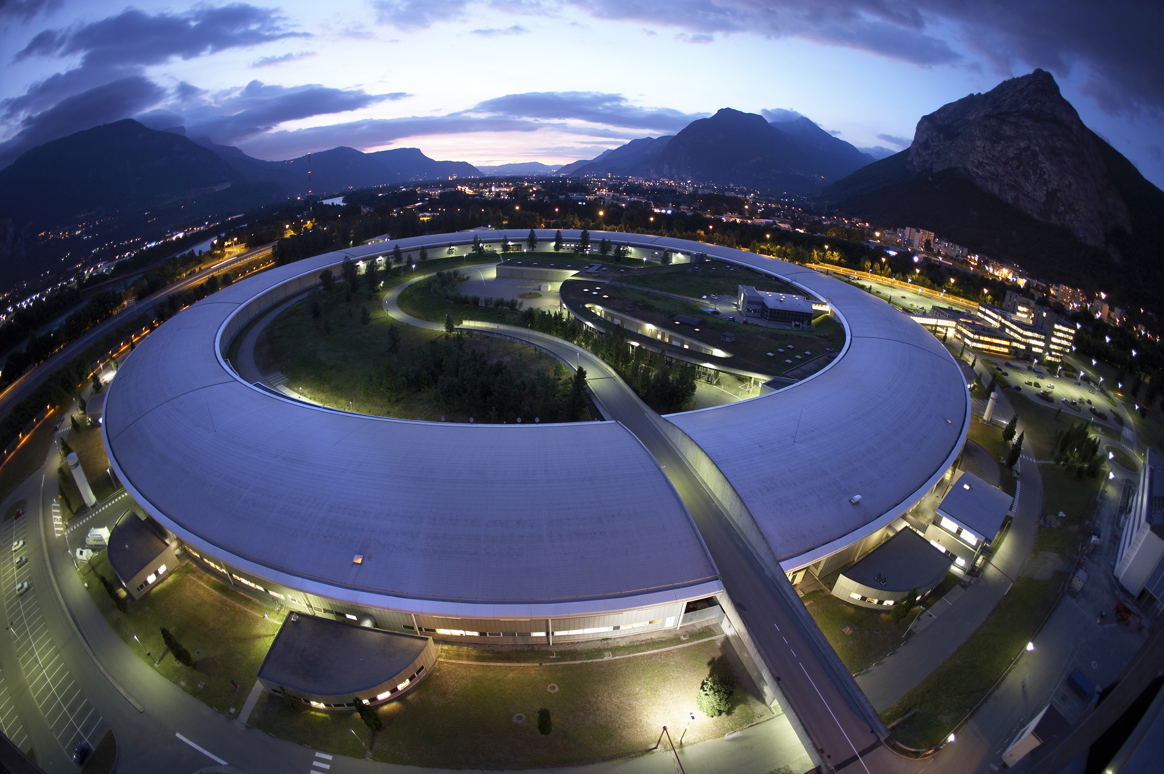
Synchrotron radiation vs. Conventional x-rays
an increase by 26 orders of magnitude since 1970, while computer chips “only” improved by 7 orders of magnitude!!!

Slide 7
Source and radiation characteristics

Slide 8
Synchrotron applications in medical research
 | Primary anatomy | Image or therapy
Coronary arteries | Projection image | Angiography
Lungs and airways | Projection and CT | Bronchography
Head and neck | CT image | Computed tomography
Bone structure | 3D CT image | Microtomography
Breast tumours | Absorption, phase scattering contrast | Mammography
Brain tumours | External beam | Radiotherapy
Brain | External beam | Photon activation therapy
Cells and tissues | Projection and CT | X-ray microscopy and microfluorescence
Molecular assemblies | Scattering pattern | Small-angle scattering
Protein structure | Crystallography | Structural biology
Local molecular | Spectroscopy | EXAFS

Slide 9
Medical imaging with synchrotron radiation Phase detection imaging
Excellent results is due to the small opening angle in the vertical direction and the possibility to place the detector at a large distance.
Beam hardening due to the sample absorption of the low energy photons is also avoided.
By increasing the energy, phase contrast imaging could allow a significant dose reduction with little deterioration.

Slide 10
Synchrotron Biomedical Imaging Methods Projection and CT
Absorption Imaging
Uses tunability
K-edge Subtraction
Uses tunability
In -Line Phase Contrast Imaging
Uses high source brightness (small source size)
Analyzer Based Imaging / Diffraction Enhanced Imaging / Multiple Image Radiography
Uses high source brightness (high intensity)
High Resolution Imaging / Microtomography
Uses high source brightness (intensity & source size)
Can apply to most of above imaging methods

Slide 11
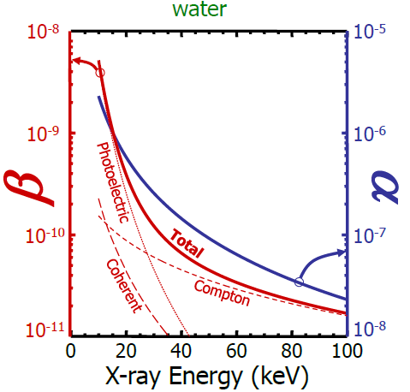
Interaction of X-rays –Refractive Index Absorptive Effects (imaginary part) and Refractive Effects (real part)
Optical Effects
It is composed by an imaginary component β related to the absorption and by a real component α related to phase-shift due to scattering of the waves.
In the imaging x-ray energy range
n = 1–α-iβ
Refractive index correction is weak
α & β<<1
Absorption index is weaker β<<α
α~ 1000β

Slide 12
Absorption vs. Phase shift
ta/tp | t_{a}=μ⁻¹ (mm) | t_{p}=λ/α (mm) | μ/ρ (cm²g⁻¹) | α (10⁻⁷) | λ (nm) | E (keV)
0.6 | 0.003 | 0.005 | 3260 | 2340 | 1.24 | 1
43 | 2.3 | 0.05 | 4.30 | 23.4 | 0.12 | 10
144 | 19 | 0.1 | 0.51 | 3.7 | 0.05 | 25
169 | 45 | 0.3 | 0.22 | 0.9 | 0.02 | 50
109 | 58 | 0.5 | 0.17 | 0.2 | 0.01 | 100
t_{p}=λ/α : Distance over which the phase change is 2π
t_{a}: Absorption thickness
Keyriläinen, J. (2004). Diffraction-enhanced x-ray imaging of in vitro breast tumours, University of Helsinki

Slide 13
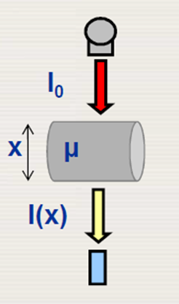
CT PRINCIPLES (1/3)
The purpose of a computed tomography acquisition is to measure x ray transmission through a patient for a large number of views.
The values that are assigned to the pixels in a CT image are associated with the average linear attenuation coefficient μ which depends on the composition of the material, the density of the material, and the photon energy
Notes:
generally 800-900 detector elements
taking about 1000 angular measurements
attenuation of the primary beam

Slide 14
CT PRINCIPLES (2/3)
As an X ray beam is transmitted through the patient, different tissues are encountered with different linear attenuation coefficients.
The intensity of the attenuated X ray beam, transmitted a distance d, can be expressed as:

Slide 15
CT PRINCIPLES (3/3)
Illustration: a simplified 4 x 4 matrix representing the measurement of transmission along one line.
Each element in the matrix can in principle have a different value of the associated linear attenuation coefficient.
Image reconstruction techniques can then be applied to derive the matrix of linear attenuation coefficients, which is the basis of the CT image.

Slide 16
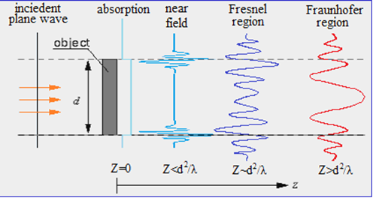
PHase-Contrast radiography (PHC)
The technique exploits the high spatial coherence of the X-ray source.
z =0 -> absorption image
For z > 0 -> interference between diffracted and un diffracted wave produces edge and contrast enhancement. A variation of d is detected.

Slide 17
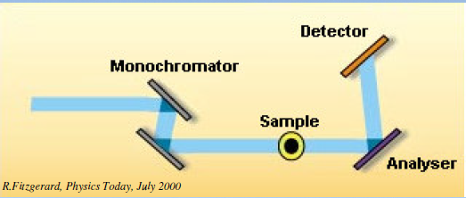
Diffraction Enhanced Imaging (DEI)
In the diffraction enhanced imaging in addition to the monochromator crystal, which is present between the source and the sample, a second (analyzer) crystal is placed between the sample and the detector
Image formation with DEI is sensitive to a variation of d in the sample.

Slide 18
K-edge Subtraction Imaging Lung Tomography

Slide 19
Applications
Mammography
Bronchography
Musculoskeletal imaging
Coronary angiography
Micro-angiography
Cartilage and bone imaging
Non-Medical

Slide 20
Images of a mouse liver and lungs
R. A lewis, eta l. X-ray refraction effects: application to the imaging of biological tissues, The British Journal of Radiology, 76 (2003), 301–308
conventional image refraction image

Slide 21
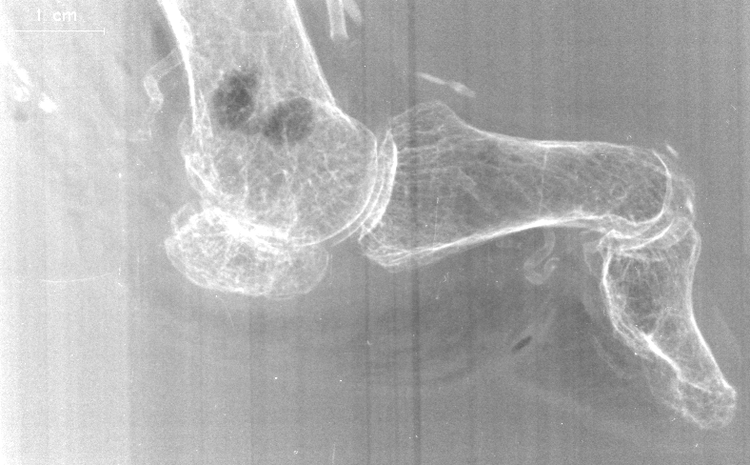
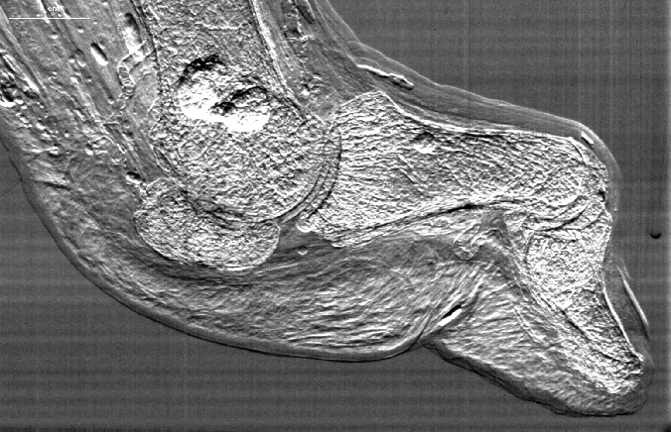
DEI vs. Absorption
Air bubbles
Air bubbles
Tendon Calcification
Tendon Calcification
Tendon of Extensor
hallucis longus
skin
Sclerotic blood vessel
Tendon of flexor
hallucis longus
Fat pad
Blood
Nail plate
vessel
X-Ray Absorption
DEI
NSLS X15-A: Pisano, Johnston(UNC); Sayers(NCSU); Zhong(BNL); Thomlinson(ESRF); Chapman(IIT)

Slide 22
DEI vs. Absorption
Conventional radiograph vs. DEI image of a nylon fiber. With conventional radiography, smaller objects show little contrast, a drawback that is not seen in the DEI images.
Thomlinson, W. (1992). "Medical applications of synchrotron radiation." Nuclear Instruments and Methods in Physics Research Section A: Accelerators, Spectrometers, Detectors and Associated Equipment 319(1): 295-304

Slide 23
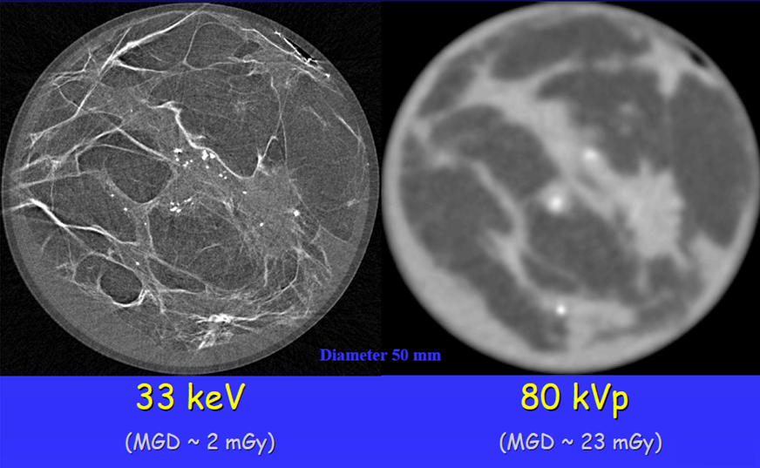
DEI-CT vs. Toshiba CT

Slide 24
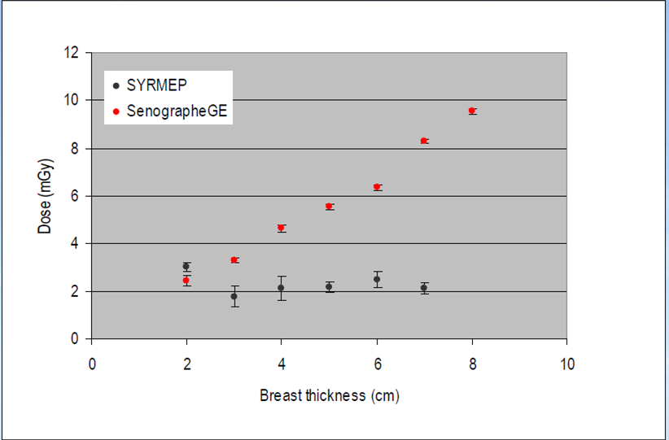
Dose Comparison
K.Casarin, E.Quai, G.Tromba , A.Vascotto, Radiation Safety and Dosimetric Issues of the Beamline for Clinical Mammography at Elettra RadSync07, Saskatoon, June 6th -8th , 2007

Slide 25
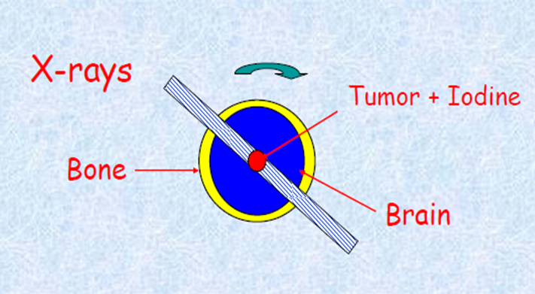
Synchrotron Radiation Therapy
The inherent high collimation means that it can be targeted onto small tumours.
The ability to tune the energy of a monochromatic beam means that the beam energy can be optimized for a particular depth.
Microbeam Radiation Therapy
Photon Activation Therapy

Slide 26
Microbeam Therapy
High doses (>100 Gy) are delivered in one fraction by using arrays of parallel thin beams.
MRT might be a promising technique to treat brain tumors and tumors in the radio-sensitive organs (spinal cord) and some illness like epilepsy with no significant secondary effects.
The main attributes of microbeams are:
(a) Their sparing effect on normal tissues, including the central nervous system (CNS).
(b) Their preferential damage to tumors.

Slide 27
Dose comparison
Histological images after irradiation using a millimetric beam (left) or a microbeam (right).
Zeman et al., Radiat. Res. 15, 496,1961

Slide 28
Dose volume-effect
Beam diameter (μm)
Threshold dose (Gy)
25
75
250
1000
CELLS
Tissues
4000
500
360
140
(Fike & Gobbel, 2001)

Slide 29
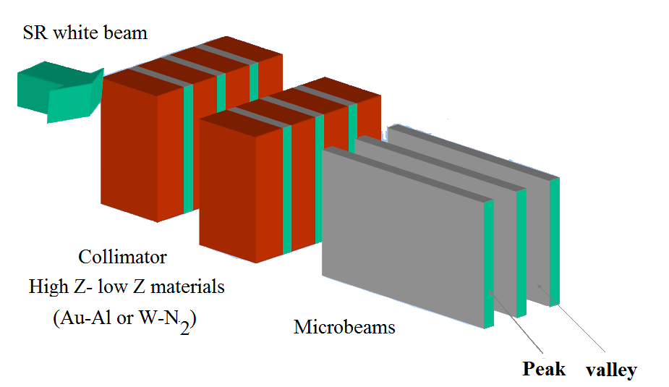
Microbeams production
Microbeams: variable width (0-100 μm), 100-400 μm pitch
50-125 microbeam array to cover up to 5x5 cm2
Brauer et al. Rev.Sci.Instr.76, 064303, 2005

Slide 30
Microbeam lateral dose profile
Engels, et al Toward personalized synchrotron microbeam radiation therapy, Nature 2020.
Notes:
Geant4 Monte Carlo calculated 3 T (Cu/Al) microbeam dose profile (A) at the entrance (0.25 mm) and tumor depths (5.5 mm) in water. MRT irradiation depth dose curve (B) showing the peak (red) and valley (green) doses in water, overlaid with the micro-CT sagittal profile of a rat in this study to show the dose distribution in the rat and tumor (location indicated by white arrow). Monte Carlo calculated peak and valley doses were verified dosimetrically at 12.5 mm depth.

Slide 31
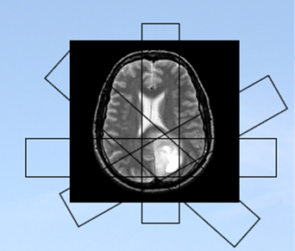
CT-Therapy
Principle:
Tumor loaded with a high Z element (iodine, gadolinium) + a chemotherapic drug (cis-platinum)
Beam size adjusted to the tumor dimensions
Tumor positioned at the center of rotation
Irradiation with hundred keV X-ray beam
Combined chemo and radio-therapic procedure

Slide 32
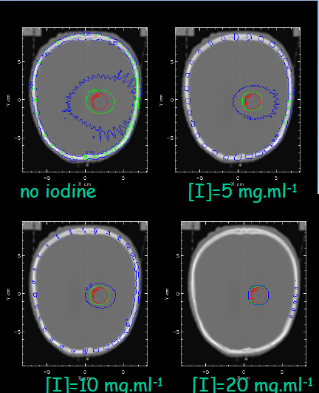
Dose distribution vs. Iodine concentration in the target
Animal model: Fisher Rat
Energy: 85 keV
• Beam height : 2 cm
• Beam width : 2 cm
• Iodine: 10 mg/ml
Isodose lines:
red = 90%,
green = 50%,
blue=25%
C. Boudou et al. Phys Med Biol. 2005 Oct 21;50(20)

Slide 33
Survival curves
CT PAT + Chemo-therapic
Cisdiamminedichloroplatinum(CDDP)
Irradiated controls
Chemo-therapic (CDDP)
Sham controls
694 % Increase in life span relative to median survival time
M.C. Biston, et al., Cancer research, 64, 2317-2323 (2004)

Slide 34
PHARMACEUTICALS and Synchrotron
Pharma and biotech firms make wide use of synchrotron X-rays for drug discovery, drug development and drug delivery systems, as well as health care technologies such as implants.

Slide 35
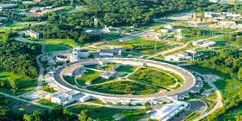
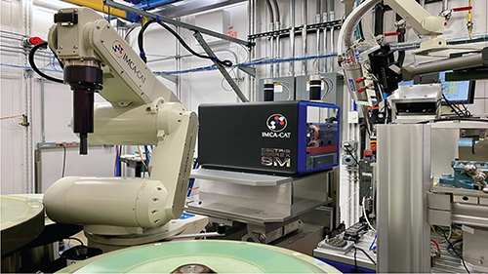
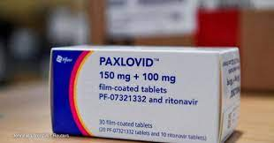
Coronavirus drug developed with the help of synchrotron
Mapping a SARS-CoV-2 protein led to the discovery of a compound to disable it.
Advanced Photon Source
Company: Pfizer
Notes:
Owen, D.R., Allerton, C.M., Anderson, A.S., Aschenbrenner, L., Avery, M., Berritt, S., Boras, B., Cardin, R.D., Carlo, A., Coffman, K.J. and Dantonio, A., 2021. An oral SARS-CoV-2 Mpro inhibitor clinical candidate for the treatment of COVID-19. Science, 374(6575), pp.1586-1593.
استفاده از پرتو ایکس سنکروترونی برای بررسی ساختارهای اتمی پروتئین‌هایی که ویروس کووید-19 را می‌سازند برای تولید داروی Paxlovid

Slide 36
BEATS, the BEAmline for Tomography at SESAME
The European Horizon 2020 project BEAmline for Tomography at SESAME (BEATS) has the objective to design, procure, construct and commission a beamline for hard X-ray full-field tomography at the SESAME synchrotron in Jordan.
The European grant is worth 6 million euros and span a four-year period from beginning 2019 to end 2022.
BEATS involves leading research facilities in the Middle East (SESAME and the Cyprus Institute), and European synchrotron radiation facilities ALBA-CELLS (Spain), DESY (Germany), the ESRF (France), Elettra (Italy), INFN (Italy), PSI (Switzerland), SESAME (Jordan) and SOLARIS (Poland).

Slide 37
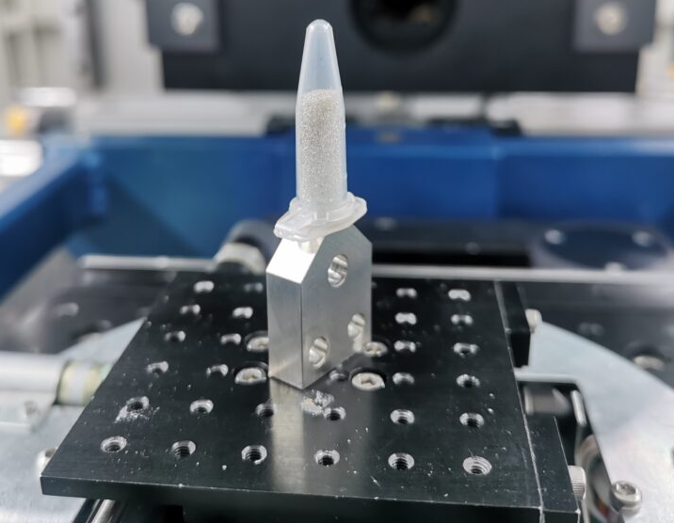
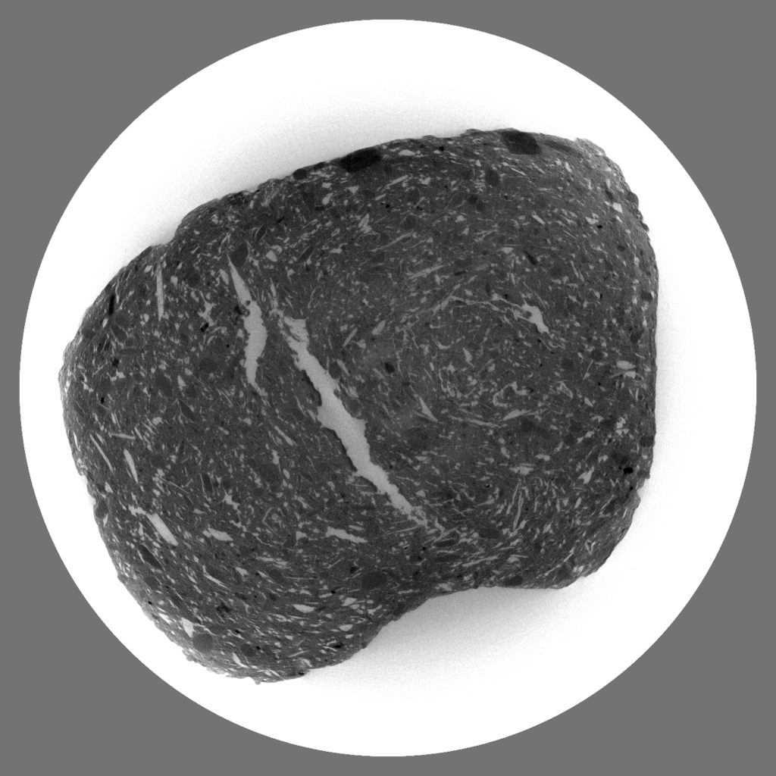
First 3D tomography images from BEATS
The scientists used a vial of glass spheres of 300 µm in diameter as a test sample. The scan, which lasted just 12 seconds, involved taking over 1000 radiographic images of 12 ms exposure time with filtered white beam of the rotating sample.

Slide 38
“Whenever we build something that is 2 or 3 orders of magnitude better than any existing one, that will lead to a new science.”
Heinz Maier-Leibnitz
Thank you for your attention

