Slide 1
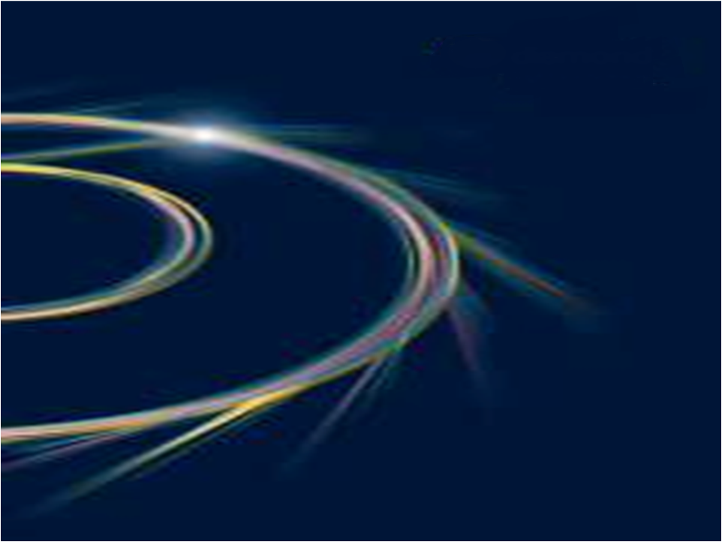


One-day Meeting:
Cooperation capacities with SESAME and CERN in research and technology
June 26, 2023
ILSF Beamlines optical design
A. Gholampour Azhir
Beamline Group
Iranian Light Source Facility (ILSF)
Institute for Research in Fundamental Sciences (IPM)
26 June 2023

Slide 2
Outline
What is a Beamline?
  Synchrotron Radiation Sources
  Front End of a beamline
  Optics hutch
phase-one beamlines of ILSF
  XPD beamline

Slide 3
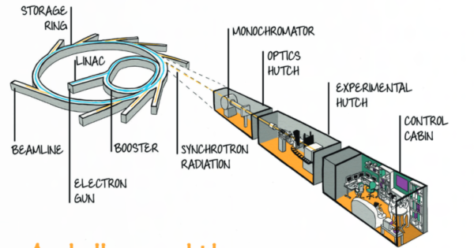
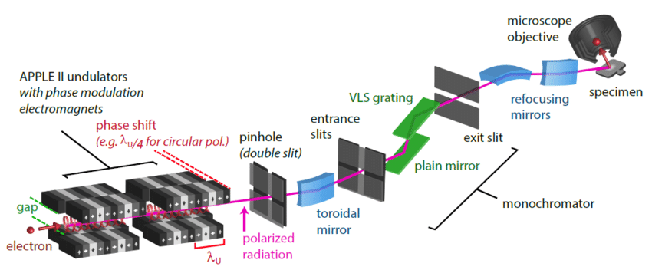
What is a Beamline?
https://www.ttk.fr/case_studies/ttk-au-centre-de-recherche-synchrotron-soleil-france/
https://www.researchgate.net/figure/Scheme-of-the-NanoESCA-beamline-at-the-3rd-generation-synchrotron-ELETTRA-in-Triest_fig9_301337993

Slide 4
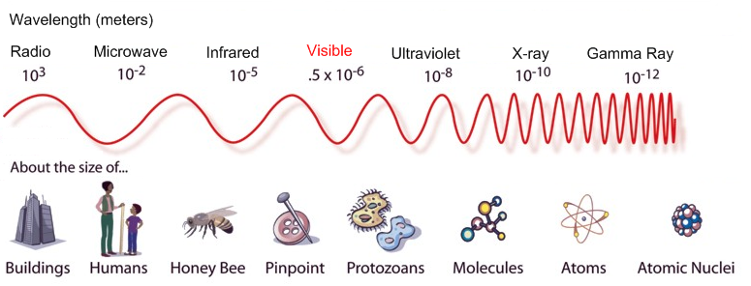
X-ray regime
Soft X-ray: 30-2000 eV
Hard X-ray: 2-150 keV

Slide 5
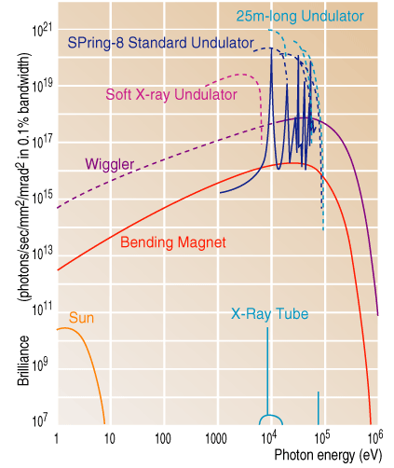
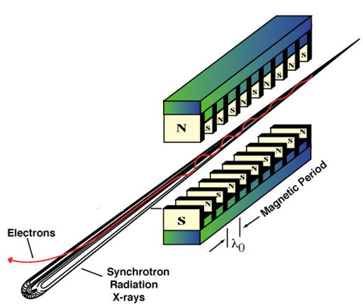
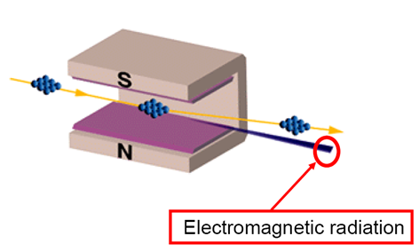
Properties of synchrotron radiation:
Ultra bright
Highly Directional
Spectrally Continuous or Quasi-monochromatic
Linearly or Circular Polarized
Pulsed Time Structure
http://www.spring8.or.jp/en/about_us/whats_sr/sp8_features
Helmut Wiedeman book

Slide 6
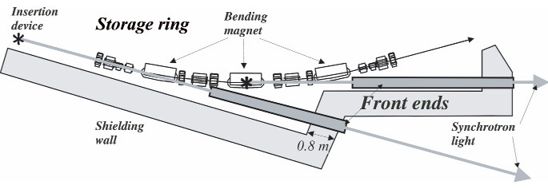
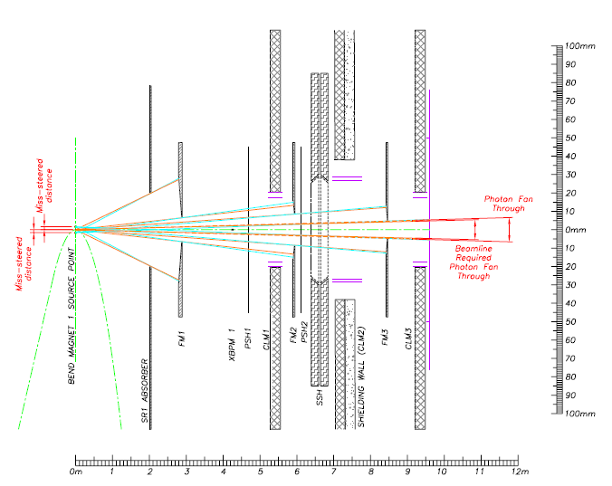
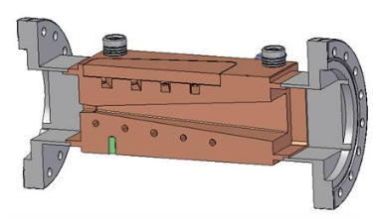
Front End functionality
To remove as much as of the heat possible from the synchrotron light.
To protect the storage ring if there is a leak in the beamline.
To allow safe access into the optics hutch when required.
http://e-ssrf.sari.ac.cn/technology/front_ends/

Slide 7
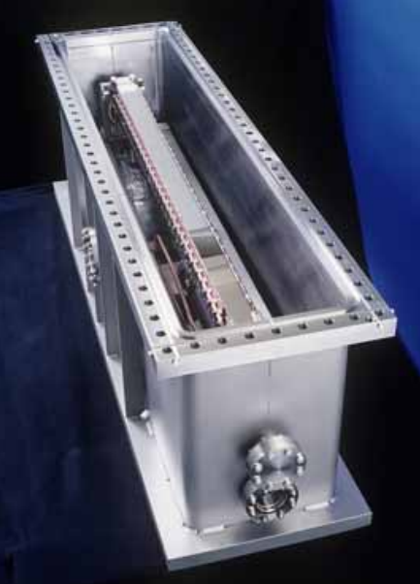
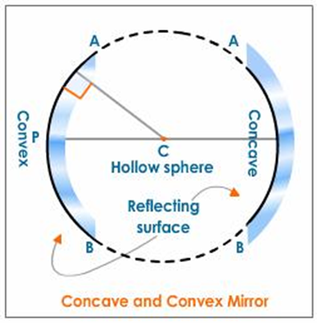
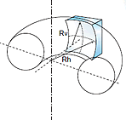
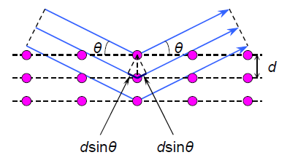
Material: SiO₂ ,SiC, Si
Coating: Pt, Au, Ni
Long mirror for hard x-ray
Length=1.5 m
Radius (tangential): 10 m-∞
Radius (sagittal): 5 cm-∞
Slope error ~ µrad
Roughness ~ Å
Vacuum ~ 10⁻⁹ mbar
Incidence angle ~ mrad
https://neutrons.ornl.gov/sites/default/files/optics_2016_mills%201.pdf

Slide 8
phase-one beamlines of ILSF
No | beamline |  | Energy range (eV) | Flux (ph/s) | E-Resolution/ Resolving power | Spot Size (μm) | Source
1 | Powder Diffraction |  | 6-30 k | 10¹² | 10⁻⁴ | 100×100-10000×10000 | Wigg./ IVU
2 | Single crystal X-ray Diffraction for Small Molecules |  | 5-25 k | 10¹² | 10⁻⁴ | 50×50 | IVU
3 | EXAFS |  | 3-35 k | 10¹³ | 10⁻⁴ - 10⁻⁵ | Few mm | Wigg.
4 | Gas phase photoemission (XPS, AES, ARPES) |  | 15-1000 | 10¹¹ | 10000 | Few mm | Electromagnetic Und.
5 | Solid State Electron Spectroscopy |  | 10-1500 | 10¹² | 10000 | Few μm | Electromagnetic Und.
6 | Spectromicroscopy | SPEM (+ARPES) | 100-1500 | 10¹² | 5000 | Few μm | Hellical Und.
 |  | PEEM (+XMCD)
7 | Macromolecular Crystallography |  | 3-25 k | 10¹² | 10⁻⁴ | 50×50 | IVU

Slide 9
Softwares for simulation of a beamline
XOP
History: First version 1.0 released at ESRF in 1994 by Manuel Sanchez del Rio
Functionality: source: flux, brilliance, power, B field, trajectory ,Optics: data base, RC of flat and mosaic and bent crystals, absorption and reflection of mirrors and filters, multilayer reflection, CRL reflection
SHADOW, OASYS
History: At First released at Madison university in 1984 by F. Cerrina
Functionality: Ray-tracing from source to sample, such as spot size, divergence, mirrors, grating, crystals, resolution …
RAY
History: 1st version released at BESSY in 1984 byF. Schafers and J. Feldhaus
Functionality: very similar to SHADOW
SPECTRA
History: First version released at Spring-8 in 1993 by T. Tanaka & H. Kitamura
Functionality: This program calculates SR properties such as:
Brilliance, Density, power,
Spatial profile of photon flux , K-value dependence of photon flux, Degree of polarization, filtering, coherency , Fully graphical pre- and post-processor
SRW
History: First Release : December 1997 at ESRF, Authors : O. Chubar, P. Elleaume
Functionality: - The spectral, spatial and polarization characteristics of the radiation for BM and IDs
BeamLine Design and optimization in the IR, UV and X-ray range
The pre and post processing is made in the Igor Pro.

Slide 10
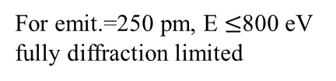



Diffraction limited storage ring
y
y
$$ε_{xt}=Σ_{x}{Σ′}_{x}$$
ph
ph
$${ε_{xe}=σ}_{x}{σ′}_{x}$$
e
x
e
x
$$Σ_{x}=\sqrt{σ_{x}^{2}+σ_{r}^{2}}$$
$$σ_{r}=\frac{1}{4π}\sqrt{λL}, σ_{r′}=\sqrt{\frac{λ}{L}}$$
y
$$ε_{x}=\frac{λ}{2π}$$
y
For emit.=250 pm, E $≤$800 eV fully diffraction limited
e
x
e
x

Slide 11
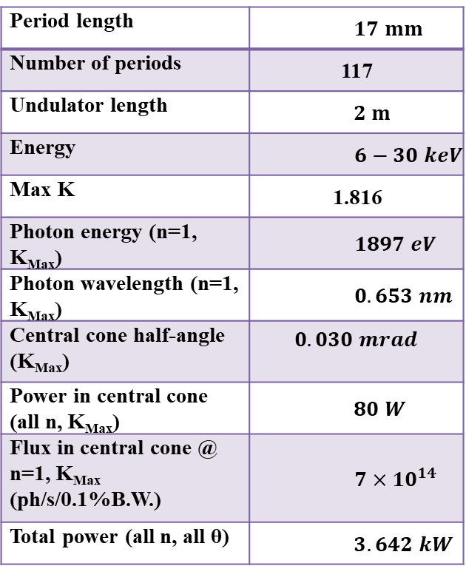
parameters of the ILSF machine
σ_{x} | µm | 67.45
σ_{y} | µm | 2.62
σ'_{x} | µrad | 3.894
σ'_{y} | µrad | 1.003
e_{x} | pm.rad | 267
b_{x} | m | 17.40
b_{y} | m | 2.54
h_{x} | m | 0
h_{y} | m | 0
h'_{x} | - | 0
h'_{y} | - | 0
a_{x} | - | 0
a_{x} | - | 0
Magnetic field of dipole | T | 0.567
Nominal field length | m | 1.2
Fringe field length | m | 0.034
bunch | # | 141
σ_{z} | mm | 7.9
Energy spread | - | 0.00068
Current | mA | 100 (Max: 400)
Circumference | m | 528
Coupling constant | - | 0.01
Powder Diffraction | 6-30 k | 10¹² | 10⁻⁴ | 100×100-1000×10000 | Wigg./ IVU
parameters of the undulator (I=250 mA)
$$17 mm$$ | Period length
117 | Number of periods
$$2 m$$ | Undulator length
$$6−30 keV$$ | Energy
1.816 | Max K
$$1897 eV$$ | Photon energy (n=1, K_{Max})
$$0.653 nm$$ | Photon wavelength (n=1, K_{Max})
$$0.030 mrad$$ | Central cone half-angle (K_{Max})
$$80 W$$ | Power in central cone (all n, K_{Max})
$$7×{10}^{14}$$ | Flux in central cone @ n=1, K_{Max} (ph/s/0.1%B.W.)
$$3.642 kW$$ | Total power (all n, all θ)

Slide 12

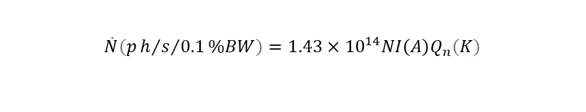


$$\dot{N}\left(p{h/s}/{0.1}\%BW\right)=1.43×{10}^{14}NI\left(A\right)Q_{n}\left(K\right)$$
$$Σ_{x}=\sqrt{σ_{x}^{2}+σ_{r}^{2}}$$
$$σ_{r^{′}}\left(σ_{ε}\right)=σ_{r0}^{′}Q_{a}\left(σ_{ε}\right) , σ_{r0}^{′}=\sqrt{\frac{λ}{2L}}$$
$${ Q}_{a}\left(x\right)={\left[\frac{2x^{2}}{−1+\exp\left(−2x^{2}\right)+({2π)}^{\frac{1}{2}}x erf⁡(2^{\frac{1}{2}}x)}\right]}^{1/2}$$
$$σ_{ε}=2πnNɛ_{E}$$

Slide 13
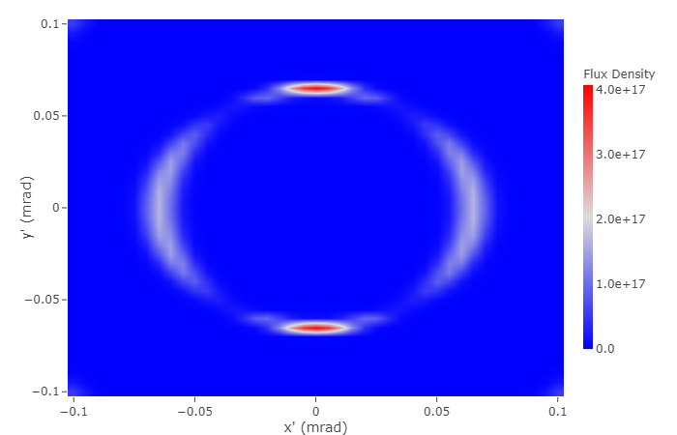

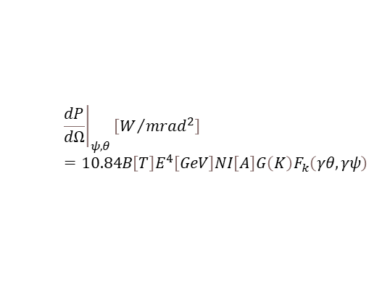
$$P_{total}\left[W\right]=632.8E^{2}\left[GeV\right]B^{2}\left[T\right]L\left[m\right]I\left[A\right]$$
$${\left.\frac{dP}{dΩ}\right|}_{ψ,θ}\left[W/{{mrad}^{2}}\right]=10.84B\left[T\right]E^{4}\left[GeV\right]NI\left[A\right]G\left(K\right)F_{k}\left(γθ,γψ\right)$$
$$\frac{F_{coh.}}{F_{total}}=\frac{λ^{2}}{{\left(4π\right)}^{2}}\frac{1}{Σ_{x}Σ_{y}{Σ′}_{x}{Σ′}_{y}}$$

Slide 14
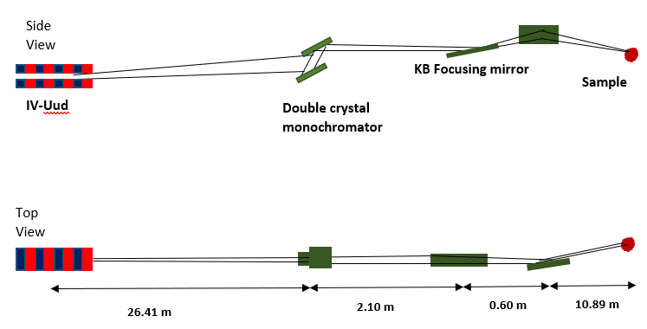
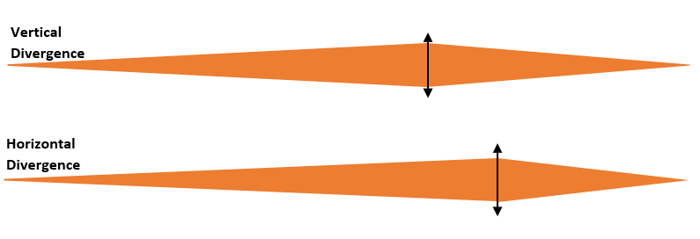
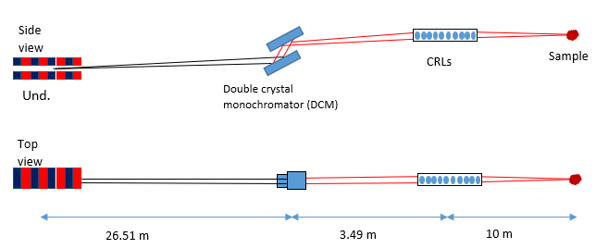
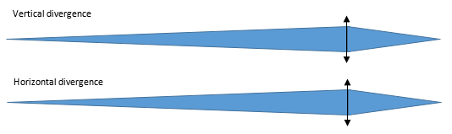

Slide 15
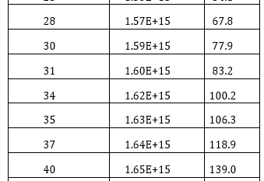
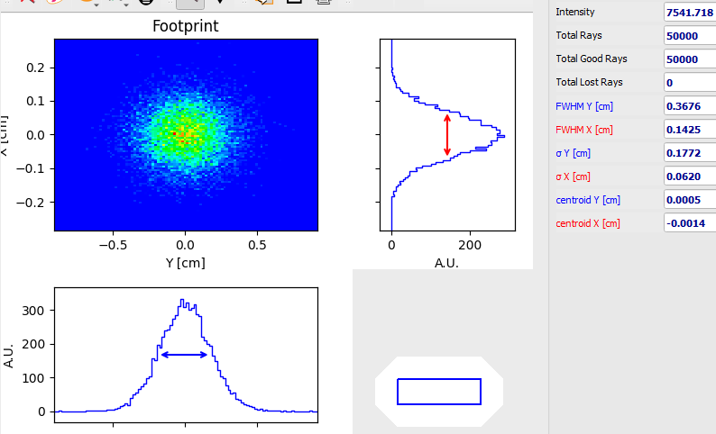


$$θ_{cen,n}\left(rad\right)=\frac{1}{γ\sqrt{nN}}\sqrt{1+\frac{K^{2}}{2}}$$
$$w_{D}=\frac{2}{sin2θ_{B}}\frac{r_{e}λ^{2}}{πV}C\left|F\right|e^{−M} , \\ W_{FWHM}=\frac{3}{2\sqrt{2}}ω_{D}=1.06 ω_{D}$$
Footprint on the Si(111)@ 6 @ 26.41 m

Slide 16
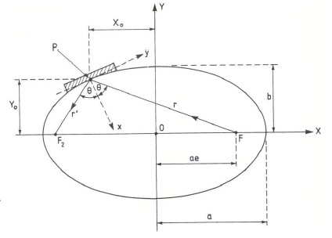
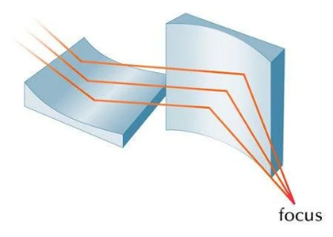
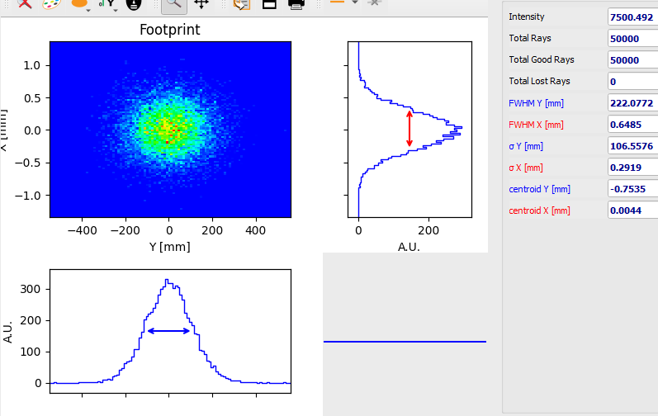
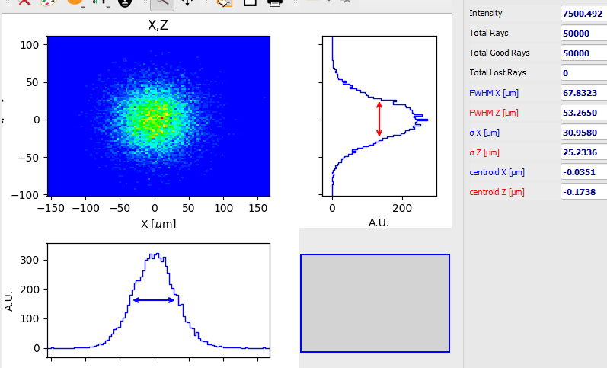
KB mirrors
Elliptical - cylinder
1) p=28510 mm, q=11490 mm, ϴ=2.5 mrad
$$a=20,000 mm , e=0.99999744, b=45.2485 mm$$
2) p=29110 mm, q=10890 mm, ϴ=2.5 mrad
$$a=20,000 mm , e=0.99999752, b=44.5122 mm$$

Slide 17
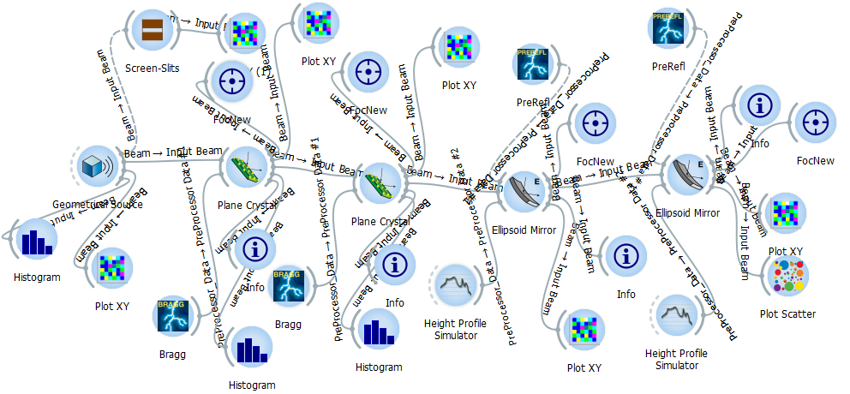


Slide 18
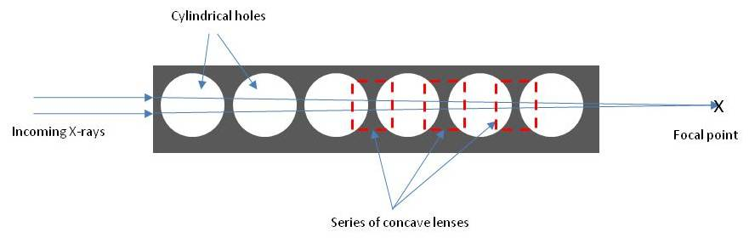
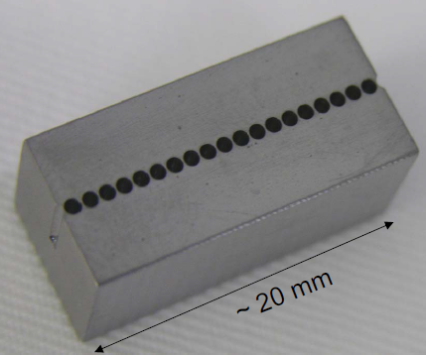

What is Compound Refractive Lens (CRL)?
CRL is a series of lenses arranged in a linear array in order to achieve focusing of X-rays (few um) in the energy range of E> 5 keV.
$$n=1−δ+iβ$$
$$δ\sim {10}^{−5}−{10}^{−7}$$
$$δ=\frac{r_{0}Nλ^{2}}{2π} , β=\frac{μλ}{4π}$$
Material:
Low-Z material such as Al, Be, B, C, Li
Why CRL?
Fabrication of the lenses is simple & inexpensive.
Alignment of CRL is easy.
CRL is easy to cool.

Slide 19
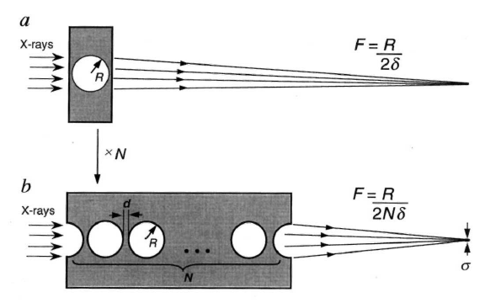
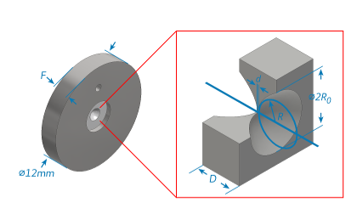
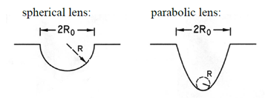
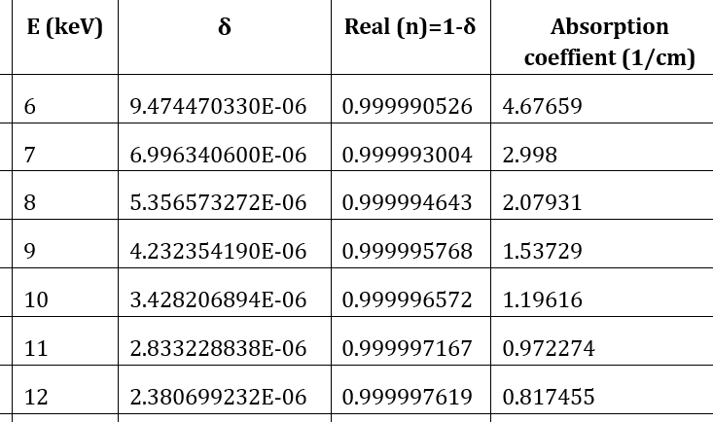
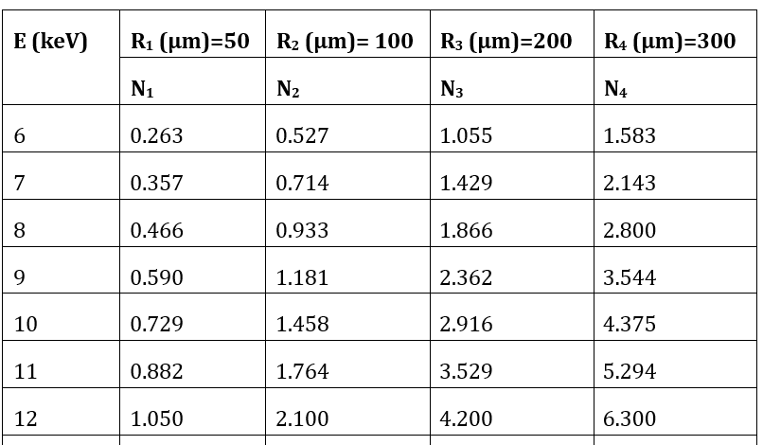
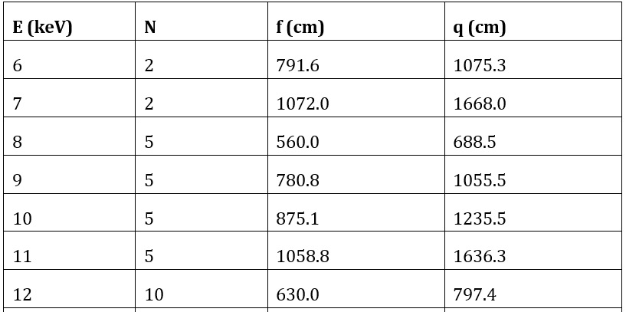


$$δ=\frac{r_{0}Nλ^{2}}{2π}$$
$$δ_{Be}=2.217 708 913×{10}^{14}λ^{2}\left(m\right)$$
$$f=\frac{R}{2Nδ}$$
d | E (keV) | Material
< 50 µm | ~ 5-40 | Be
< 30 µm | ~ 30-80 | Al
< 20 µm | ~ 80-150 | Ni

Slide 20
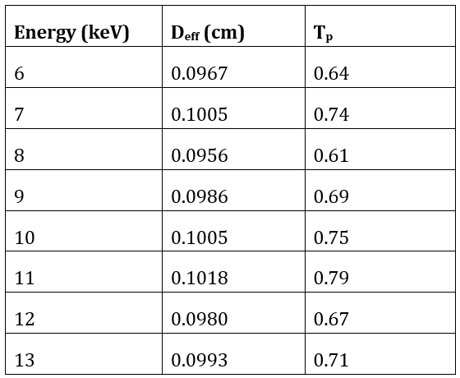
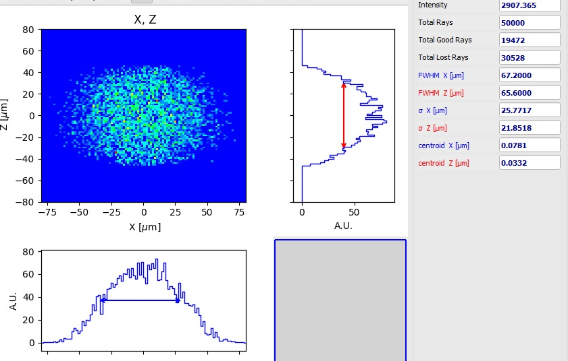
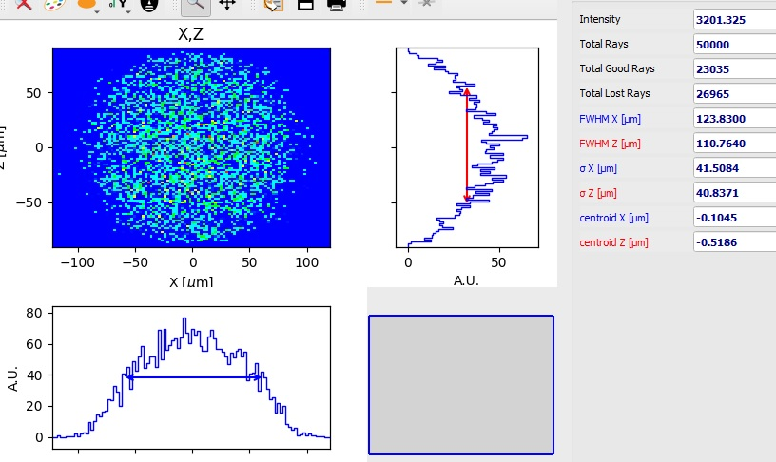
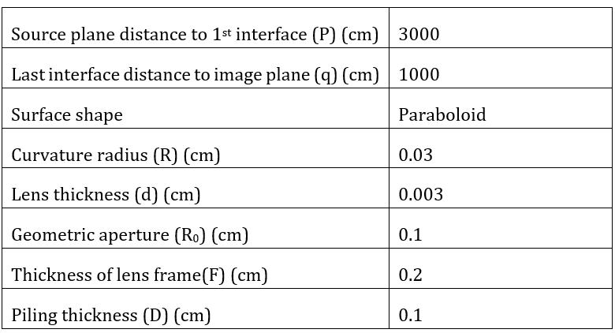


$$D_{eff}=2R_{0}\sqrt{\frac{1−exp⁡({−a}_{p})}{a_{p}} } , a_{p}=\frac{μNR_{0}^{2}}{2R}+\frac{Nδ^{2}k_{1}^{2}σ^{2}R_{0}^{2}}{R^{2}}$$
$$T_{p}=\frac{\exp\left(−μNd\right)\left[1−\exp\left({−2a}_{p}\right)\right]}{2a_{p}}$$
$$gain= \frac{919×815}{67×68}×0.64≅105$$

Slide 21
E(keV) | H×V (µm²) | H×V (µrad²)
6 | 66×67 | 89×75
7 | 202×176 | 61×54
8 | 76×68 | 68×61
9 | 37×34 | 70×65
10 | 204×193 | 59×54
11 | 181×156 | 59×50
12 | 172×163 | 62×56
13 | 174×169 | 58×56
14 | 91×92 | 70×63
15 | 123×105 | 63×55
16 | 148×148 | 63×58
17 | 109×100 | 64×59
18 | 146×129 | 67×55
19 | 119×113 | 63×58
20 | 96×38 | 69×64

Slide 22
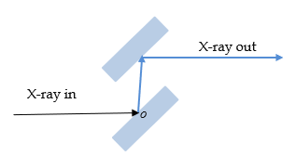
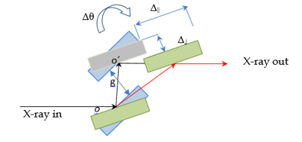
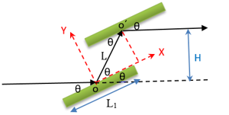
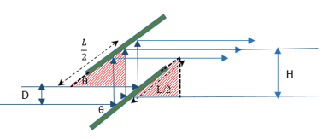


$\frac{1}{X^{2}}+\frac{1}{Y^{2}}=\frac{4}{H^{2}}$
$$\sin{θ}=\frac{H−D/2}{L/2}:cross point →H≥\frac{D}{2}+\frac{L}{2}\sin{θ} OR L≤\frac{2H−D}{\sin{θ}}$$
For Si(111): If L=6 cm $⇒H≥ \frac{D}{2}+\frac{L}{2}\sin{θ_{max}≅}2.05 cm$, if H=2.5 cm $⇒L≤\frac{2H−D}{\sin{θ_{max}}}≅7.36 cm$

Slide 23
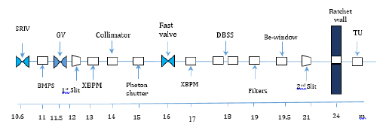

Slide 24
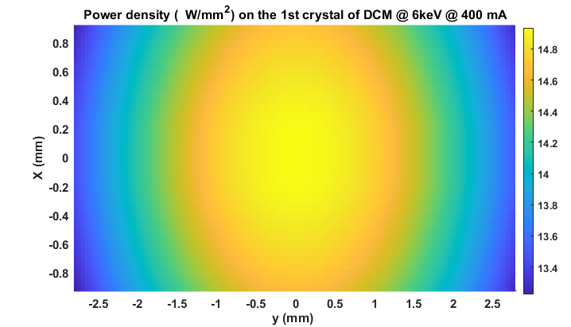
Mono | Be(250μm)+C(1.2 mm) | Aperture | Source | elements | Opening angle = 70 μrad
- | 59 | 151 | 3457 | Transmitted power after each element (W) | 250 mA
59 | 92 | 3306 | - | Absorbed power (W)
- | 94 | 241 | 5532 | Transmitted power after each element (W) | 400 mA
94 | 147 | 5291 | - | Absorbed power in the elements (W)

Slide 25
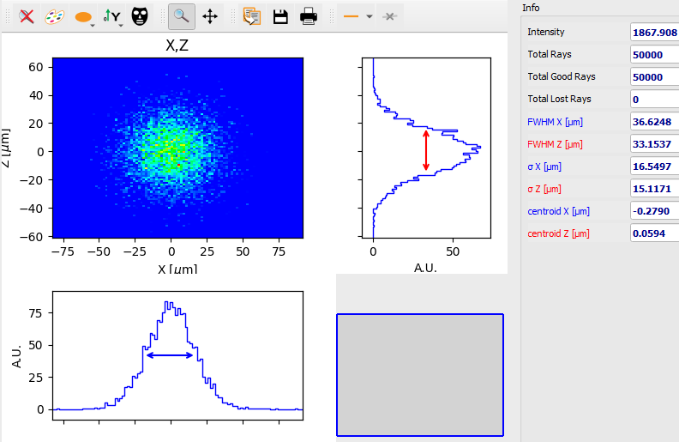
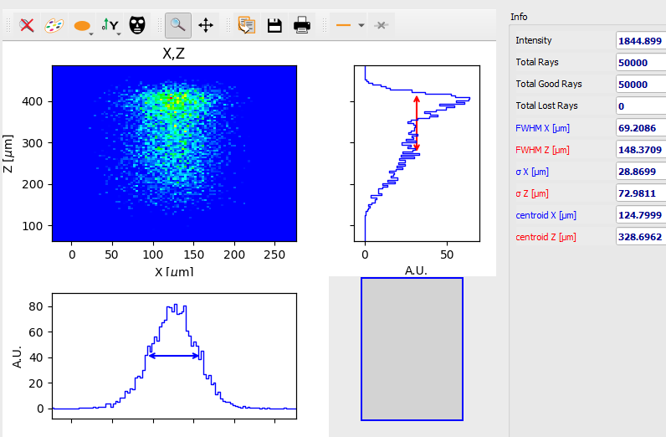

Slide 26
No | beamline |  | Energy range (eV) | Flux (ph/s) | E-Resolution/ Resolving power | Spot Size (μm) | Source
1 | Powder Diffraction |  | 6-30 k | 10¹² | 10⁻⁴ | 100×100-1000×10000 | Wigg./ IVU
2 | Single crystal X-ray Diffraction for Small Molecules |  | 5-25 k | 10¹² | 10⁻⁴ | 50×50 | IVU
3 | EXAFS |  | 3-35 k | 10¹³ | 10⁻⁴ - 10⁻⁵ | < mm | Wigg.
4 | Gas phase photoemission (XPS, AES, ARPES) |  | 15-1000 | 10¹¹ | 10000 | Few mm | Electromagnetic Und.
5 | Solid State Electron Spectroscopy |  | 10-1500 | 10¹² | 10000 | Few μm | Electromagnetic Und.
6 | Spectromicroscopy | SPEM (+ARPES) | 100-1500 | 10¹² | 5000 | Few μm | Hellical Und.
 |  | PEEM (+XMCD)
7 | Macromolecular Crystallography |  | 3-25 k | 10¹² | 10⁻⁴ | 50×50 | IVU

Slide 27



Magnetic material | NdFe:B
Type | Hybrid-Halbach
Length (m) | 2
Gap (mm) | 12
Period length (cm) | 6
B_{max} (T) | 1.259
K_{m} | 7.05
Number of periods | 33
E_{c}(keV) | 7.53
P_{T}(kW) | 7.5 (@ 400 mA)
flux density (ph/s/mrad²/0.1%B.W.)

Slide 28





















1st mirror | 2nd mirror
Cylinder-spherical, Si,bendable | Troidal
Si(3.7), Rh (3), Pt (2.3) | Rh (4), Pt (2.3)
R_{m,Si}=11891.919 m, 14666.666 m, R_{m, Pt}=19130.434 m | R_{major}= 725000.0 cm , R_{minor}= 7.7 cm R_{major}= 1260869.5 cm , R_{minor}= 4.4 cm
22 m | 29 m
1.2 m, 10 cm | 1.2 m
1×0.107 mrad² (H×V).
Meridional and sagittal radius are variable and depend on the focus position. At 14.5 m for Rh coating, FWHM of spot size is 147×25 μm² and for Pt coated FWHM of spot size is 135×30 μm²

Slide 29




Slide 30


Si(111): Δx≈(142-12)= 130 mm, Δy≈-(8-11)= 3 mm

Slide 31

Thanks for your attention
APS-synchrotron

Slide 32




Different part of Front End
Mask
Shutter
Be-window
shutter

