Slide 1
How to get to perform an experiment in a synchrotron radiation facility from idea to publication!
Ehsan Salimi
Head, ILSF Users’ Development Division
Institute for Research in Fundamental Science (IPM)
Salimi.ehsan@ipm.ir
26 June 2023

Slide 3
Research Infrastructure (1/2)
Research Infrastructure (RI) are facilities, resources and related services that are used by the scientific community to conduct top-level research in their respective fields and covers major scientific equipment or sets of instruments; knowledge-based resources; enabling information and communications technology-based infrastructures or any other entity of a unique nature essential to achieve excellence in research.
For research communities, infrastructures are centers of excellence that provide the highest quality and most economical solution to their needs.
Notes:
چرا به زیرساخت نیاز است؟حل چالش های مهم
مراکز knowledge-based هستند برای تولید جمع آوری آرشیو و سازماندهی به داده های علمی
جمع‌آوری، آرشیو و سازماندهی اطلاعات علمی
مرکز علم با کیفیت و اقتصادی تولید می کنند.
فناوری علم محور
مدیران این زیرساخت‌ها همواره در حال رقابت برای استخدام بهترین پرسنل، جذب بهترین کاربران متخصص، انتشار مقالات علمی تراز اول و تامین بهترین تجهیزات آزمایشگاهی هستند. یکی از اهداف اصلی این مدیران جذب سرمایه‌های دولتی کافی برای توسعه زیرساخت‌ها است.

Slide 4
Research Infrastructure (2/2)
Built and managed for external users
Users selected solely on quality: unlike a bridge or an highway they are not asked to pay a «toll», but are given «free access» upon winning a competition/selection
The reason?: The users bring-in their «in-kind contributions»…
The «sustainability/business plan» consists in acquiring (public) financial support to allow the non-financial exchanges of «in-kind» values: from users to RI & from RI to users, as well as from RI (and users) to society (i.e. returns to all stakeholders(.

Slide 5
Different types of RIs
Scientific discipline
basic
specialized
Geographical distribution
Single sited
Local / national
Access mode
on site
Economic rationale
cost sharing among members
Age and dynamics of evolution
new RI
applied
multidisciplinary
distributed
regional / worldwide
remote / virtual
complementarity / diversity of resources;
upgrade
recovery of pre-existing resources.

Slide 6
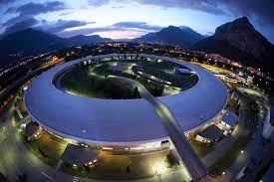
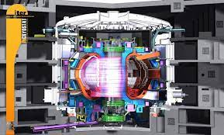
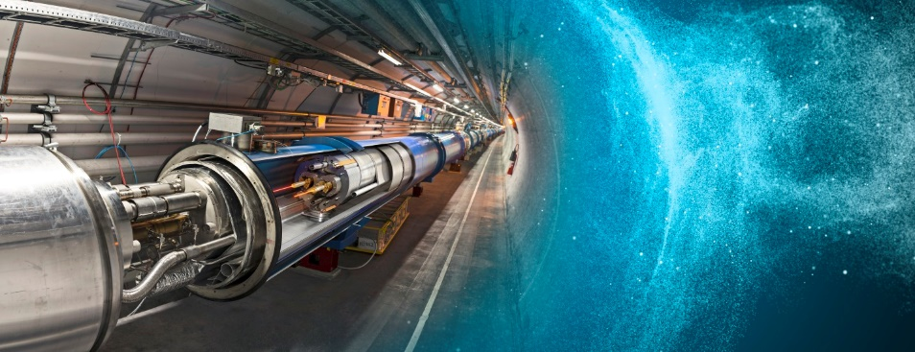
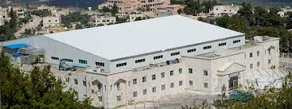
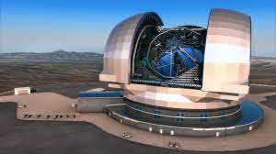
Large-Scale Research Infrastructures
Large-scale facilities that are used by the research communities to conduct research and foster innovation in their fields:
e.g. particle accelerators for particle collisions or for X-ray generation
used by large collaborations of research teams
offer unique research opportunities at forefront of S&T
attract and host best researchers in the world, promote young talents!
Important role in the advancement of knowledge and technology, liberating creative potential of staff, users and providers, thus being crucial socio-economic drivers.

Slide 7
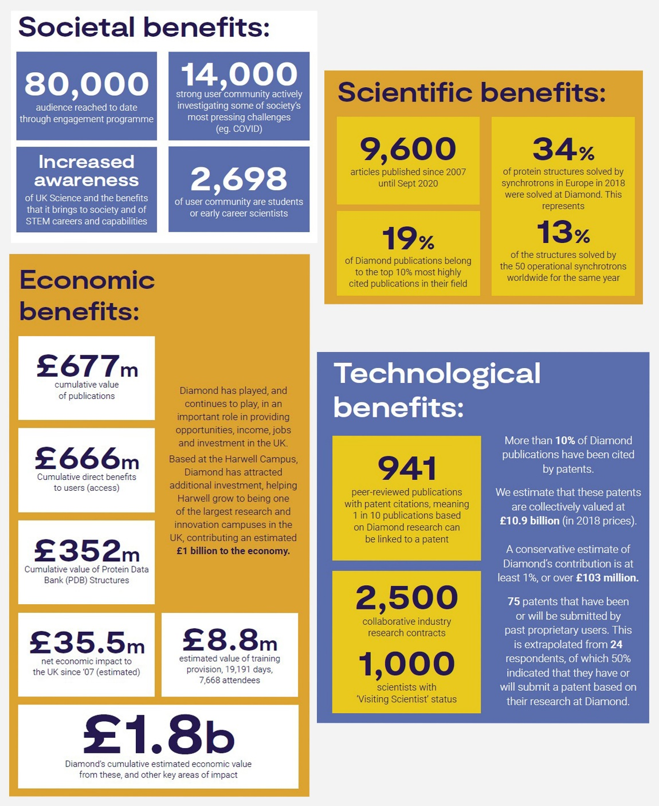
Socio-economic impact study of Diamond Light Source

Slide 8
Many ways to use x-rays
photo-emission
(electrons)
electronic structure
& imaging
diffraction
crystallography
& imaging
scattering
SAXS
& imaging
absorption
from the synchrotron
to the detector
Spectroscopy
EXAFS
XANES
& imaging
fluorescence
EXAFS
XRF imaging
Notes:
IR

Slide 9
Scientific Topics
Notes:
Multiwavelength anomalous
Single-wavelength anomalous dispersion

Slide 10
Writing a proposal
Idea
Literature review
Team members
Materials and methods
Notes:
اهمیت تیم همکار و افراد با تخصص های مختلف

Slide 11
Writing a proposal steps
Technique(s) selection
Beamline(s)/synchrotron selection
Prerequisite materials
Proposal preparation
Notes:
آزمایش های پیش نیاز

Slide 12
Synchrotron and beamline selection
Scientific criteria:
Beamline parameters: i.e. Resolution(energy, time, spatial), spot size, energy range, beam divergence, detector, end–station, …
Scientific collaboration history
Synchrotron energy regime (soft- hard)
Non-scientific criteria:
Travel cost, visa and logistic issues, culture, …

Slide 13
Worldwide synchrotron facilities

Slide 14
THIRD generation light sources

Slide 15
 | SYNCHROTRON | COUNTRY
1 | Advanced Light Source (ALS) | USA
2 | Advanced Photon Source (APS) | USA
3 | ALBA | SPAIN
4 | ASTRID | DENMARK
5 | Australian Synchrotron | AUSTRALIA
6 | Beijing Synchrotron Radiation Facility (BSRF) | CHINA
7 | BESSY II | GERMANY
8 | Canadian Light Source | CANADA
9 | Cornell High Energy Synchrotron Source (CHESS) | USA
10 | DAFNE | ITALY
11 | Diamond Light Source | UK
12 | ELETTRA | ITALY
13 | European Synchrotron Radiation Facility (ESRF) | FRANCE
14 | Indus 1 | INDIA
15 | Kurchatov Synchrotron Radiation Source | RUSSIA
16 | LNLS | BRAZIL
17 | MAX IV | SWEDEN
18 | National Synchrotron Light Source (NSLS-II) | USA
19 | PETRA III | GERMANY
20 | Photon Factory (PF) at KEK | JAPAN
21 | Pohang Light Source | SOUTH KOREA
22 | SESAME | JORDAN
23 | Shanghai Synchrotron Radiation Facility (SSRF) | CHINA
24 | Singapore Synchrotron Light Source (SSLS) | SINGAPORE
25 | Sirius | BRAZIL
26 | Solaris (synchrotron) | POLAND
27 | SOLEIL | FRANCE
28 | SPring-8 | JAPAN
29 | Stanford Synchrotron Radiation Lightsource (SSRL) | USA
30 | Swiss Light Source | SWISS
31 | Synchrotron Light Research Institute | THAILAND
32 | Taiwan Light Source | TPS
33 | Taiwan Photon Source | TLS

Slide 16
Beamline selection
Before submitting a proposal you should first identify the beamlines that can be used for your project and contact the Beamline Spokesperson for each beamline.
Discuss with the Beamline Spokesperson
Does the beamline meet the specifications required for your project?
Does your project require additional instrumentation or a non‐standard beamline configuration? Can the instrumentation be supplied or the beamline reconfigured?
The amount of beamtime that would be required to complete your project.
Can a preliminary feasibility check be made on your sample?
Notes:
شماره 2 : نمونه سازی- نصب نمونه

Slide 17
Way for light https://www.wayforlight.eu/

Slide 18
Way for light http://www.wayforlight.eu/en/

Slide 19
General User Access to Synchrotrons
Beamlines tend to give at least 30% of the beamtime (often much more) for General Users, i.e. open access to any researcher:
Beamtime allocated by peer-review and open competition.
The process is designed to bring in new people, while keeping access open to all researchers.
Many beamlines give much more than 50% General User time
Synchrotron calendars include “run cycles” with specific deadlines for proposal submission.
Always check the synchrotron website for the submission calendar.

Slide 20
Way for light http://www.wayforlight.eu/en/

Slide 21
Proposal Deadlines http://www.wayforlight.eu/en/users/next-call-deadlines/

Slide 22
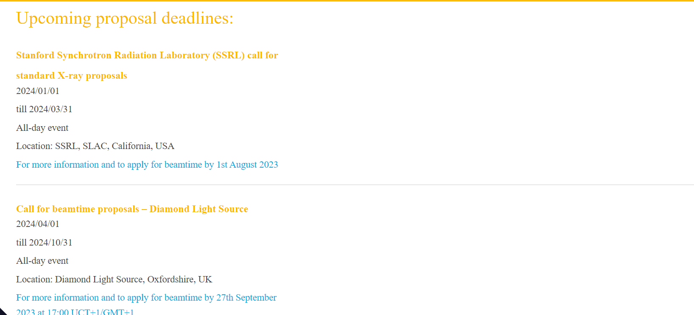
Proposal Deadlines https://lightsources.org/for-users/proposal-deadlines/

Slide 23
Key Points for Successful Beamtime Proposals
2-3 pages: Take the time to make it short
Describe the importance of your science in terms any scientist can understand
Aim broadly, proposals are read by physicists, chemists, biologists, etc....
Describe your experiment well. Include details of samples to be measured and of experimental setup if non-standard. Account for the time you request and make clear that the time will be well-used.
Consult with a beamline scientist and/or your collaborators before submitting proposal.

Slide 24
More hints on proposal writing
Describe the “Societal Impact” in the Abstract – reviewers love this.
Describe other measurements that have been made on these samples
Be specific and explicit about:
Element(s) and edge(s) to be studied
Concentrations of elements to be studied.
Transmission, fluorescence, multi-element detector
Give literature references. (Don’t attach your CV. Don’t attach PDFs of published papers.)
If you’re a student or postdoc (most reviewers love this, too):
say so.
list yourself as Spokesperson, not your advisor.
write the proposal yourself, with help from advisor / senior students.
If you’ve had some beamtime and “need a bit more time”, include a plot of any data collected so far.
List a 2nd choice beamline.
Proposal Shifts number of 8-hour shifts required for next run and for the lifetime of the proposal
Each proposal is reviewed usually by 3 reviewers who provide a rating between 1 and 5 (1 high).

Slide 25
Why is Synchrotron Radiation Required
You need to convince the reviewer that your experiment could not be done on an in‐house light source.
Reasons might include:
Your experiment requires a unique property of synchrotron radiation such as, high brightness (small beam area), high flux (for weakly scattering samples), or energy tunability (for spectroscopic measurements).
Your experiment requires high through ‐put to characterize a large number of samples.
Notes:
نمره از 5 یا 10

Slide 26
Scientific structure
Scientific Importance of Proposed Experiment
Background
Impact
Describe Work Previously Done at a Synchrotron Facility
List of Three Publications to Assist in Proposal Review
Research Description
Safety Approval Form

Slide 28
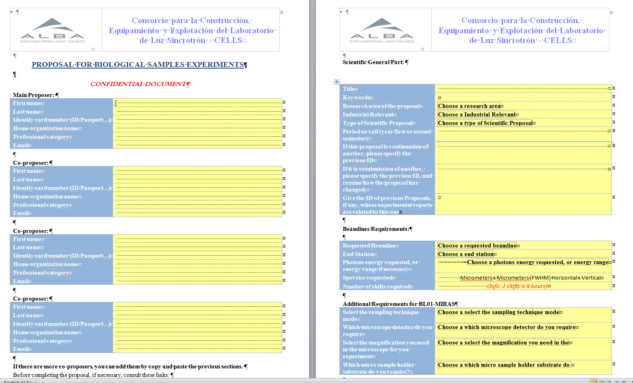
Proposal document: administrative and technical information

Slide 29
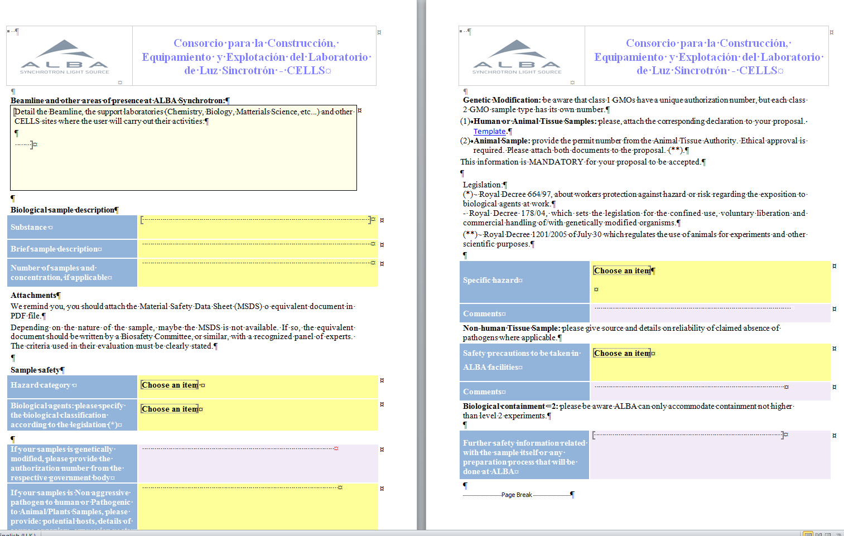
Proposal document: safety content

Slide 30
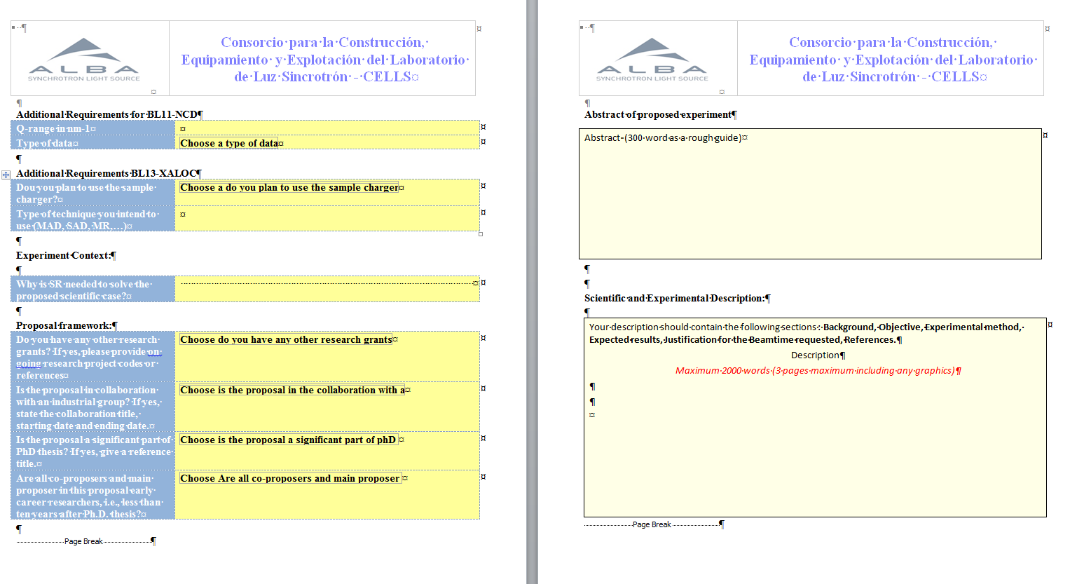
Proposal document: scientific content

Slide 31
Proposal Submission Flowchart
submit proposal online
proposal scientific reviews
technical feasibility review
proposal score notification
Beamtime beamtime allocation
safety review & approval
beamtime scheduling
beamtime

Slide 32
After you’ve submitted a proposal
Most beamlines are oversubscribed – many by 2× to 3×.
oversubscription = (requested days ) / (available days)
It may take one or more run cycles to get beamtime.
You may get less time than you ask for.

Slide 33
Proposal submitted and allocated beamtime, 2008-1017, ESRF ~40% acceptance rate

Slide 34
Beamtime Allocation: July - December, 2018 Canadian Light Source (CLS)
Beamline | New Proposals | Beamtime Renewals | Allocated/Not allocated proposals
01B1-1 (Mid IR) | 11 | 10 | Allocated: 17 Not allocated: 4
021B-1 (Far IR) | 3 | 15 | Allocated: 18 Not allocated: 0
BMIT | 31 | 21 | Allocated: 28 proposals Not allocated: 15
06B1-1 (SXRMB) | 27 | 17 | Allocated proposals: 17 Not allocated: 22
06ID-1 (HXMA) | 39 | 16 | Allocated: 22 Not allocated: 32
07B2-1 (VESPERS) | 19 | 14 | Allocated: 19 Not allocated: 9
10ID-1 (SM) | 26 | 16 | Allocated: 13 Not allocated: 28
10ID-2 (REIXS) | 11 | 4 | Allocated: 9 Not allocated: 5
11ID-1 (SGM) | 18 | 16 | Allocated: 19 Not allocated: 13
11ID-2 (VLS-PGM) | 6 | 8 | Allocated: 13 Not allocated: 1

Slide 35
From experiment to publication!
Performing experiment
Data accusation procedure
Data analysis
Publication

Slide 36
Synchrotron Granting Institutions
ICTP-Elettra Users Programme
SESAME
CERIC (Central European Research Infrastructure Consortium) https://www.ceric-eric.eu/
CALIPSOplus http://www.calipsoplus.eu/
Remote Users
برنامه حمایت از کاربران ایرانی در آزمایشگاه‌های سنکروترونی
Notes:
کالیپسو پلاس قبلا اروپا بود اکنون خاورمیانه هم هست
برخی سینکروترون ها خودشان حمایت محدود دارند مثل بسی در حد 200 تا 400 یورو

Slide 37
برنامه پشتیبانی از کاربران ایرانی در آزمایشگاه‌های سنکروترون
این برنامه با دو هدف کلی پایه‌ریزی شده است:
آموزش و مشاوره به کاربران ایرانی:
برگزاری کارگاه‌های آموزشی در مورد تکنیک‌ها و کاربری تابش سنکروترون
آموزش و مشاوره نگارش طرح پیشنهادی برای دریافت زمان آزمایش
آموزش آنالیز و تحلیل داده‌های آزمایش
همکاری با صنایع، شرکت‌های دانش‌بنیان، مراکز رشد و ....
در این مورد خدمات ارائه شده توسط سازمان کاربری سنکروترون و FEL اروپا مورد اقتباس قرار گرفته است:
ESUO - European synchrotron and FEL user organisation
http://www.wayforlight.eu/en/
2. تامین بخشی از هزینه‌های سفر کاربرانی که موفق به دریافت زمان آزمایش از یکی از سنکروترون‌های در حال کار دنیا شده‌اند.
در این مورد برنامه کاربری ICTP-Elettra Users Programme مورد اقتباس و بومی‌سازی قرار گرفته است:
https://www.elettra.trieste.it/userarea/ictp-elettra-users-programme.html

Slide 38
شرایط تخصیص حمایت مالی
طرح پیشنهادی در یکی از سنکروترون‌های در حال کار دنیا پذیرفته شده باشد.
طرح پیشنهادی هیچ حمایت مالی از موسسات داخلی و یا بین‌المللی دریافت نکرده باشد.
در صورتی‌که حمایت مالی دریافت شده برای سفر کافی نباشد، با ارائه مستندات لازم امکان تامین بخش باقیمانده هزینه وجود دارد.
سرگروه شاغل به کار در یکی از موسسات علمی، دانشگاهی و یا صنعتی داخلی باشد و ایده اصلی، انجام یک پژوهش ایرانی باشد.

Slide 39
روند تخصیص حمایت مالی به کاربران
تهیه طرح پیشنهادی و ثبت درخواست در یکی از آزمایشگاه‌های سنکروترون دنیا
دریافت نامه رسمی پذیرش طرح پیشنهادی
ارسال درخواست به سامانه برنامه به نشانی https://ilsf.ipm.ac.ir/sgn-pg/sync-user-sprt.jsp
بررسی درخواست در کارگروه علمی برنامه
تایید کارگروه و ارسال به صندوق حمایتی

Slide 40
موارد حمایت مالی
بلیط سفر رفت و برگشت از مبدا تهران (هواپیما و قطار و اتوبوس داخلی)
اقامت به ازاء مدت زمان انجام آزمایش به اضافه یک روز قبل و دو روز بعد از انجام آزمایش
تهیه نمونه‌های آزمایشگاهی.
موارد ضروری با تشخیص کارگروه.
حمایت تشویقی:
چاپ مقاله
ارائه در همایش کاربران چشمه نور ایران

Slide 41
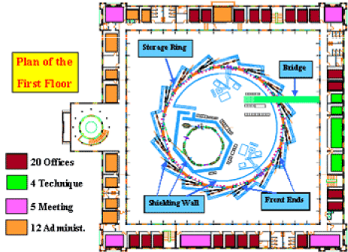
SESAME(Synchrotron-light for Experimental Science and Applications in the Middle East)
The idea of an international synchrotron light source in the Middle East was first proposed in 1997.
It had been decided to decommission BESSY I facility, since a newer one was being built in Berlin.
The groundbreaking ceremony was held in January 2003 and construction work began the following July.
The component parts of BESSY 1 have been shipped from Germany to Jordan

Slide 42
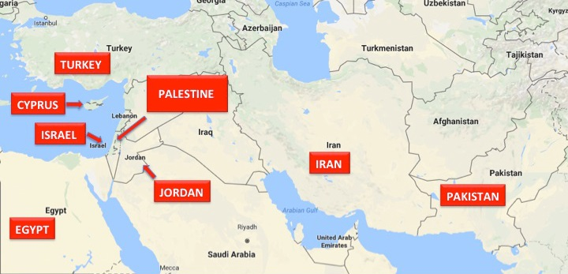
SESAME: Members and Observers
The current Members of SESAME are Cyprus, Egypt, Iran (Islamic Republic of), Israel, Jordan, Pakistan, Palestine, and Turkey.
Current Observers (2017) are Brazil, Canada, China (People’s Republic of), the European Organization for Nuclear Research (CERN), the European Union (EU), France, Germany, Greece, Italy, Japan, Kuwait, Portugal, Russian Federation, Spain, Sweden, Switzerland, the United Kingdom, and the United States of America.

Slide 43
SESAME Beamlines Phase-one
No. | Beamlines | Energy Range | Photon Source | Research Area | Comment
1 | MX Protein Crystallography | 4 – 14 keV | In-vacuum Und. | Structural Molecular Biology | Partially financed through Jordanian Research Fund
2 | XAFS / XRF | 4 – 30 keV | Bending Magnet | Material Science, Environment | HZDR Institute
3 | Infra-Red (IR) Spectromicroscopy | 0.01 – 1 eV | Bending Magnet | Environmental, Materials and Archaeological Science | Constructed by SESAME with supervision of SOLEIL
4 | Powder Diffraction | 5 – 25 keV | Wiggler | Material Science | Donated by SLS (with source)
5 | Soft X-ray, Vacuum Ultraviolet (VUV) | 0.05 – 2 keV | Elliptically Polarizing Undulator | Atomic, Molecular and Condenced Matter Physics | Donated by Helmholtz Association of German Research Centres
6 | Tomography Beamline | 5 - 50 KeV | Super bend or super wiggler | Tomography | BEATS European Project (Call H2020-INFRASUPP-2018-2020)
7 | SAXS / WAXS | 8 – 12 keV | Bending Magnet | Structural Molecular Biology, Material Science | Daresbury
8 | Extreme Ultraviolet (EUV) Spectroscopy | 10 – 200 eV | Bending Magnet | Atomic and Molecular Physics | LURE

Slide 44
“Whenever we build something that is 2 or 3 orders of magnitude better than any existing one, that will lead to a new science.”
Heinz Maier-Leibnitz
Thank you for your attention

Slide 45
Elettra is a multidisciplinary international research center of excellence, specialized in generating high quality synchrotron and free-electron laser light and applying it in materials and life sciences
Notes:
Slide 1: Company Logo Full Page
Before you start editing the slides of your talk change to the Master Slide view:
Microsoft Office :Menu: View > Slide Master;
Macintosh – View > Master > Slide Master
Edit the following items:
On the Slide Master (first master slide) – lower area
a) On the left Delete the text and write the title of the event/Conference, Location
b) On the right delete the text and write the name and surname of the speaker and the date (day, month , year)
Close Master View

Slide 46
Notes:
Last Slide 1: Thanks to the audience

Slide 47
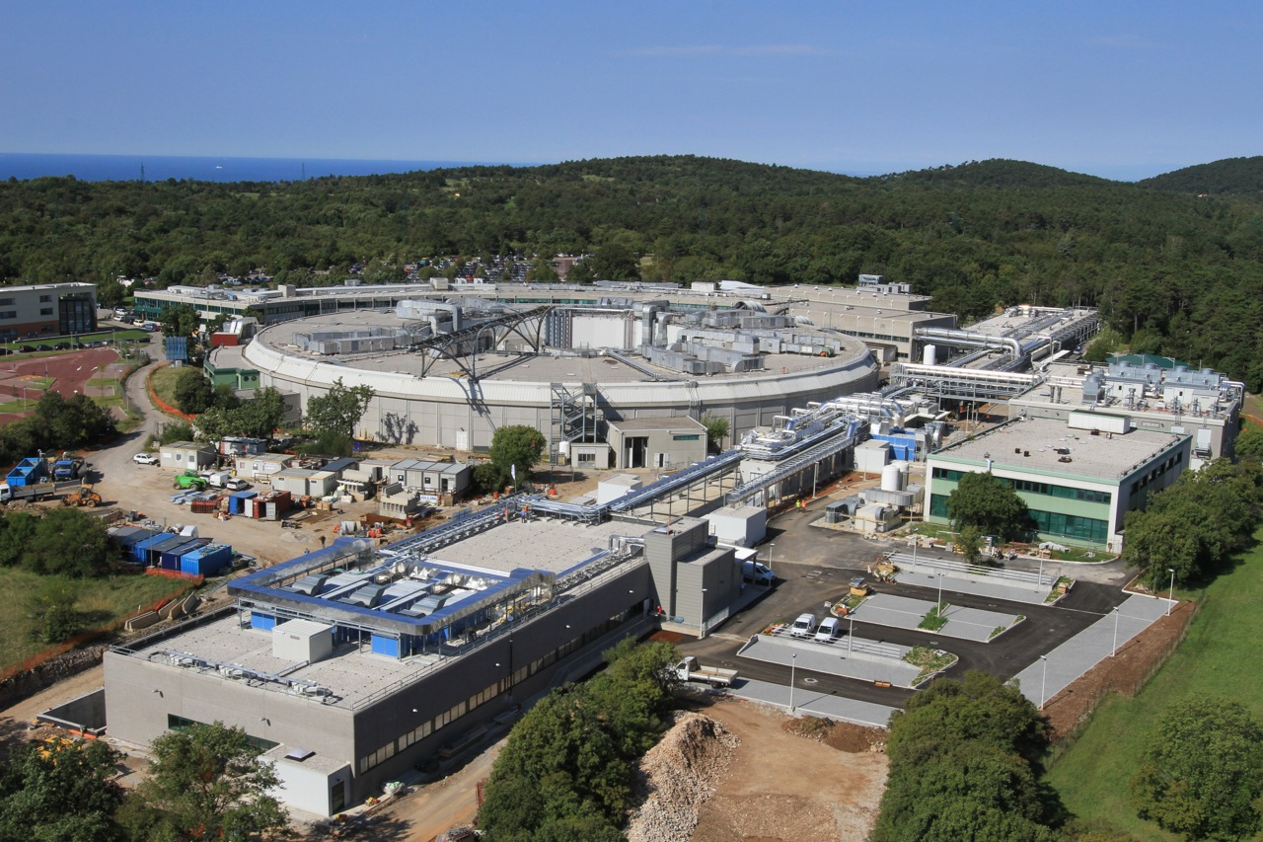
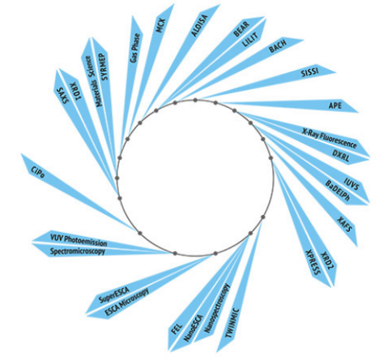
Elettra Sincrotrone Trieste laboratory
ELETTRA Storage Ring Synchrotron
1993: 2-2.4 GeV Storage Ring
28 VUV-Xrays beamlines
Spectroscopy
Spectromicroscopy
Diffraction
Scattering and lithography
Infrared microscopy and spectroscopy
Ultraviolet inelastic scattering
Upgrade project: Elettra2.0
2-2.4 GeV storage ring
Reduced emittance for increased brilliance and coherence
Time schedule: 2025-2026

Slide 48
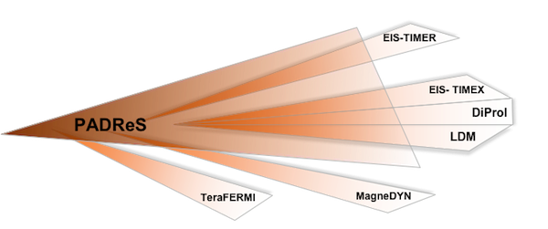
Elettra Sincrotrone Trieste laboratory
FERMI Free Electron Laser (FEL): 2010
Free Electron Laser source:
“Seed” by a conventional laser
high peak power (>GWs)
short pulse length (<100 fs)
full spatial and temporal coherence
photon energy bandwidth < 10⁻³
tunable wavelength (100-4 nm)
variable polarization
1.5 GeV electron linear accelerator
Two undulator lines: FEL-1 and FEL-2
Experimental hall with 6 end stations
Notes:
Slide 3 – (..) : Content of the presentation
Insert a new slide: Home > “New Slide” and choose a slide Layout:
For Title & Subtitle
For text with bullet points
For Text
For Picture, graphs, visuals
Two columns
Blank
If you want Copy & paste an element from the Clip Board to the particular slide: 1. Click on a box to mark it.
2. Position the mouse pointer on the box frame: Copy! 3. Click on the particular slide: Paste!
How you intend to use the elements is your choice. You can combine the text block style with the background colour in different manner.

Slide 49
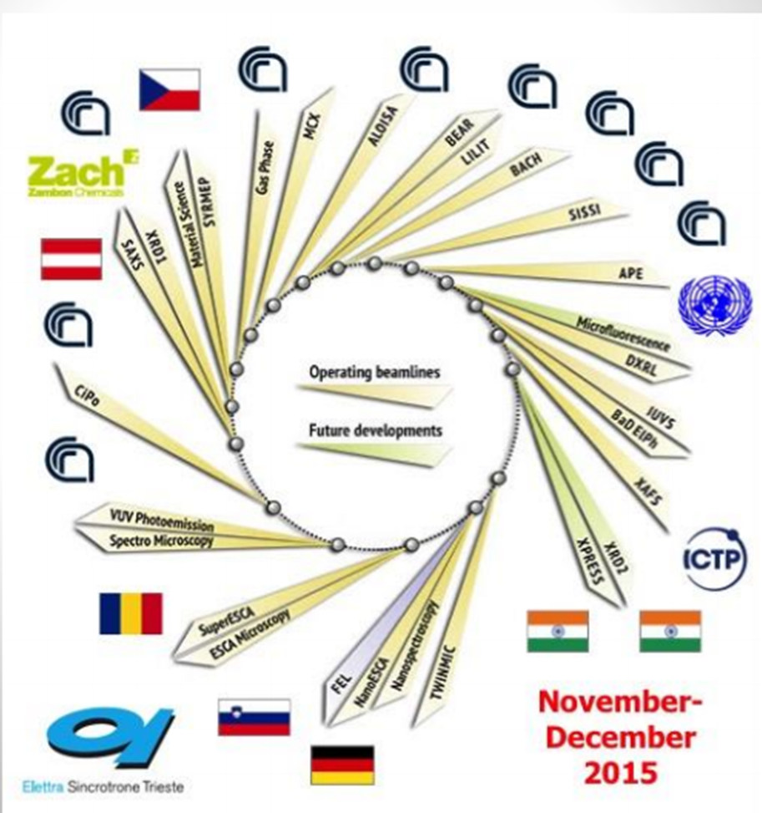
Elettra's Beamlines

Slide 50
ICTP-Elettra Users Programme
The ICTP-Elettra Users Programme is offering access to the synchrotron radiation facility Elettra-Sincrotrone Trieste in Trieste in the years 2002-2024 to scientists who are citizens of and work in developing countries.
The programme is offering a limited number of grants to cover travel and living expenses of individuals and small groups using beamtime at Elettra:
up to 2 scientists for experiments with less than 12 shifts.
up to 3 scientists for experiments with 12 shifts or more.

Slide 51
ALBA’s Beamlines
BL29: BOREAS
EU71– (0.08-3 keV)
Resonant Absorption
and Scattering
Bending: e⁻ Diagnostics
BL01: MIRAS
Bending – (0.4-100 µm)
IR Spectroscopy
BL24: CIRCE
EU62– (0.1-2 keV)
Photoemission
spectroscopies
BL04: MSPD
SCW31 – (8-50 keV)
HP/HR
Powder Diffraction
BLXX: FaxTor
ID: 3 pole wiggler
Hard x-ray tomography
In operation (8)
In construction (4)
BL06: XAIRA
IVUXX (~5-25 keV)
Macromolecular Cristallography
BL22: CLÆSS
MPW80– (2-63 keV)
Absorption &
Emission Spectroscopies
BL09: MISTRAL
Bending– (0.27-2.6 keV)
X ray Microscopy
BL20: LOREA
EU125 – (10-450 eV)
ARPES
BL11: NCD
IVU21– (6-13 keV)
Non Cristalline Diffraction
SAXS/WAXS
BL16: NOTOS
Bending
Metrology, XAS
BL13: XALOC
IVU21 – (5-22 keV)
Macromolecular Cristallography

Slide 52
SESAME(Synchrotron-light for Experimental Science and Applications in the Middle East)
The idea of an international synchrotron light source in the Middle East was first proposed in 1997.
It had been decided to decommission BESSY I facility, since a newer one was being built in Berlin.
The groundbreaking ceremony was held in January 2003 and construction work began the following July.
The component parts of BESSY 1 have been shipped from Germany to Jordan

Slide 53
SESAME: Members and Observers
The current Members of SESAME are Cyprus, Egypt, Iran (Islamic Republic of), Israel, Jordan, Pakistan, Palestine, and Turkey.
Current Observers (2017) are Brazil, Canada, China (People’s Republic of), the European Organization for Nuclear Research (CERN), the European Union (EU), France, Germany, Greece, Italy, Japan, Kuwait, Portugal, Russian Federation, Spain, Sweden, Switzerland, the United Kingdom, and the United States of America.

Slide 54
No. | Beamlines | Energy Range | Photon Source | Research Area | Comment
1 | MX Protein Crystallography | 4 – 14 keV | In-vacuum Und. | Structural Molecular Biology | Partially financed through Jordanian Research Fund
2 | XAFS / XRF | 4 – 30 keV | Bending Magnet | Material Science, Environment | HZDR Institute
3 | Infra-Red (IR) Spectromicroscopy | 0.01 – 1 eV | Bending Magnet | Environmental, Materials and Archaeological Science | Constructed by SESAME with supervision of SOLEIL
4 | Powder Diffraction | 5 – 25 keV | Wiggler | Material Science | Donated by SLS (with source)
5 | Soft X-ray, Vacuum Ultraviolet (VUV) | 0.05 – 2 keV | Elliptically Polarizing Undulator | Atomic, Molecular and Condenced Matter Physics | Donated by Helmholtz Association of German Research Centres
6 | Tomography Beamline | 5 - 50 KeV | Super bend or super wiggler | Tomography | BEATS European Project (Call H2020-INFRASUPP-2018-2020)
7 | SAXS / WAXS | 8 – 12 keV | Bending Magnet | Structural Molecular Biology, Material Science | Daresbury
8 | Extreme Ultraviolet (EUV) Spectroscopy | 10 – 200 eV | Bending Magnet | Atomic and Molecular Physics | LURE

Slide 55
Some Case Studies

Slide 56
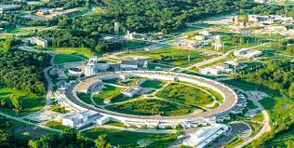
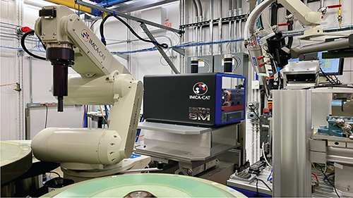
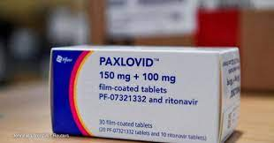
Coronavirus drug developed with the help of synchrotron
Mapping a SARS-CoV-2 protein led to the discovery of a compound to disable it.
Advanced Photon Source
Company: Pfizer
Notes:
Owen, D.R., Allerton, C.M., Anderson, A.S., Aschenbrenner, L., Avery, M., Berritt, S., Boras, B., Cardin, R.D., Carlo, A., Coffman, K.J. and Dantonio, A., 2021. An oral SARS-CoV-2 Mpro inhibitor clinical candidate for the treatment of COVID-19. Science, 374(6575), pp.1586-1593.
استفاده از پرتو ایکس سنکروترونی برای بررسی ساختارهای اتمی پروتئین‌هایی که ویروس کووید-19 را می‌سازند برای تولید داروی Paxlovid

Slide 57
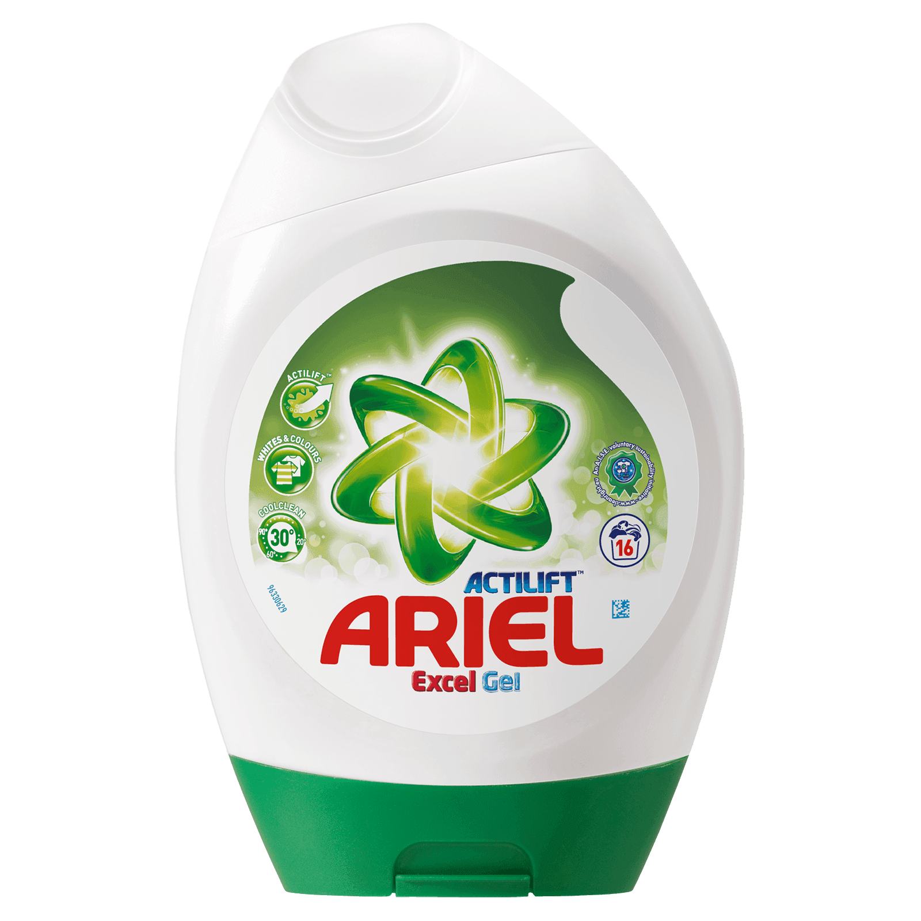
MORE ENVIRONMENTALLY-FRIENDLY DETERGENTS
Small Angle X-ray Scattering was used to map the phase diagram of Ariel Excel Gel to determine the regions that are physically stable within the formulation space of interest.
Company: Procter & Gamble (P&G)

Slide 58
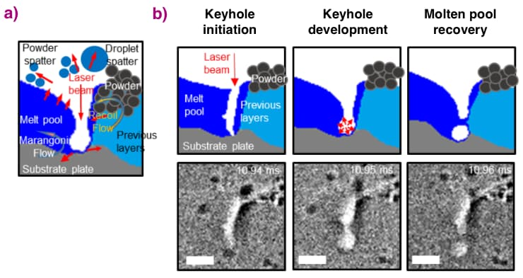
ULTRA-FAST X-RAY IMAGING OF POWDER BED FUSION ADDITIVE Manufactures
The sample consisted of the alloy Ti-6Al-4V commonly used for aerospace and biomedical applications.
Company or institute:
University College London and Rolls-Royce Plc.
Notes:
اضافه کردن افزودنی ها برای ساخت سریع مواد

Slide 59
HOW DO SAFETY FOAMS IN CAR DEFORM?
Company
Jaguar Land Rover and University of Warwick
Microtomography reveals how safety foam disperses energy under load for car headrests.
Notes:
ضربه گیر پشت سر در صندلی ماشین

Slide 60
RADIATION DAMAGE IN MICROELECTRONICS
Company: Airbus
Electronic equipment is affected by radiation in the atmosphere and especially in space.

Slide 61
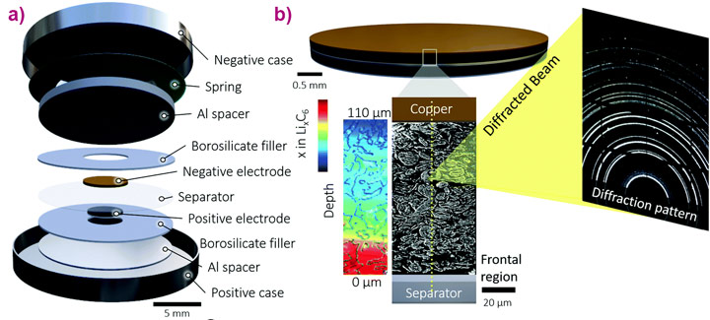
LITHIATION OF GRAPHITE ELECTRODES TRACKED DURING FAST BATTERY CHARGING
The challenge was to visualise the lithiation of a graphite electrode under operando conditions during fast charging and in particular to track the changes throughout the depth of the material, from separator to current collector.
Company: National Renewable Energy Laboratory, Golden, USA.
Notes:
Lithiation refers to the process by which a lithium atom replaces a hydrogen atom in an organic molecule
Operando spectroscopy is an analytical methodology wherein the spectroscopic characterization of materials undergoing reaction is coupled simultaneously with measurement of catalytic activity and selectivity

Slide 62
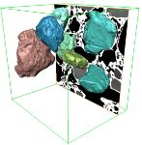
Understanding the microstructure of ice cream
The quality of ice cream is considered to depend on the size of constituent air cells and ice crystals, the smaller and rounder the better
Company: Unilever
Notes:
شرکت یونیلیور از سال ۲۰۱۱ پس از شرکت‌های پروکتر اند گمبل و نستله سومین تولیدکننده کالاهای مصرفی جهان محسوب می‌شود، همچنین از سال ۲۰۰۹ تاکنون پس از پروکتر اند گمبل و لورئال در رتبه سوم از بزرگترین شرکت‌های آرایشی و بهداشتی جهان، قرار دارد. این شرکت هم‌اکنون به‌عنوان بزرگترین تولیدکنندهٔ بستنی در جهان شناخته می‌شود. سانسیلک و نپتون

Slide 63
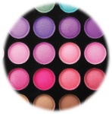
HP - novel display technology
The microscale ordering and alignment of the nanoparticles in the suspension under applied fields is key to identifying the most suitable materials for novel display technologies.

Slide 64
TOYOTA Beamline BL33XU @ SPRING8
The Toyota beamline (BL33XU) is a multi-purpose beamline at SPring-8, designed and constructed by Toyota Central R&D Labs., Inc., in collaboration with the Japan Synchrotron Radiation Research Institute (JASRI) and RIKEN.
The beamline is intended for use in the study of a wide variety of materials with applications in sustainable vehicle technologies, such as auto exhaust catalysts, secondary batteries, fuel cells and structures.
Notes:
korea

