Slide 1
همبستگی های کوانتومی: نقش آنها در عدم قطعیت آنتروپی و باتری های کوانتومی
شهریار سلیمی
گروه فیزیک، دانشگاه کردستان
اصفهان 10 و 11 خرداد 1402

Slide 2
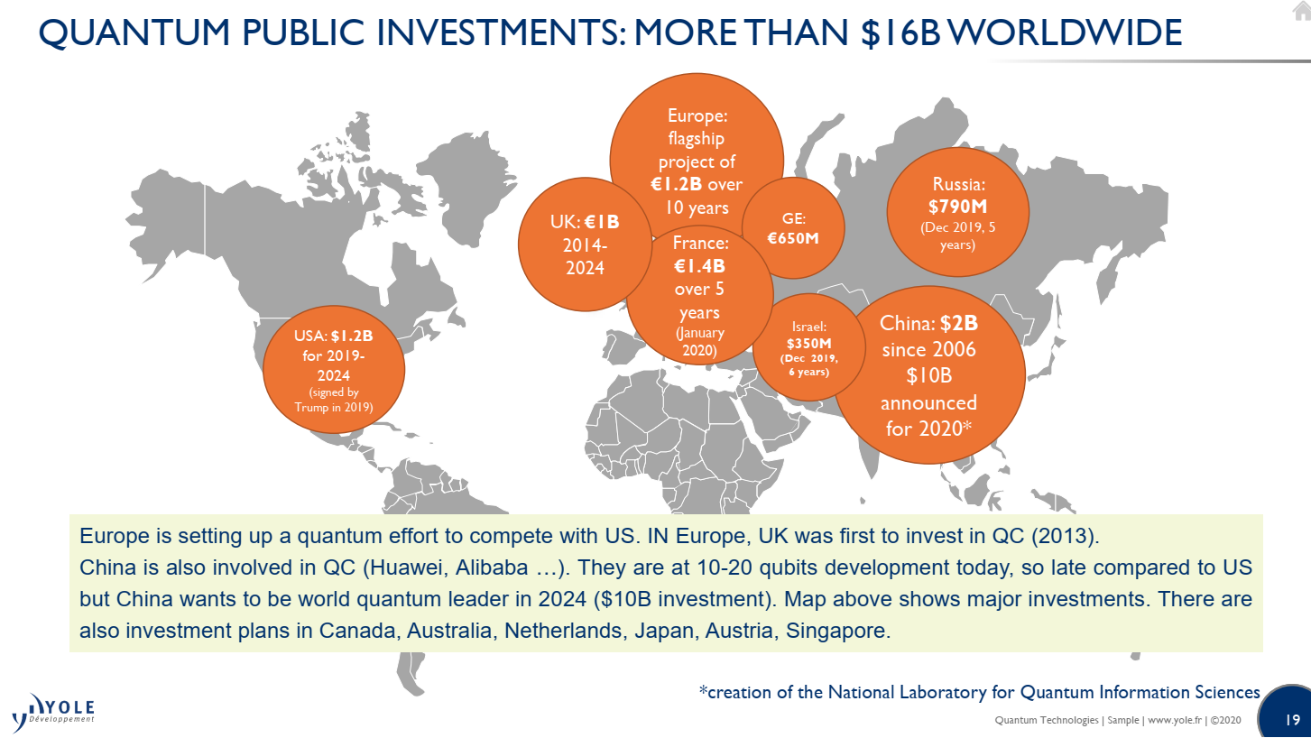

Slide 3
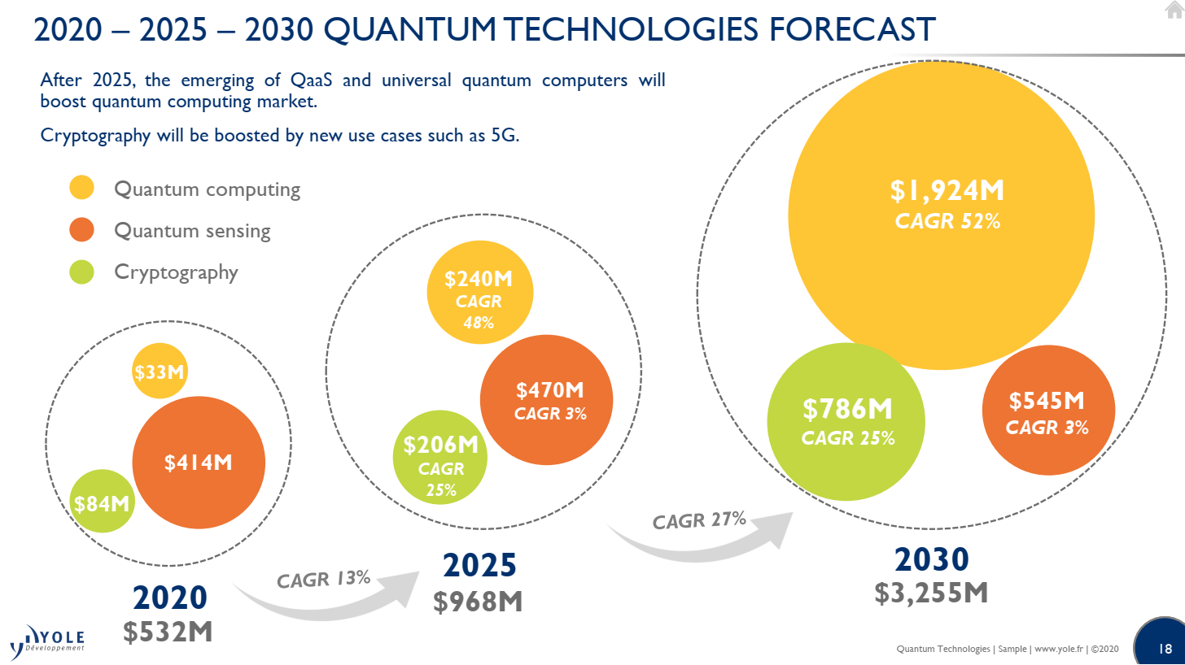
CAGR:Compound Annual Growth Rate

Slide 4
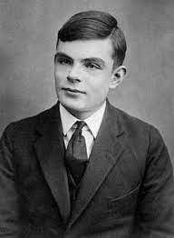
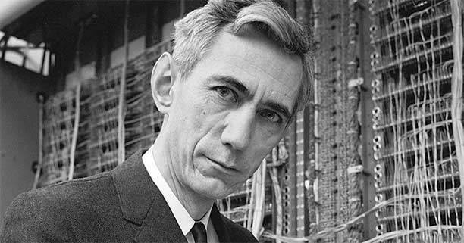
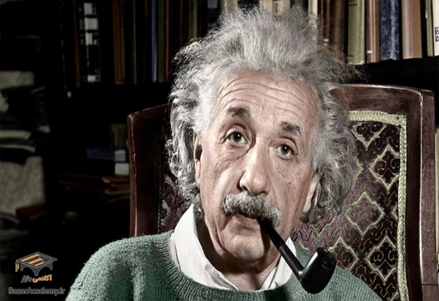
شکل گیری قرن بیست و بیست یک
4
اینشتین: فیزیک(پدر علم فیزیک جدید)
1955-1879
تورینگ: ریاضیات(پدر علم کامپیوتر و هوش مصنوعی)
1954-1912
شانون: ریاضیات، مهندس الکترونیک(پدر علم اطلاعات)
2001-1916

Slide 5
Outline:
Quantum Mechanics
Quantum correlations
Entropy Shannon
Entropy Uncertainty Relation and Heisenberg
Quantum Battery

Slide 6
Quantum Correlations
Entanglement
Quantum Discord

Slide 7
Entanglement
Hilbert space :
Pure State:
Product state
:

Slide 8
Entanglement
Entangled state:
For example:
Bell state:

Slide 9
Entanglement
Mixed State:
Mixed Product State:

Slide 10
Entanglement
Separable State:
A convex sum of different
product states

Slide 11
Quantum Discord
Shannon Entropy:
where is the probability of occurrence of event X
.

Slide 12
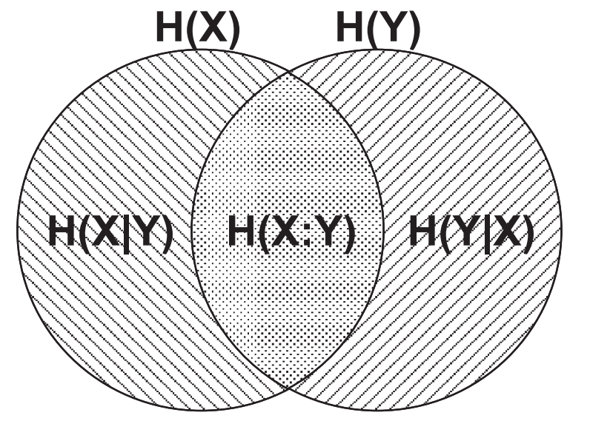
Quantum Discord
Mutual Information:

Slide 13
Quantum Discord
Classical Information
Quantum Information

Slide 14
Quantum Discord
Von Neumann Entropy
Mutual Information

Slide 15
Quantum Discord
Conditional Entropy:

Slide 16
Quantum Discord
Classical correlation:
Quantum Discord

Slide 17
Entropy Uncertainty Relation
Heisenberg’s Uncertainty Principle (1927)
we cannot know both the position and speed of a particle with perfect accuracy, such as electron.
W. Heisenberg, Z. Phys. 43, 172 (1927)

Slide 18
Entropy Uncertainty Relation
E.H. Kennard(1927)
E. H. Kennard, Zeitschrift für Physic 44, 326(1927).

Slide 19
Entropy Uncertainty Relation
H.P. Robertson (1929)
H. P. Robertson, Phys. Rev. 34 163 (1929)

Slide 20
Entropy Uncertainty Relation
If
Then

Slide 21
Entropy Uncertainty Relation
Deutsch(1983)

Slide 22
Entropy Uncertainty Relation
Massen , Uffink
Berta at el.
H. Maassen and J. B. M. Ufﬁnk, Phys. Rev. Lett. 60, 1103 (1988).
M. Berta et al. Nature Phys. 6, 659 (2010).

Slide 23
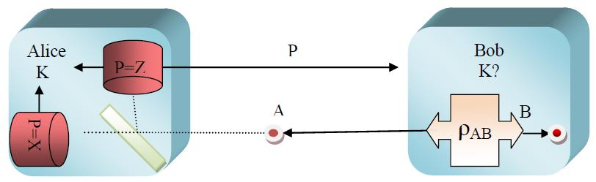
Entropy Uncertainty Relation

Slide 24
Entropy Uncertainty Relation
Pati 2012
Upper bound:
A. K. Pati, M. M. Wilde, A. R. Usha Devi, A. K. Rajagopal and Sudha, Phys. Rev. A 86, 042105 (2012)

Slide 25
Entropy Uncertainty Relation
Adabi at el. 2016
Holevo quantity
F. Adabi, S. Salimi, S. Haseli, Phys. Rev. A 93 (6), 062123 (2016)

Slide 26

Entropy Uncertainty Relation
Renes (2009)
$S\left(X | B\right)+S(Z|C)≥q_{MU}$
J. Renes and J. C. Boileau, Phys. Rev. Lett. 103, 020402 (2009).
M. Berta, M. Christandl, R. Colbeck, J. M. Renes, and R. Renner, Nat. Phys. 6, 659 (2010).

Slide 27

Entropy Uncertainty Relation
H. Dolatkhah at el. (2020)
$S\left(X | B\right)+S\left(Z | C\right)≥q_{MU}+\frac{S\left(A|B\right)+S(A|C)}{2}+max⁡\{0,δ\}$
$$δ=\frac{I\left(A:B\right)+I\left(A:C\right)}{2}−\left[I\left(X:B\right)+I\left(Z:C\right)\right]$$
H. Dolatkhah, S. Haseli, S. Salimi and A. S. Khorashad, , Phys. Rev. A 102, 052227 (2020).

Slide 28

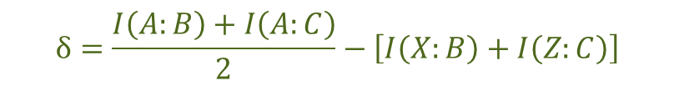
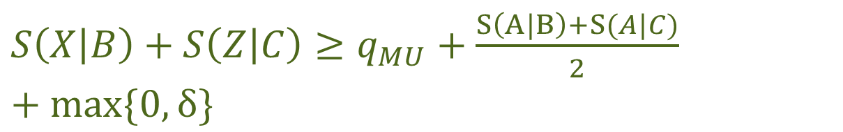
Summary
$$H\left(X\right)+H\left(Z\right)≥q_{MU}+S(A)$$
$$\left.S\left(X | B\right)+S\left(Z | B\right)≥q_{MU}+S\left(A | B\right)+max⁡\{0,δ\right\}$$
$$δ=I\left(A:B\right)−\left[I\left(X:B\right)+I\left(Z:B\right)\right]$$
$S\left(X | B\right)+S\left(Z | C\right)≥q_{MU}+\frac{S\left(A|B\right)+S(A|C)}{2}+max⁡\{0,δ\}$
$$δ=\frac{I\left(A:B\right)+I\left(A:C\right)}{2}−\left[I\left(X:B\right)+I\left(Z:C\right)\right]$$

Slide 29

Quantum Batteries

Slide 30
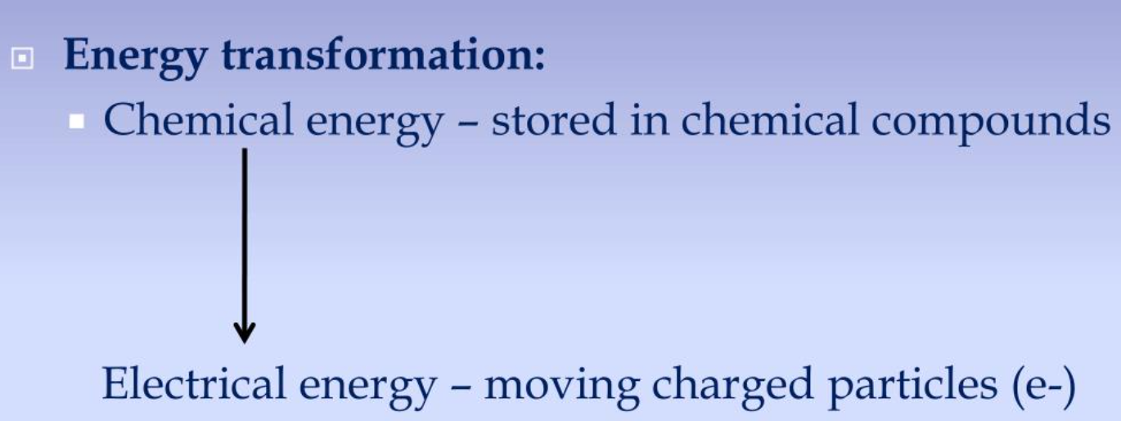
What does a battery do?

Slide 31

Quantum Battery
A quantum battery is a quantum system that ideally charges quickly and stores energy for long periods of time, providing useful energy in the form of work over time.
The performance of quantum batteries characterizes based on other characteristics, such as extractable work, charging and storage time.

Slide 32
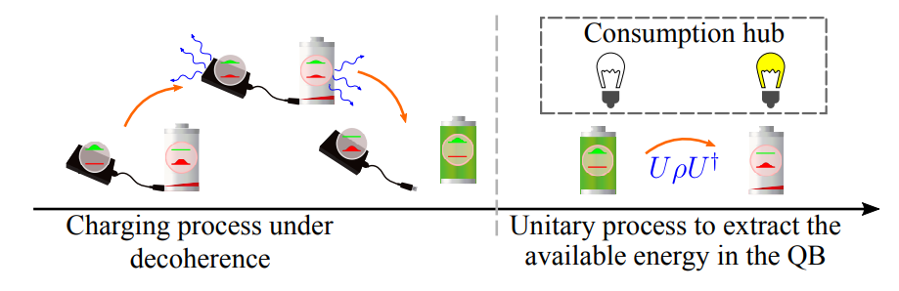



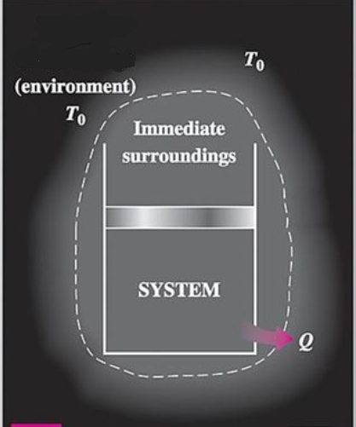
Types of quantum batteries
Open quantum battery
Close quantum battery
Non-unitary process to extract the available energy in the QB

Slide 33
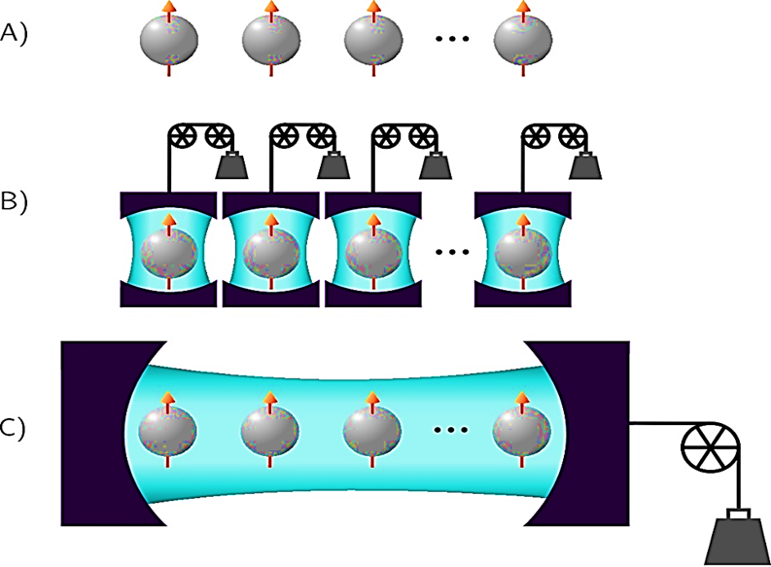
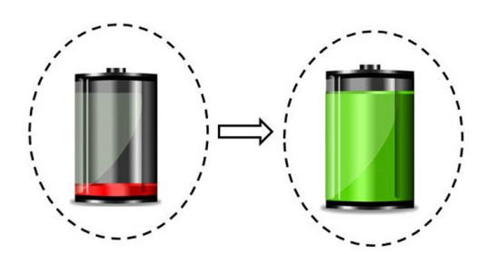



Charging Processes
$$ρ$$
$$ρ^{′}$$
Charging
R. Alicki and M. Fannes, Phys. Rev. E 87, 042123 (2013).
A. E. Allahverdyan, R. Balian, T. M. Nieuwenhuizen, Europhys. Lett. 67, 565 (2004).

Slide 34

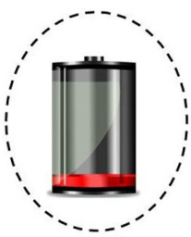


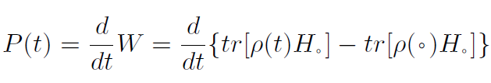

Discharging Process
discharging
Average power
power

Slide 35
Work Extraction
Maximum extractable work
by
Work extraction by non-unitary process (Exergy)
Work extraction by cyclic unitary process (Ergotropy)

Slide 36
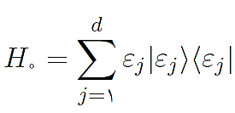
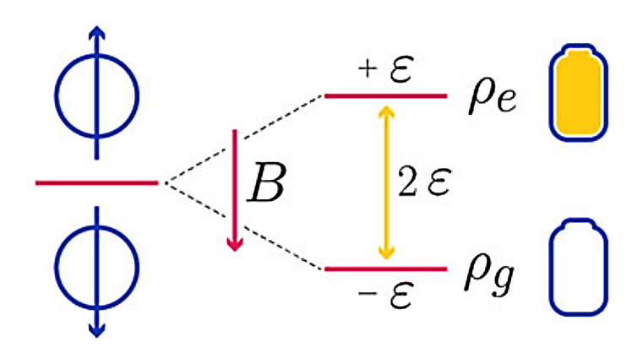




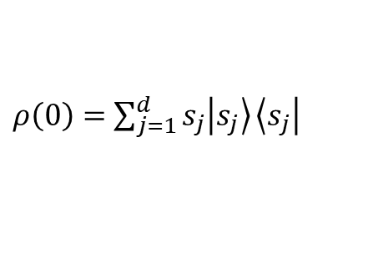

Ergotropy
Simple quantum battery
$ρ\left(0\right)=$ $\sum_{j=1}^{d}{s_{j}\left|\left.s_{j}\right\rangle \right.}\left\langle \left.s_{j}\right|\right.$
$$W_{max}=tr\left[ρ(0)H_{0}\right]−tr\left[ρ_{ρ}H_{0}\right]$$
Passive state
R. Alicki and M. Fannes, Phys. Rev. E 87, 042123 (2013).
A. E. Allahverdyan, R. Balian, T. M. Nieuwenhuizen, Europhys. Lett. 67, 565 (2004).

Slide 37
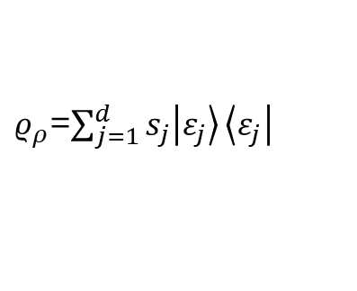

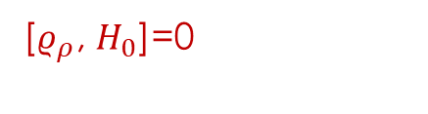
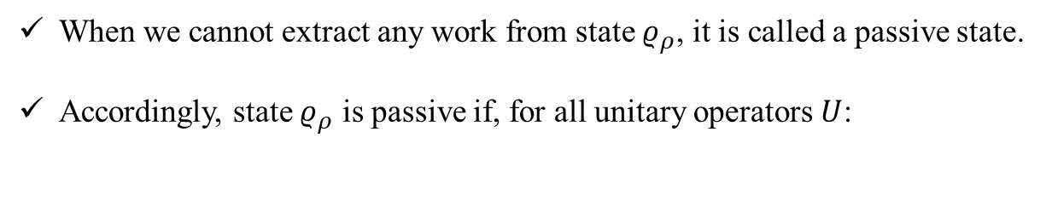

Ergotropy
When we cannot extract any work from state $ρ_{ρ}$, it is called a passive state.
Accordingly, state $ρ_{ρ}$ is passive if, for all unitary operators $U$:
$$tr[ρ_{ρ}H_{0}]≤tr[Uρ_{ρ}H_{0}U^{†}]$$
$ρ_{ρ}$=$\sum_{j=1}^{d}{s_{j}\left|\left.ε_{j}\right\rangle \right.}\left\langle \left.ε_{j}\right|\right.$
[$ρ_{ρ}$, $H_{0}$]=0
$$s_{j+1}≤s_{j}$$

Slide 38
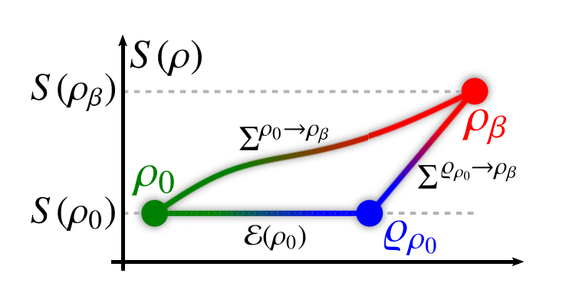

Exergy of passive states: Waste energy after ergotropy extraction
Residual energy after ergotropy extraction
$$Σ\left(ρ_{0}→ρ_{β}\right)=ℇ+Σ_{ex}$$
Balance equation
F. H. Kamin, S. Salimi, and Alan C. Santos, Phy. Rev E, 104, 034134 (2021)

Slide 39
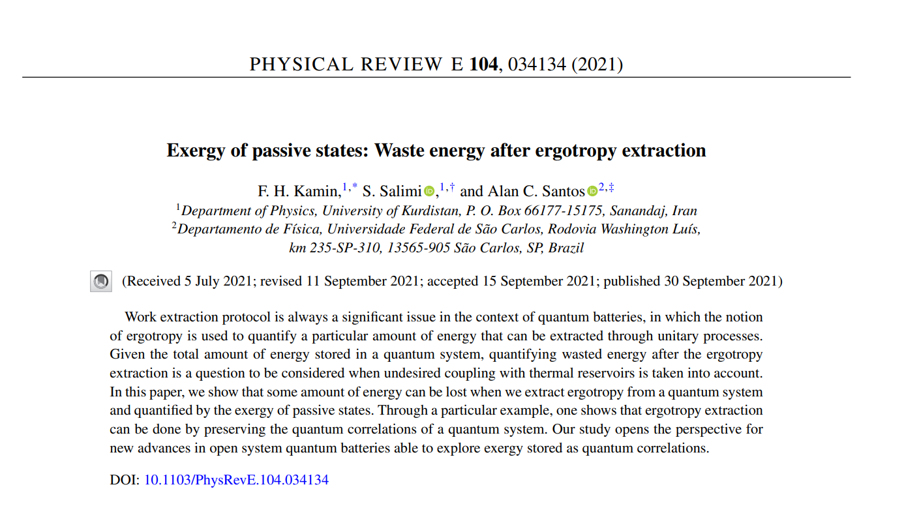

Slide 40


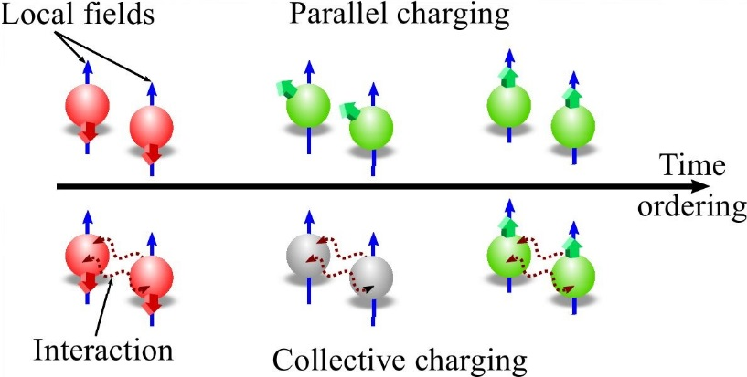




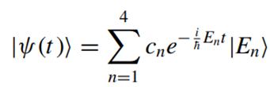




Entanglement, coherence, and charging process of quantum batteries
Driving Hamiltonian
in interaction picture
Two-cell quantum battery
Intrinsic interaction between spins
Empty battery
Charged battery
XXZ one-dimensional Heisenberg spin chain
F. H. Kamin, F. T. Tabesh, S. Salimi, and A. C. Santos, Phys. Rev. E 102, 052109 (2020).

Slide 41

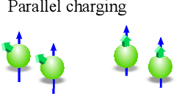






Parallel charging
The required minimum time
to obtain the maximum charge

Slide 42
















Collective charging
General initial state
Time evolution
Coherence
Entanglement
$$ρ\left(0\right)=$$
Initial state
Ergotropy
Power
$l_{1} norm$ measure
Wootter measure
W. K. Wootters, Phys. Rev. Lett. 80, 2245 (1998).
23

Slide 43
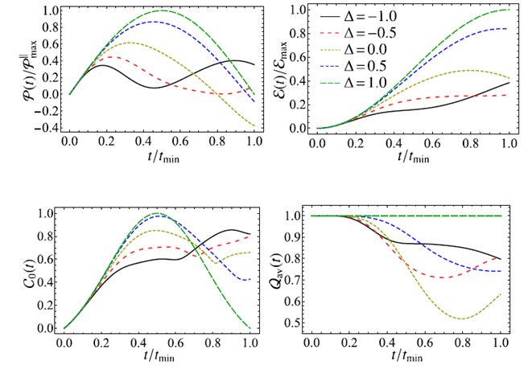






Three-cell quantum battery
Energy current operator
separable state
correlated state
A. C. Santos, A. Saguia, and M. S. Sarandy, Phys. Rev. E 101, 062114 (2020).
F. H. Kamin, F. T. Tabesh, S. Salimi, and A. C. Santos, Phys. Rev. E 102, 052109 (2020).
L. F. S. Jaime L. C. da C. Filho, A. Saguia and M. S. Sarandy, Phys. Rev. B 96, 014204 (2017).

Slide 44
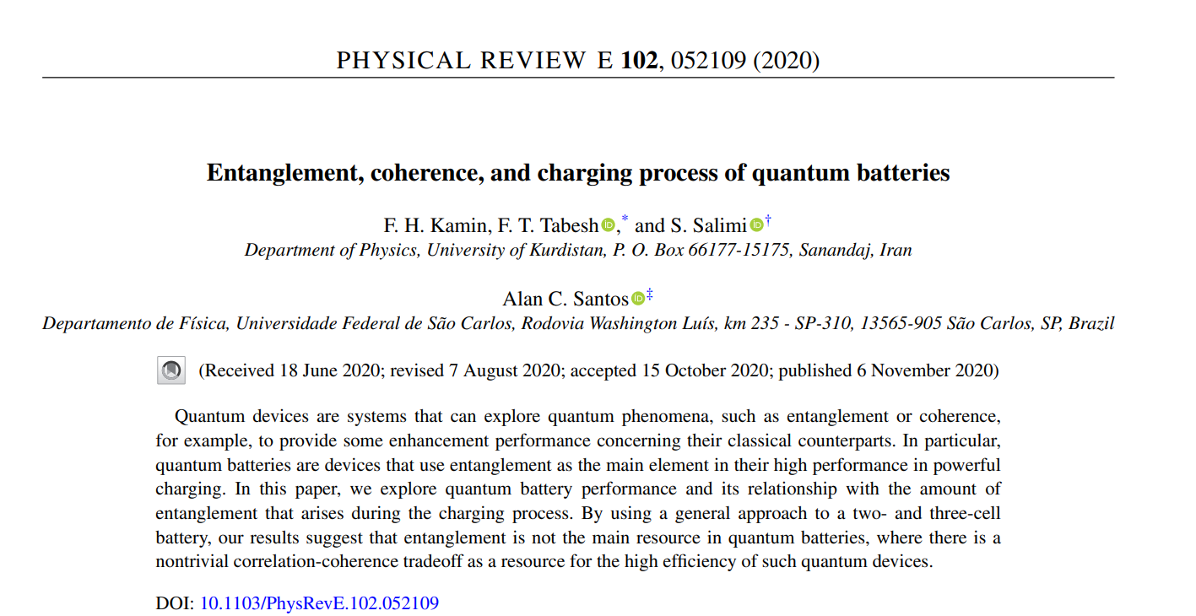

Slide 45
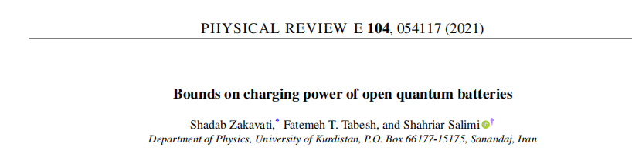
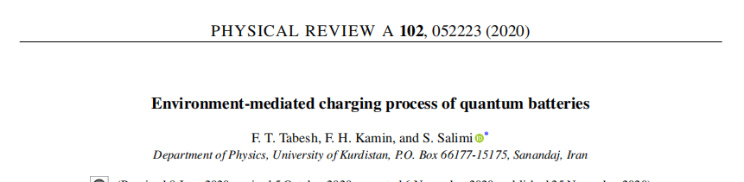
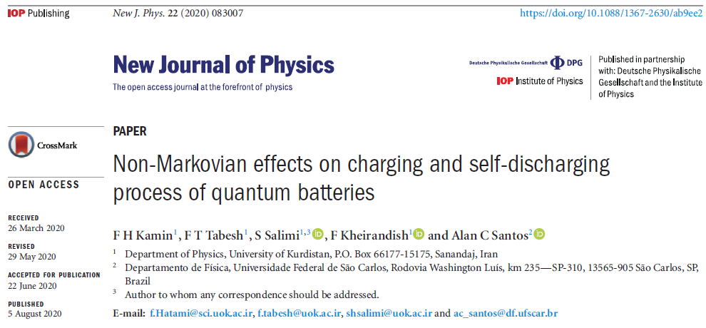

Slide 46
با سپاس

