Slide 1
بسم الله الرحمن الرحیم
دومین دوره همایش فناوری های نوظهور کوانتومی- دانشگاه صنعتی اصفهان
Gate-based superconducting quantum computing
(Circuit quantum electrodynamics)
محسن اکبری
خرداد 1402

Slide 2
Contents
Circuit quantum electrodynamics (QED)
History of Quantum
Why Quantum computer?
What is a Quantum Computer?
Quantum Superposition
Quantum Entanglement
Superconducting qubits
Coupling between resonator and qubit
Dispersive readout
Quantum gate
A quantum algorithm

Slide 3
History of Quantum

Slide 4
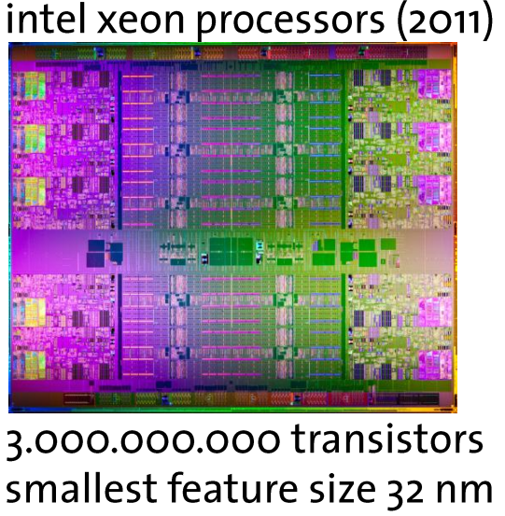
Usual computers and Quantum computer
Research on semiconductors based on First quantum revolution
Transistor
Moore’s Law,
The limits of energy resources for information processing,
The theoretical limits on the information processing power.
First transistor-based computers
The limits of usual computers:
The coherence of quantum states,
Quantum superposition,
Quantum entanglement.
Second quantum revolution
First Quantum computers

Slide 5
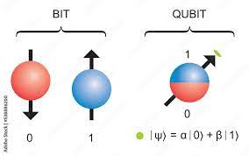
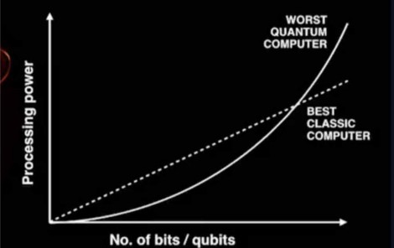
Comparison between Usual computer and Quantum Computer
Classical Computer
Quantum Computer
Bit
Quantum Bit
Transistor
Atom /Photon / Superconductor circuits / …
Compute Power: linear
Compute Power: exponential
Low error rate
High error rate

Slide 6
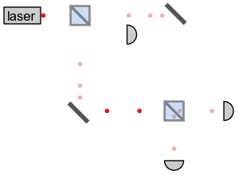
Quantum Superposition
50/50
آینه
چشمه تک-فوتون
50/50
مسیر 2
چشمه تک-فوتون
آشکارساز
مسیر 1
50%
100%
آشکارساز
آینه
50%
0%
آشکارساز
آشکارساز
تک-فوتون از کدام مسیر می رود؟
1- مسیر 1
2- مسیر 2
3- هم مسیر 1 و هم مسیر 2
4- نه از مسیر 1 و نه از مسیر 2
هیچ کدام از گزینه ها
؟ ؟ ! ! ! ! ! ؟ ؟
مسیر حرکت فوتون
(مسیر 2 ) ضریب ب + (مسیر 1 ) ضریب الف = برهم نهی کوانتومی

Slide 7
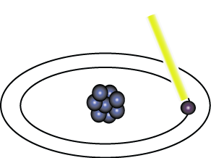
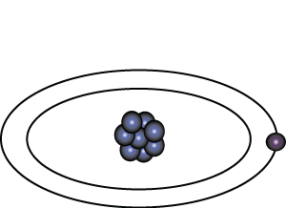
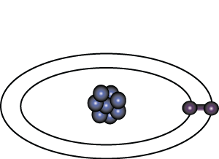
Quantum Superposition
Light pulse of frequency λ for time interval t
Excited State
Ground State
Nucleus
Electron
State |0>
State |1>
Light pulse of frequency λ for time interval t/2
State |0>
State |0> + |1>

Slide 8
Quantum Superposition
50/50
آینه
50/50
آینه
چشمه تک-فوتون
چشمه تک-فوتون
مسیر 2
مسیر 2
مسیر 1
بازوی بلند
مسیر 1
0%
100%
آشکارساز
آشکارساز
آینه
آینه
آشکارساز
0%
آشکارساز
100%

Slide 9
Quantum Entanglement
فاصله = 100 کیلومتر
شخص الف
50/50
شخص ب
آینه
چشمه جفت-فوتون
در هم تنیده
آشکارساز

Slide 10
Quantum Entanglement
فاصله = 100 کیلومتر
شخص الف
50/50
شخص ب
آینه
چشمه جفت-فوتون
در هم تنیده
بازوی بلند
آشکارساز

Slide 11
DiVincenzo's criteria for implementing a quantum computer

Slide 12
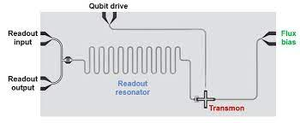
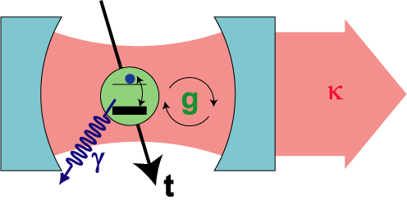
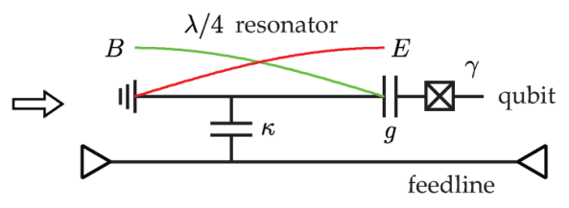
Definition Circuit quantum electrodynamics (QED)
Haroche, S., and J.-M. Raimond, 2006, Exploring the Quantum: Atoms, Cavities, and Photons (Oxford University Press, New York).
arXiv:2106.11352v1. 2021
Notes:
Circuit quantum electrodynamics inspired from atomic physics and quantum optics [1]:
Circuit quantum electrodynamics (QED) is the study of the interaction of nonlinear superconducting circuits, acting as artificial atoms or as qubits for quantum information processing, with quantized electromagnetic fields in the microwave-frequency domain.
Cooling
Temp. interaction

Slide 13
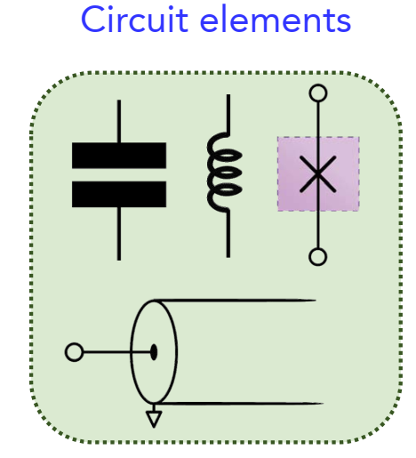
Circuit elements

Slide 14
A Qubit
To be a useful qubit:
(1) Proper operating frequency range
(2) Large an-harmonicity
(3) Long coherence time
(4) Ease of coupling (5) Ease of control
(6) Ease of fabrication
Notes:
A superconducting qubit is the two lowest energy eigenstates of an artificial atom made of a superconducting circuit.

Slide 15
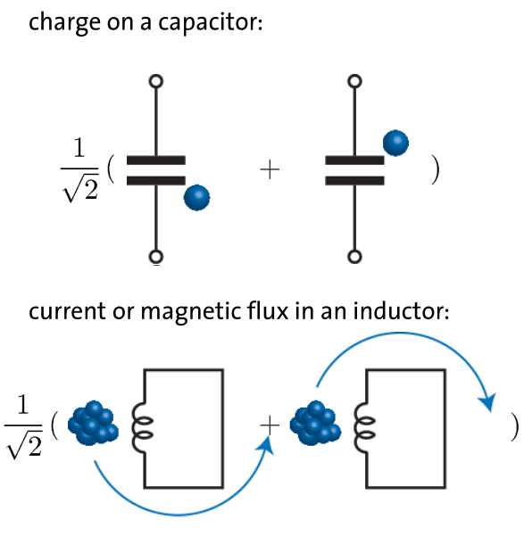
Superconducting qubits
Quantum superposition states of:
Superconducting qubits quantum state is manipulated by using electromagnetic pulses to control the magnetic flux, the electric charge or the phase difference across a Josephson junction.

Slide 16
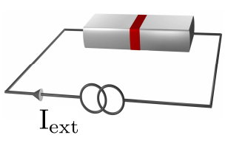
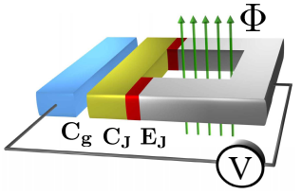
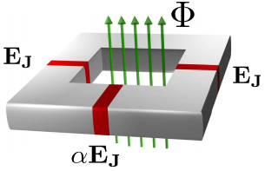
Superconducting qubits
Voltage-driven box
Flux-driven loop
Current-driven junction
You, J.Q. and Nori, F., 2011. Atomic physics and quantum optics using superconducting circuits. Nature, 474(7353), pp.589-597.

Slide 17
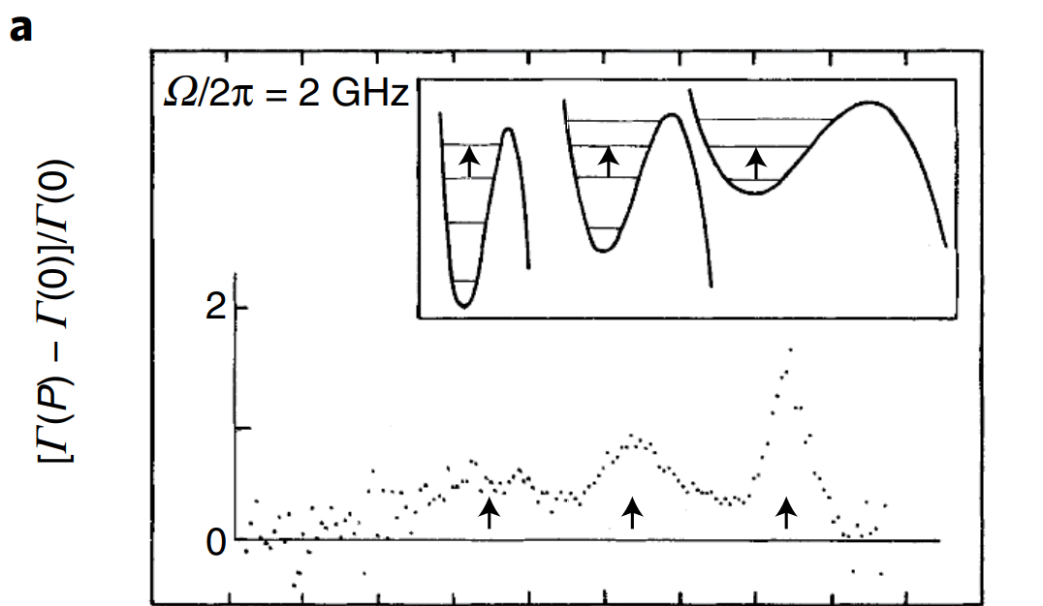
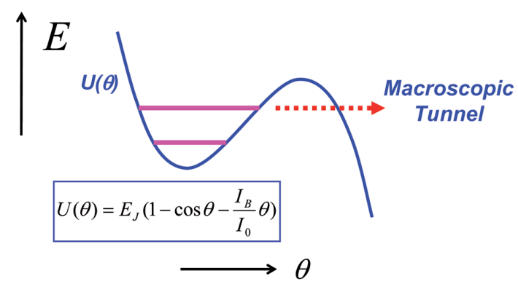
Quantum behavior in Josephson junction
In 1985 Experiment done by John Clarke, Michele Devoret and John Martinis reveal the quantum behavior in Josephson junction [1].
1. Devoret, M., Martinis, J., & Clarke, J. (1985) Physical Review Letters, 55(18), 1908-1911

Slide 18
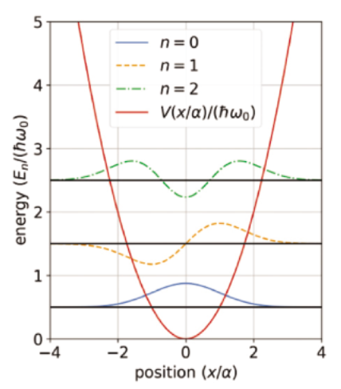
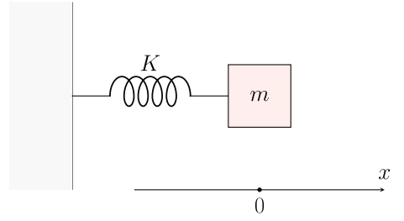
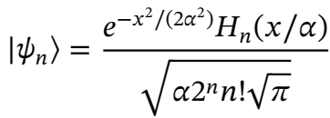
Harmonic Oscillator
Quantum Mechanical Harmonic Oscillator
Classical harmonic oscillator

Slide 19
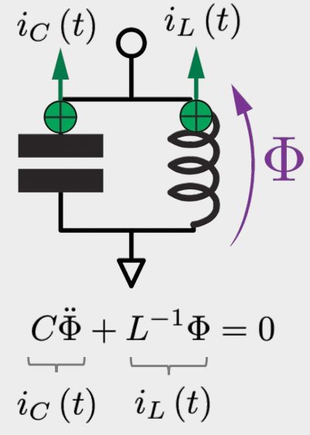
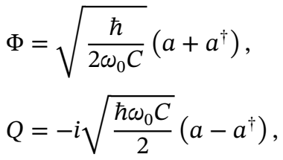
Classical LC Resonant Circuit
Euler-Lagrange equation of motion
Quantization of the LC Circuit
LC Circuit is Harmonic Oscillator.

Slide 20
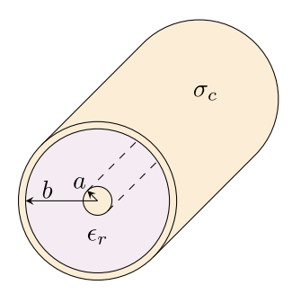
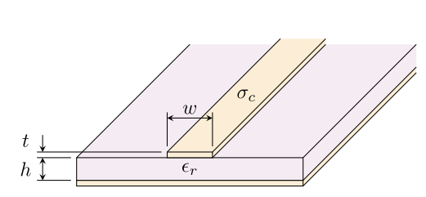
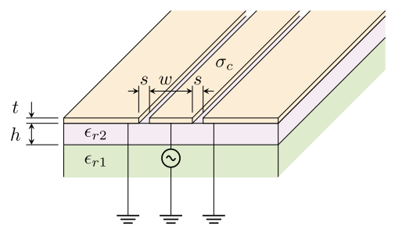
Transmission lines
Coaxial Lines
Microstrip Lines
Coplanar Waveguide
D. M. Pozar. Microwave Engineering. Addison-Wesley Publishing Company (1993).

Slide 21
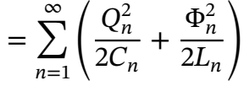
Circuit Model for Transmission Line Resonator
Lumped circuit model for an open-circuited section of transmission line of length N∆z = 𝓁.
Quantizing
single mode
D. M. Pozar. Microwave Engineering. Addison-Wesley Publishing Company (1993).

Slide 22
Can a Harmonic Oscillator Be Used as a Qubit?
The harmonic oscillator has an unlimited number of states with identical spacing

Slide 23
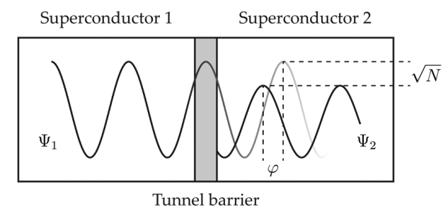
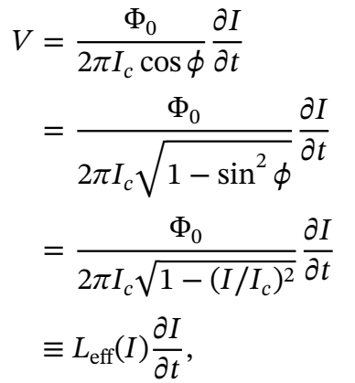
Josephson junction
The Josephson junction therefore looks like a non-linear inductor; i.e., an inductor whose value depends on the current through it.

Slide 24
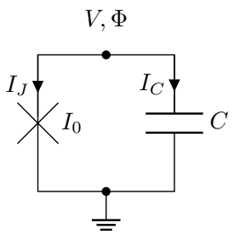
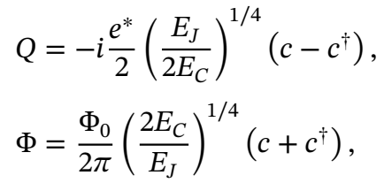
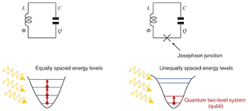
Josephson Junction Hamiltonian
Transmon qubit
Notes:
The difference in energy between adjacent transitions, 𝐸𝐶, is referred to as the anharmonicity.

Slide 25
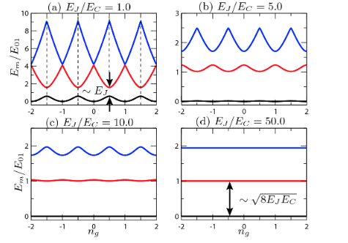
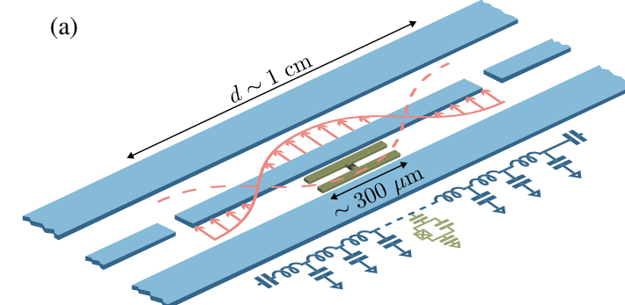
Transmon qubits
A transmon qubit.
Circuit for the fixed-frequency transmon qubit.
(c) Circuit for the flux tunable-frequency transmon qubit By using a SQUID.
The first three energy levels of the transmon Hamiltonian.
A. Blais, et al., Cavity quantum electrodynamics for superconducting electrical circuits: An architecture for quantum computation. Phys. Rev. A, 69 062320 (2004)

Slide 26
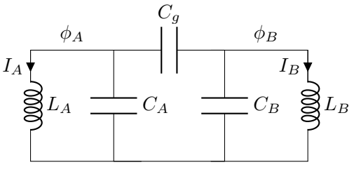
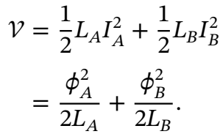
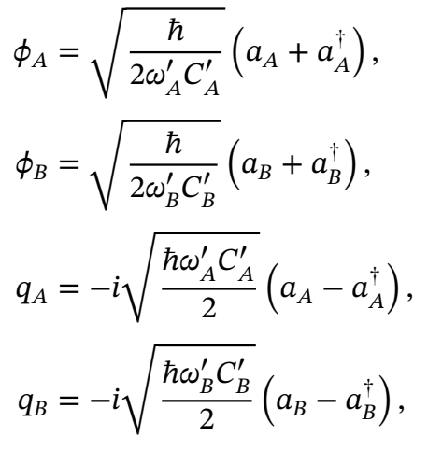
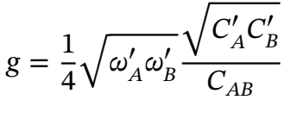
Quantized Coupled LC Resonant Circuits

Slide 27
Quantized Coupled LC Resonant Circuits: in interaction picture
The probability of finding the photon on a particular resonator to vary sinusoidally with time.
coupled-mode equations
When there is a finite probability for the photon to be on either resonator, the states |01⟩ and |10⟩ are entangled.
Notes:
Interaction picture may sound more complicated, we will see that it provides helpful simplifications in cases where we can divide a Hamiltonian up into two pieces where one piece describes a problem that can be exactly solved, while the other describes a small perturbation to this solvable problem.

Slide 28
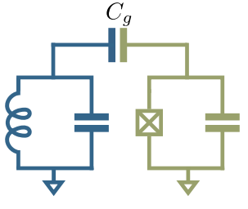
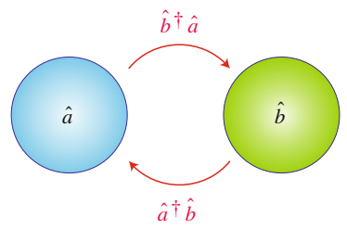
Resonant Circuits and Qubit
Coupling between a transmission line and a qubit
harmonic oscillator Hamiltonian
two state qubit Hamiltonian
Jaynes-Cummings Hamiltonian
Excitations are coherently swapped between the two systems.
A. Wallraff, et al,. Strong coupling of a single photon to a superconducting qubit using circuit quantum electrodynamics. Nature, 431 162 (2004)

Slide 29
Strong qubit–resonator coupling
cannot selectively detect or control the qubit state
near on-resonance
Why?
hybridizes the qubit and resonator states
strong qubit–resonator interaction
relaxation rate, i.e., the spectral linewidth of the qubit
Coupling strength
Loss rate of photons from the resonator, i.e., the spectral linewidth of the resonator

Slide 30
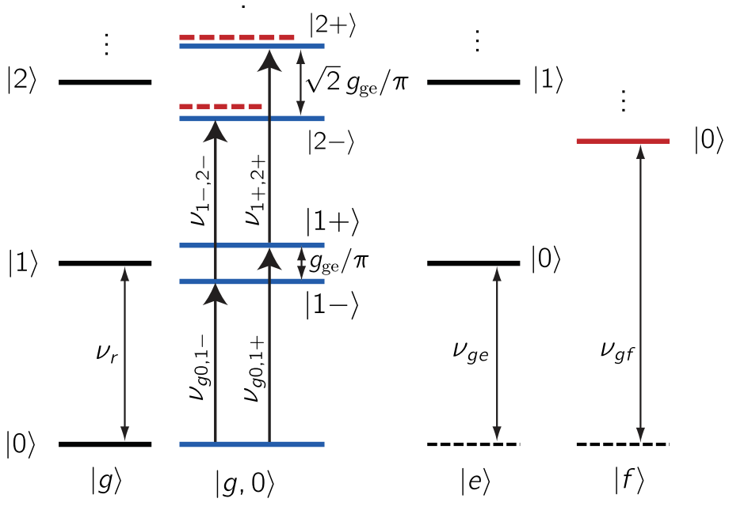
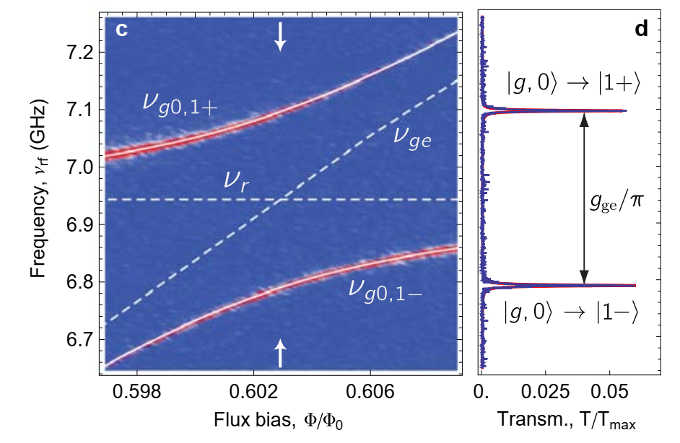
Strong qubit–resonator coupling
A. Blais, et al., Cavity quantum electrodynamics for superconducting electrical circuits: An architecture for quantum computation. Phys. Rev. A, 69 062320 (2004)

Slide 31
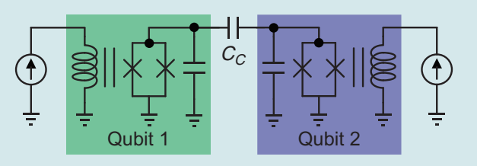
Coupling between two qubit
Two capacitively-coupled qubits
Strong qubit–qubit interaction for efficient two-qubit gate operation
J. Majer., et al., Coupling superconducting qubits via a cavity bus. Nature, 449 443 (2007)
Notes:
The strong transverse qubit–qubit coupling also yields a anticrossing.

Slide 32
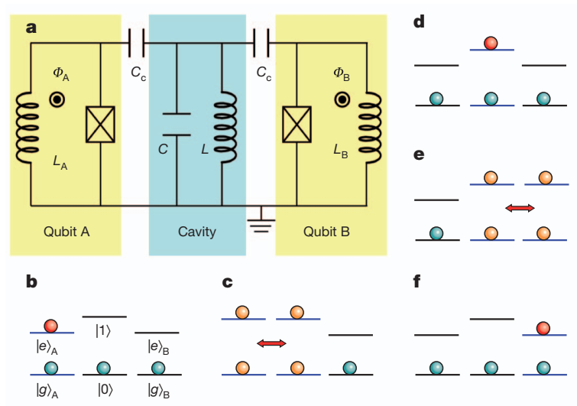
Transferring quantum information between two stationary qubits via a cavity
Shift qubit A off-resonance with the resonator
both qubits A and B are off-resonance with the cavity
superposition state
Qubit A is shifted into resonance with the resonator
ground states
Notes:
a, Schematic diagram of two flux-driven phase qubits capacitively coupled by an on-chip cavity (an LC resonator). b, Qubit A is prepared in a superposition state aj i g Azbj i e A, while both qubit B and the resonator are prepared in their ground states. In this step, both qubits A and B are off-resonance with the cavity. c, Qubit A is shifted into resonance with the resonator, for a time interval t1~p=2gA, with BgA being the interaction energy between qubit A and the resonator. This step maps the state of qubit A to the superposition state aj i 0 zbj i 1 of the resonator, where 0 j i and 1 j i are two Fock states of the resonator with zero and one photon, respectively. d, Shift qubit A off-resonance with the resonator again, and store the quantum information in the resonator for a time duration t2. e, Shift qubit B into resonance with the resonator for a time interval t3~p=2gB, where BgB is the interaction energy between qubit B and the resonator. This step maps the state of the resonator to the superposition state aj i g Bzbj i e B of qubit B. f, Shift qubit B off-resonance with the resonator again, and store the quantum information in qubit B. Note that a high-fidelity state transfer between qubits A and B can be implemented if both the relaxation and decoherence of the state are negligibly small during the above processes.

Slide 33
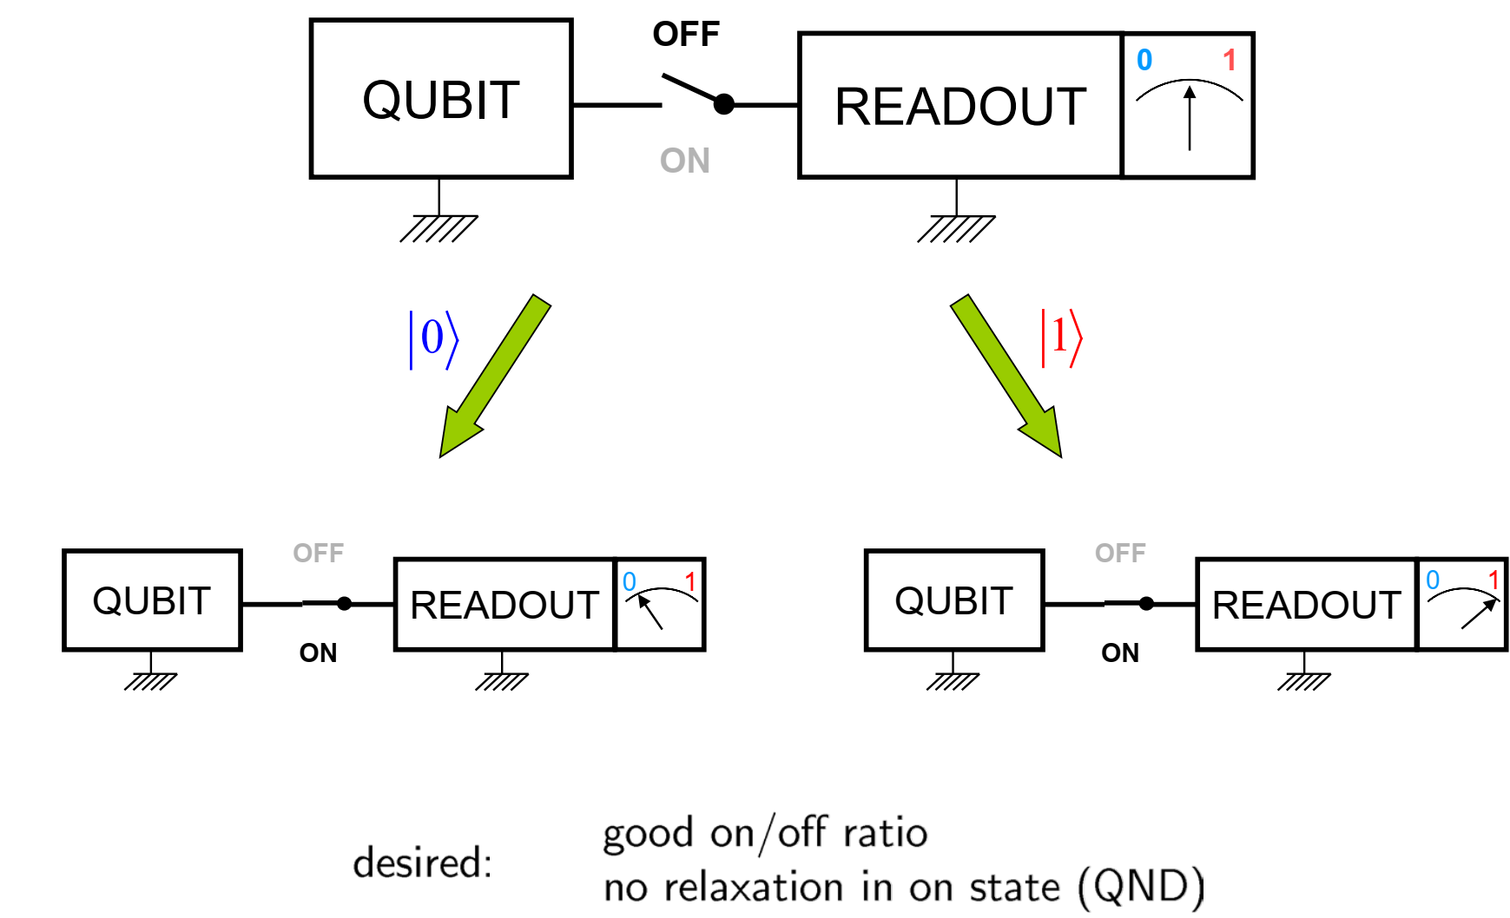
Measurements in circuit QED - Dispersive readout

Slide 34
Measurements in circuit QED - Dispersive readout
The qubit and resonator push each others’ frequencies
Unitary transformation Schrieffer-Wolff transformation.
A. Wallraff., et al, Approaching unit visibility for control of a superconducting qubit with dispersive readout. Phys. Rev. Lett., 95 060501 (2005).
Notes:
In a regime where the resonators are detuned

Slide 35
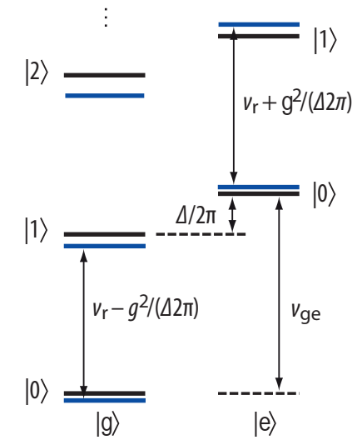
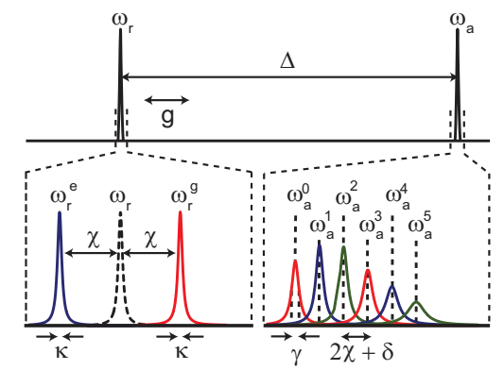
Measurements in circuit QED - Dispersive readout
AC Stark shift
Lamb shift
D. I. Schuster, et al. AC Stark shift and dephasing of a superconducting qubit strongly coupled to a cavity field. Phys. Rev. Lett., 94 123602 (2005) D. I. Schuster, et al,. Resolving photon number states in a superconducting circuit. Nature, 445 515 (2007).
Notes:
“Lamb shift’’: an amount proportional to the number of photons populating the resonator.
“ac-Stark shift”: It has the consequence that photon number fluctuations (noise) in the resonator induce small shifts of the qubit frequency: number splitting.
Advantages of dispersive readout are that (i) it does not rely on the dominant degree of freedom of a qubit, such as charge or flux, and (ii) its nondestructive nature.

Slide 36
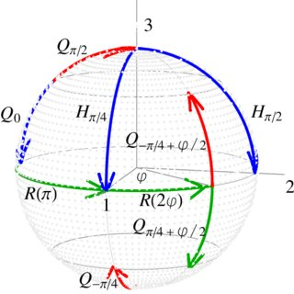
Quantum gate
Universal gate
Notes:
A quantum gate is a discrete control acting on qubits inducing the unitary evolution of the quantum states of the qubits.
Quantum computation is basically a series of quantum gate operations.

Slide 37
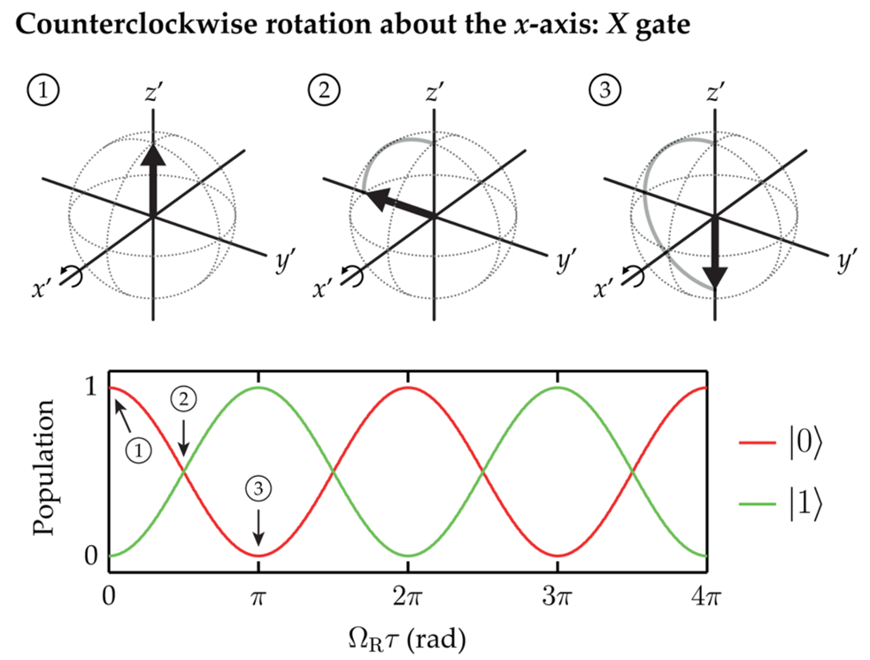
Single-qubit gate
A. Blais. Et al, Quantum-information processing with circuit quantum electrodynamics. Phys. Rev. A, 75 032329 (2007).

Slide 38
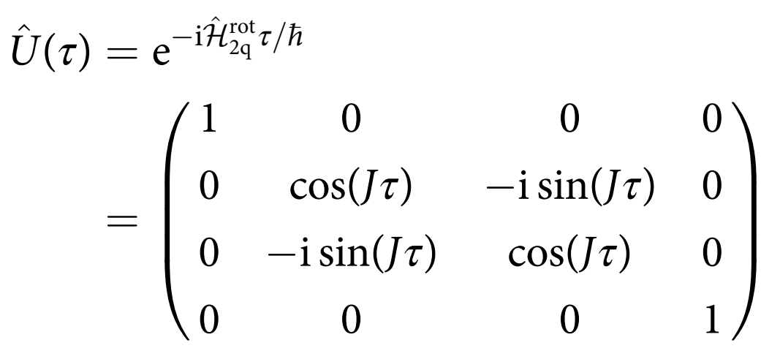
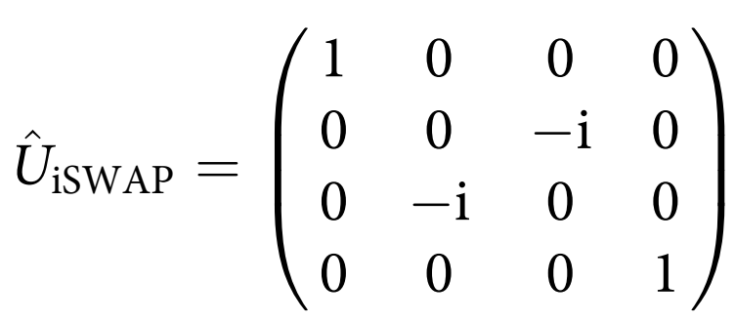
Two-qubit gate – iSWAP gate
The iSWAP gate swaps the populations of ket 10 and ket 01 with an additional phase factor -i.
L. DiCarlo,. Et al., Demonstration of two-qubit algorithms with a superconducting quantum processor. Nature, 460 240 (2009)
Notes:
The iSWAP gate relies on the frequency tunability of the qubit.

Slide 39
Two coupled classical harmonic oscillators without damping

Slide 40
Two-qubit gate - Parametric coupling
If modulate the coupling constant as:
the two qubits exchange their energy. This activates the transition between ket 01and ket 10.
iSWAP gate
we can activate the transition between ket 00 and ket 11.
bSWAP gate

Slide 41
Noise
Longitudinal relaxation time (T1) Transverse relaxation time (T2)
Thermalization of the qubit
absorption process

Slide 42
Measurement of T₁ , T₂ relaxation time

Slide 43
Diagram of a simple quantum algorithm

Slide 44
Quantum Computer
Wallraf group. ETH university, Switzerland
Notes:
A quantum computer is a machine that performs calculations based on the laws of quantum mechanics.
In order to achieve high fidelity state preparation we need be able to reliably initialize one of the two basis states, typically the ground state jgi. This can be achieved if the thermal occupation of the qubit is negligibly small such that kB T ¿ h”g,e.

Slide 45
پایان
سپاس از توجه شما

Slide 46
Non-Resonant Coupling for Qubit Readout
arXiv:2106.11352v1. 2021
Notes:
This frequency shift, called the dispersive shift, allows us to detect the qubit state by monitoring the S-parameters of the circuit.

Slide 47
Two coupled classical harmonic oscillators without damping
Notes:
The two oscillators do not interact with each other if f1 ≠ f2; however, if f1 =f2, the oscillators exchange their energy at a rate of 2δfκ0, whose quantity is determined by κ0. As shown by the Fourier-transformed solution, the energy exchange can be interpreted as a splitting of the resonance frequency with 2δfκ0.

Slide 48
Initialization
Two categories for qubit initialization
Entropy dumping
Measurement-based initialization
Purcell effect
Higher excitation level
pumping system
target system
Notes:
After computation, qubits should be initialized for the next computation, that fast initialization seem to be contradictory.
This method is to pump entropy of the target system to another system, which we call the pumping system, interacting with the target system. Here, the required condition is that the relaxation of the pumping system has to be much faster than that of the target system.
By using a frequency-tunable qubit, we can tune ωq to ωr to speed up the qubit relaxation process. Once the energy is emitted from the qubit to the resonator, the energy is quickly dissipated to the environment.
Hence, this method is useful for a transmon with the fixed qubit frequency. Note that we cannot induce a direct transition between ket e0 and ket g1 because this transition is forbidden when the qubit–resonator interaction is of the Jaynes–Cummings type.

Slide 49
Initialization
Notes:
One technical difficulty is that this method heavily relies on high-fidelity projective measurement and fast feedback. It can suffer from latency due to the classical data processing and the pulse generation and injection.
Note that, in this method, we reduce the entropy of the qubit by extracting information about its state. This suggests that information processing and thermodynamics are connected intrinsically.

