Slide 1
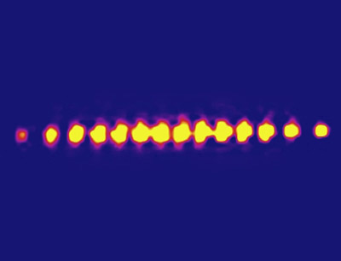
Quantum Logic of Trapped-ions at High-Temperatures Mahdi Sameti, Isfahan University of Technology

Slide 2
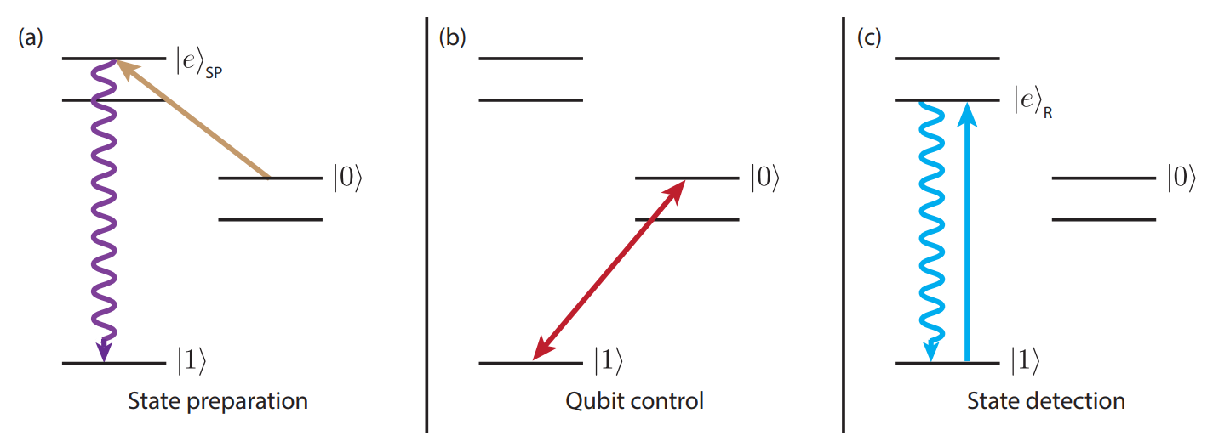
DiVincenzo Criteria for Quantum Computing
Well-defined two-level quantum states
Determinate initialization of the system
Universal set of single and two-qubit quantum gates
Qubit coherence times much longer than the gate times
Qubit readout with high-fidelity

Slide 3
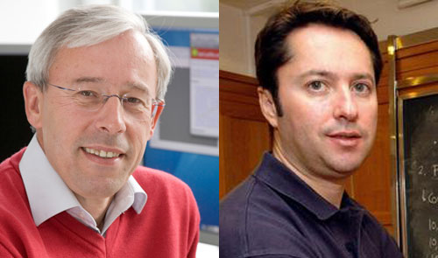
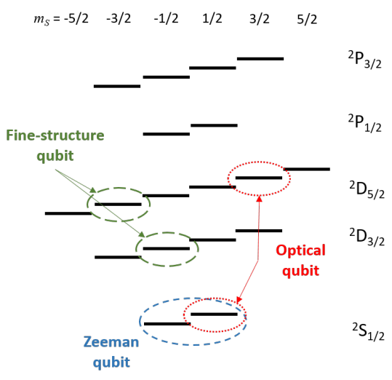
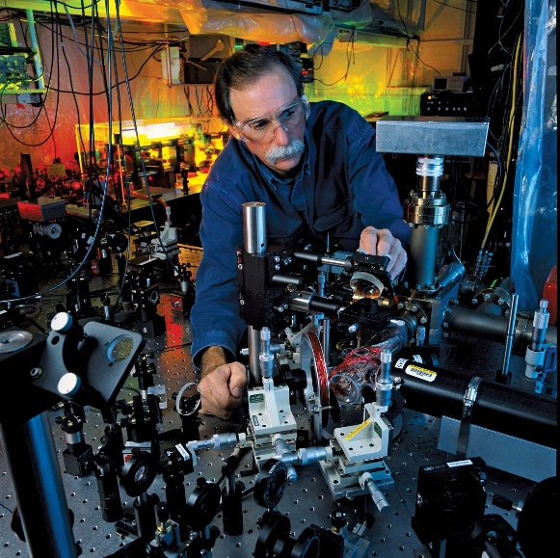
Trapped-Ion Quantum Computer
Information is encoded in the internal electronic states of ions
Ca⁺ Be⁺ Mg⁺
Sr⁺ Cd⁺ Ye⁺ Ba⁺
P. Zoller I. Cirac (1995)
D. Wineland (2012)

Slide 4
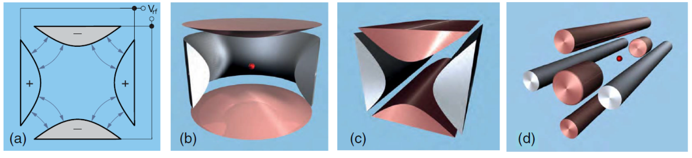
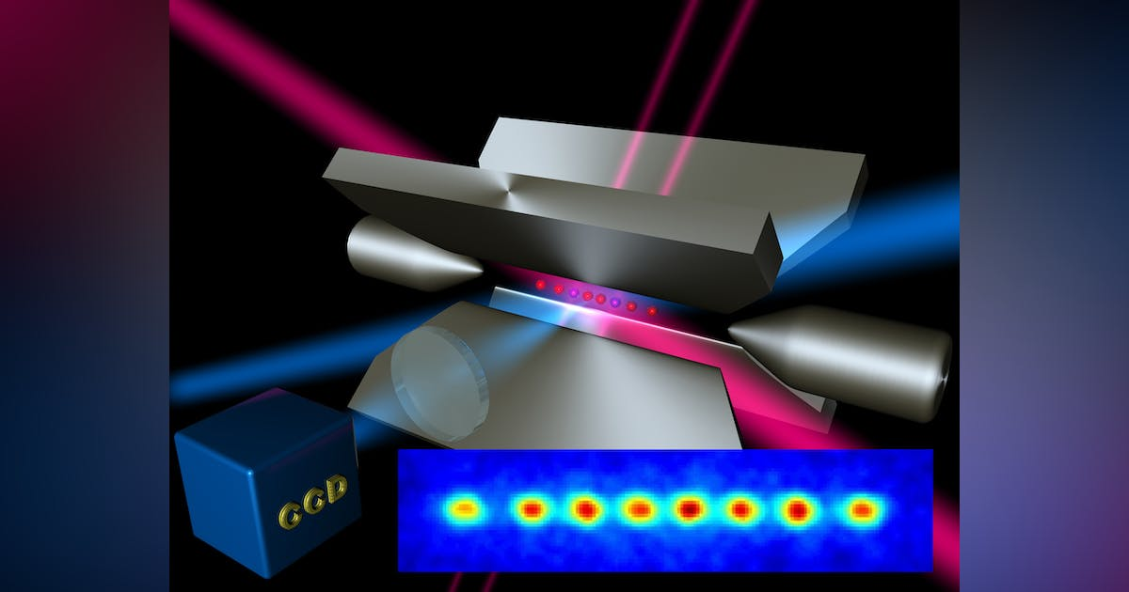
Trapped-Ion Quantum Computer
Ions are loaded inside a Paul trap

Slide 5
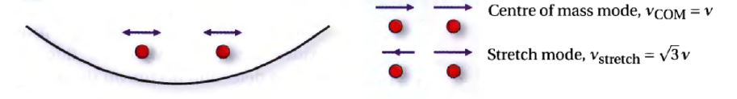
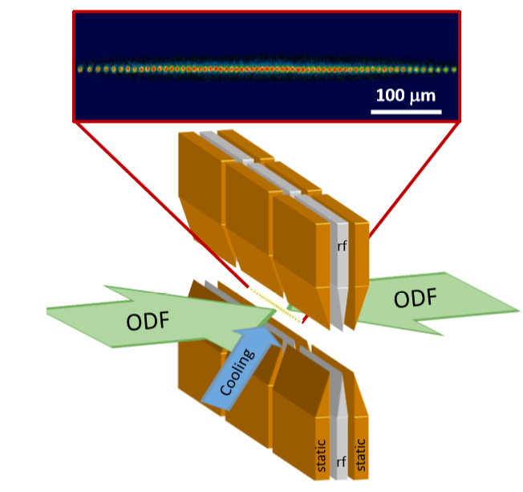
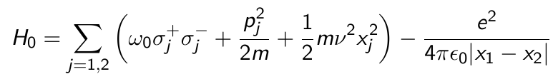

Trapped-Ion QC Hamiltonian
qubit mode
motional mode
Motional modes mediate interaction between qubits

Slide 6

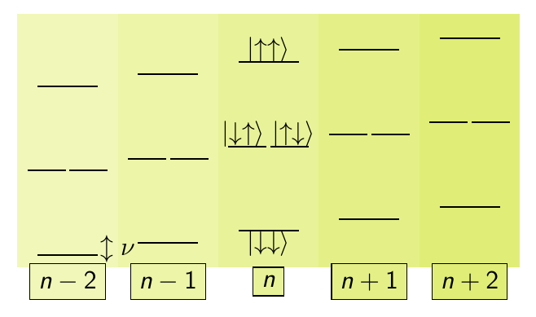
Trapped-Ion QC Hamiltonian
No interaction between qubits and motional modes yet!

Slide 7


Trapped-ion QC Hamiltonian
Laser-ion interaction
Hamiltonian in the interaction picture
Laser turns on interaction between motional modes and qubits
Lamb-Dicke parameter

Slide 8

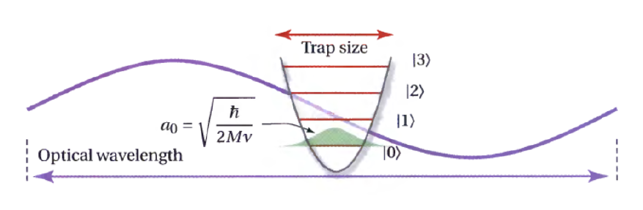



Lamb-Dicke Approximation
Lamb-Dicke Parameter
Lamb-Dicke regime
Linear approximation of the Hamiltonian
$$\overline{n}$$
Phonon occupation number

Slide 9
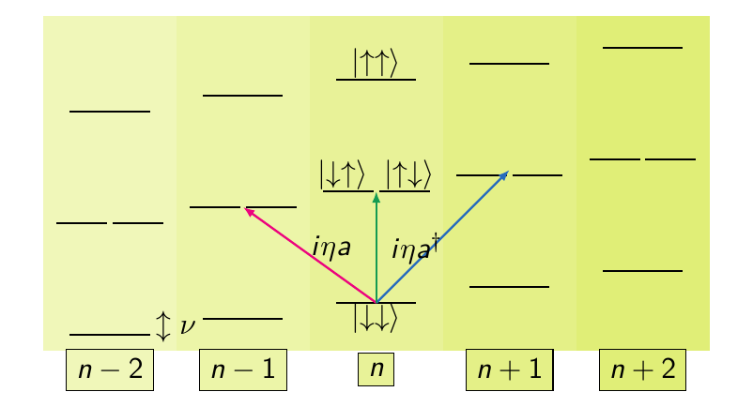
Linear Trapped-Ion Hamiltonian

Slide 10

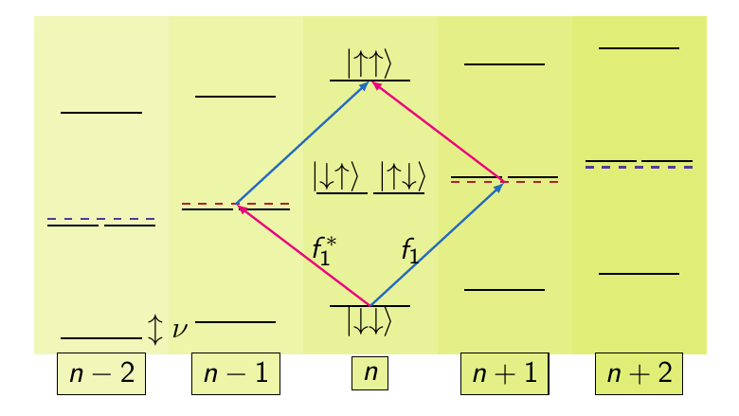
Molmer-Sorensen Entangling Two-Qubit Gate
Goal: To implement a high-fidelity maximally-entangling gate
Driving the Hamiltonian close to first red and blue sidebands
Exactly Solvable
Phys. Rev. Lett. 82, 1971 (1999), Phys. Rev. A 62, 022311 (2000)

Slide 11
Molmer-Sorensen Entangling Two-Qubit Gate
Entangled State preparation with perfect fidelity
Drawback: Weak interaction between qubit and motional modes,
slower gates and need for perfect cooling

Slide 12
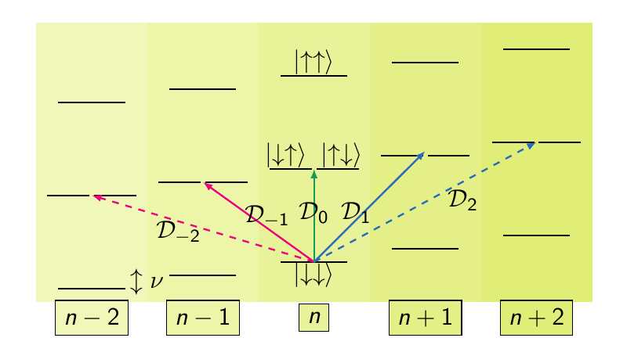
Back to the Nonlinear Hamiltonian
The exact Hamiltonian contains couplings to all higher-order sidebnds

Slide 13

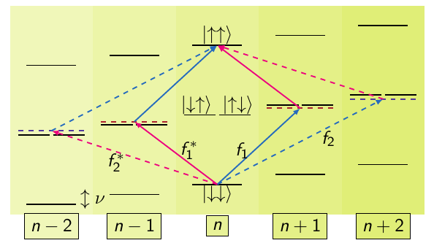
Ansatz for Driving Field
Sameti, Lishman and Mintert, Phys. Rev. A 103, 052603 (2021)

Slide 14


Multi-Sideband Driving Protocol
Driving ansatz
Resulting Hamiltonian
Corresponding Time-evolution

Slide 15
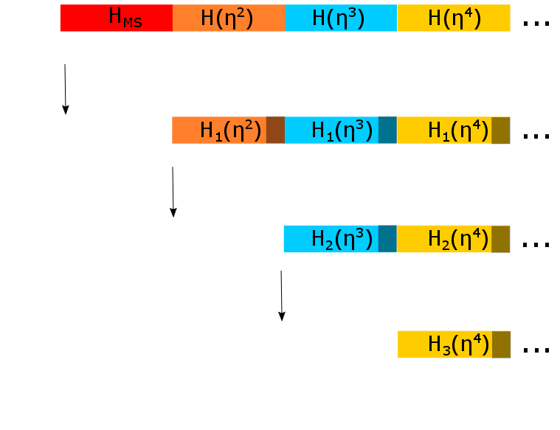



Derivation of Time-Evolution

Slide 16






Derivation of Time-Evolution
Define iteratively
Transformation of the Hamiltonian
Subsequent time-evolution
Truncate after d steps
MS time evolution operator
Only contains leading order terms
Exact to order

Slide 17


Gate Engineering
The generator of each time-evolution contains terms of the form
Except for all other terms are undesired and contribute to infidelity of the gate.
The coefficients of all the undesired terms should be set to zero at gate time T.
This gives a set of constraints on the fields in a functional form.

Slide 18


Solution with 2 and 3 Sidebands
2 sideband solution: the evolution is exact to the fourth-order
3 sideband solution: the evolution is exact to the fourth-order

Slide 19
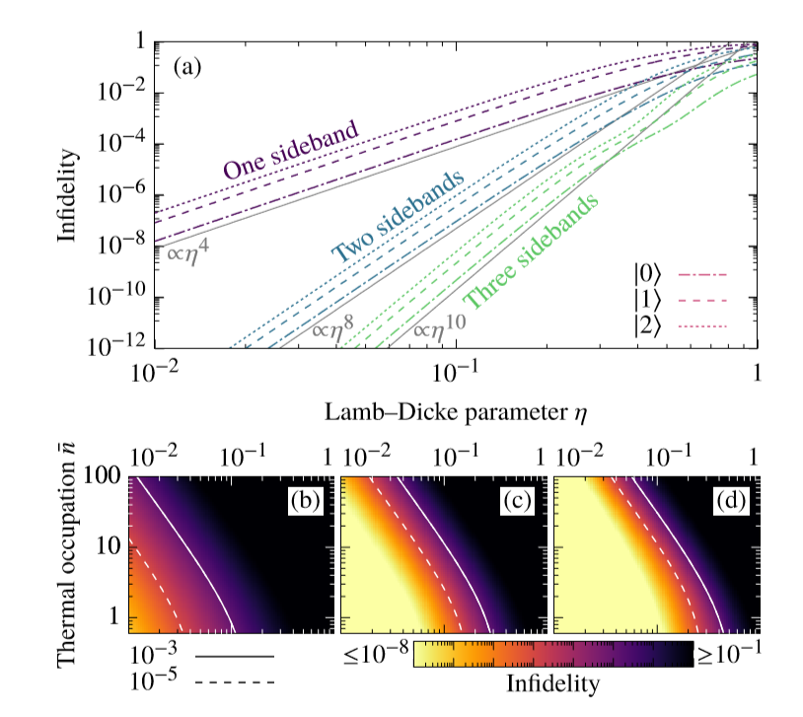
Fidelity Plot
Sameti, Lishman and Mintert, Phys. Rev. A 103, 052603 (2021)

Slide 20
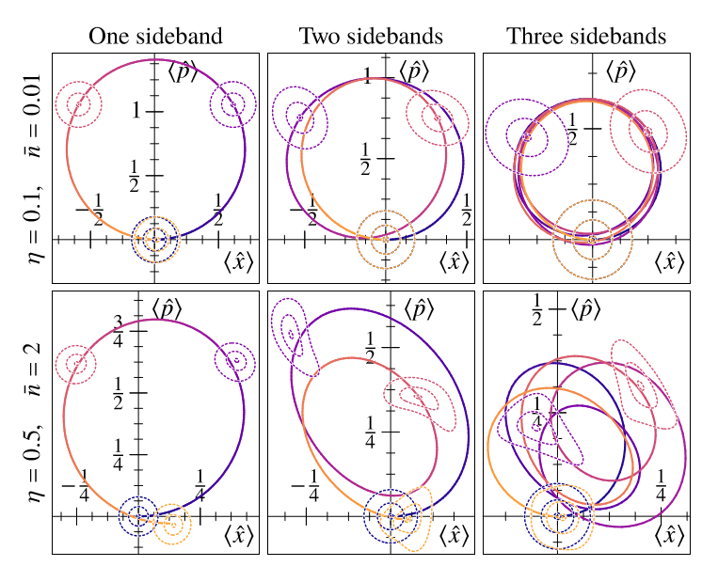
Phase-Space Plot
Sameti, Lishman and Mintert, Phys. Rev. A 103, 052603 (2021)

Slide 21
Conclusions and Outlook
A systematic and functional approach for derivation of nonlinear dynamics
A realistic scheme to implement ion-trap gates beyond LD regime: higher speed and higher temperature
Implementation of Toffoli and Fredkin quantum gates at high-temperatures.
Taking advantage of novel interaction at high-temperatures.

Slide 22


Thanks to
Jake Lishman
Prof. Florian Mintert

