Slide 1
پاسخ خطی سامانه‌های کوانتومی رانشی-اتلافی linear response of driven-dissipative quantum systems
علی دلفی
پژوهشکده لیزر و پلاسما
دانشگاه شهید بهشتی

Slide 2
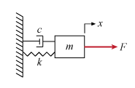
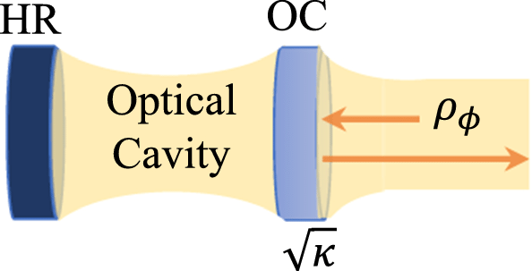
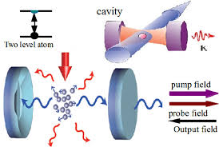
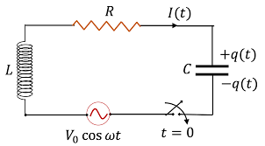
Driven Dissipative Systems

Slide 3
Some Important Quantum Phenomena
Normal Mode Splitting (NMS)
Electromagnetically Induced Transparency (EIT)
Fano Resonance
Optomechanically Induced Transparency (OMIT)
Optomechanically Induced Gain (OMIG)
Anti-resonance

Slide 4
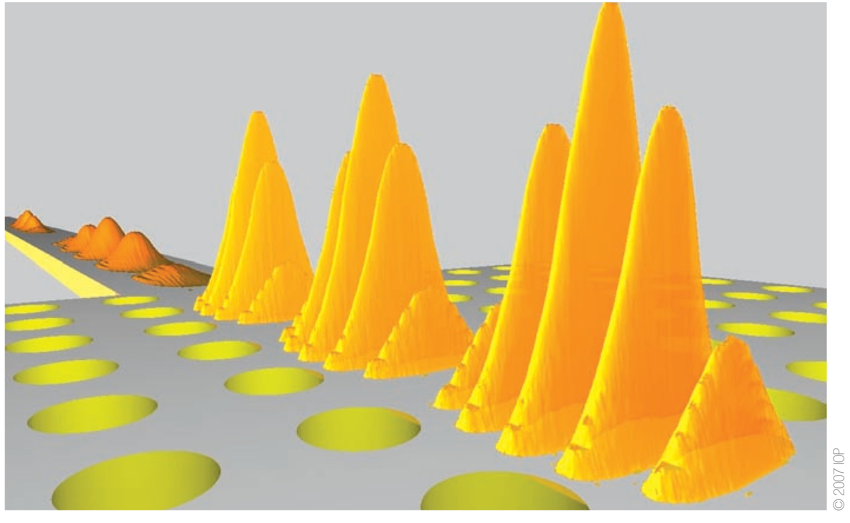
Applications in Quantum Technologies:
1- Slow Light Generation
Pulse Compression:
Enhancement of the efficiency of the nonlinear process by a factor of more than 10,000
[T. Krauss, “Why do we need slow light?” Nature Photonics 2, 448 (2008)]

Slide 5
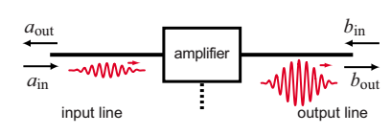
Applications in Quantum Technologies:
2- Gain and Quantum Linear Amplifiers
[A. A. Clerk, M. H. Devoret, S. M. Girvin, F. Marquardt, and R. J. Schoelkopf,” Introduction to quantum noise, measurement, and amplification ”, Rev. Mod. Phys. 82, 1155 (2010). ]

Slide 6
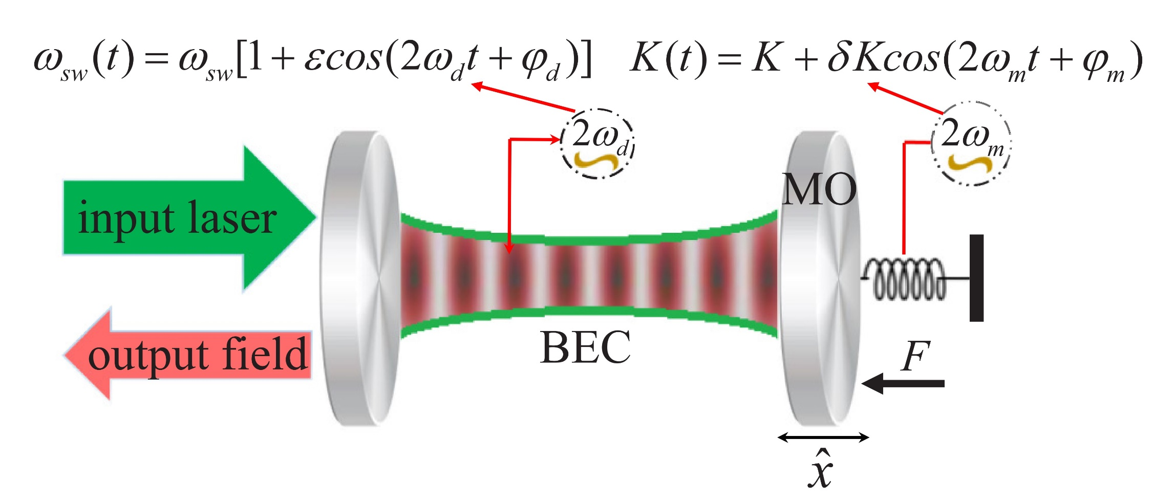
Applications in Quantum Technologies:
3-Ultraprecision Quantum Sensors
[Motazedifard, A., Dalafi, A. & Naderi, M. H. “Ultraprecision quantum sensing and measurement…”. AVS Quant. Sci. 3, 024701 (2021). ]

Slide 7
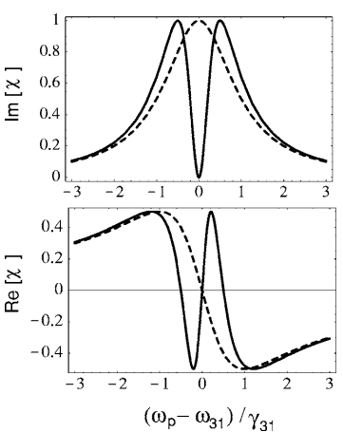
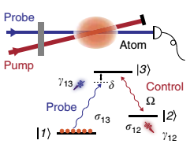
Electromagnetically Induced Transparency (EIT)
[Peng, B., Özdemir, ŞK., Chen, W., Nori, F. & Yang, L. “What is and what is not electromagnetically induced transparency in whispering-gallery microcavities” Nat. Commun. 5, 1–9 (2014). ]

Slide 8
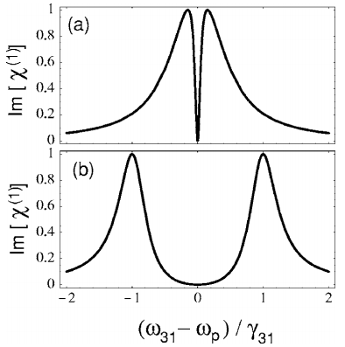
Normal Mode Splitting (NMS)
[Fleischhauer, M., Imamoglu, A. & Marangos, J. P. Electromagnetically induced transparency: Optics in coherent media. Rev. Mod. Phys. 77, 633 (2005) ]

Slide 9
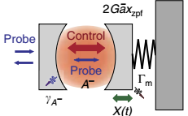
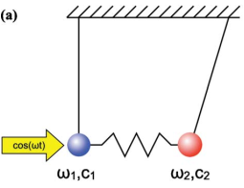
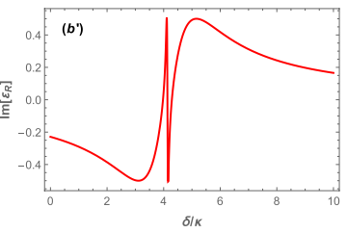
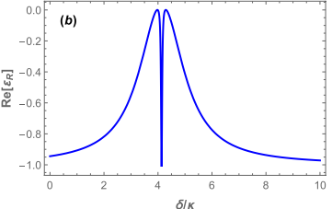
Optomechanically Induced Transparency (OMIT)
[W. P. Bowen and M. G. J. Milburn, “quantum optomechanics”, CRC Press 2016.]

Slide 10
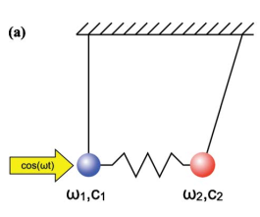
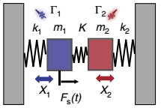
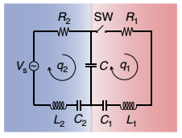
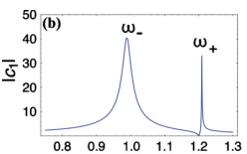
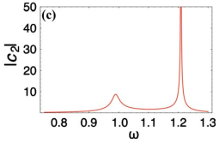
Classical Analogy
[Y.S Joe, A. M. Satanin, and C. S. Kim,” Classical analogy of Fano resonances” S 2006 Phys. Scr. 74 259 (2006)]

Slide 11
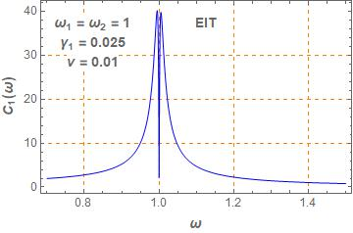
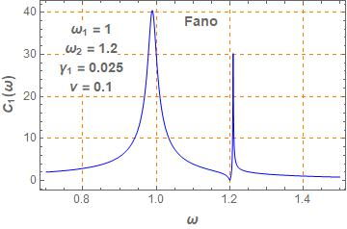
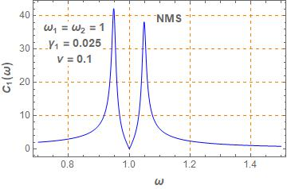

Slide 12
Driven- Dissipative Quantum systems
(Driven Open Quantum Systems)
Quantum Vacuum Fluctuations (Quantum Noise)
R
Damping of the system
H. J Carmichael, “Statistical Methods in Quantum Optics 1”, Springer-Verlag Berlin Heidelberg 1999.]

Slide 13
Dynamics of Open Quantum Systems
Master Equation Approach (The Schrödinger Picture)
Heisenberg-Langevin Approach (The Heisenberg Picture)
[M. O. Scully and M. S. Zubairy, “quantum optics”, Cambridge 1997.]

Slide 14
Generalized Linear Response Theory (GLRT)
[Ali Motazedifard, A. Dalafi, M.H Naderi, ”A Green’s function approach to the linear response of a driven dissipative OMS”
J. Phys. A: Math. Theor. 54 215301 (2021)]

Slide 15
OMS as a driven-dissipative system
$H_{OMS}=ℏω_{0}a^{†}a+ℏω_{m}b^{†}b+ℏg_{0}a^{†}a\left(b+b^{†}\right)+ℏη\left(ae^{+iω_{c}t}+a^{†}e^{−iω_{c}t}\right)$
$$+ℏ\left(ζae^{+iω_{p}t}+ζ^{∗}a^{†}e^{−iω_{p}t}\right)$$
In the frame rotating at coupling laser frequency
$$H→U^{†}(t)HU(t)−iU^{†}(t)\dot{U}(t), U(t)=e^{−iℏω_{c}ta^{†}a}$$
$$H_{OMS}=ℏΔ_{c}a^{†}a+ℏω_{m}b^{†}b+ℏg_{0}a^{†}a\left(b+b^{†}\right)+ℏη\left(a+a^{†}\right)$$
$$+ℏ\left(ζae^{+iω_{pc}t}+ζ^{∗}a^{†}e^{−iω_{pc}t}\right)$$
$$Δ_{c}\text{=}ω_{0}−ω_{c}$$
$$ω_{pc}\text{=}ω_{p}−ω_{c}$$
[W. P. Bowwn and M. G. J. Milburn, “quantum optomechanics”, CRC Press 2016.]

Slide 16
Linear response of an OMS
[Ali Motazedifard, A. Dalafi, M.H Naderi, ”A Green’s function approach to the linear response of a driven dissipative OMS”
J. Phys. A: Math. Theor. 54 215301 (2021)]

Slide 17
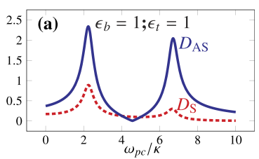
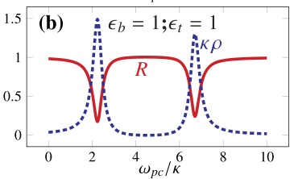
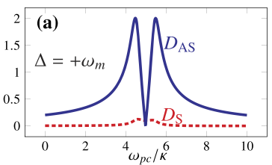
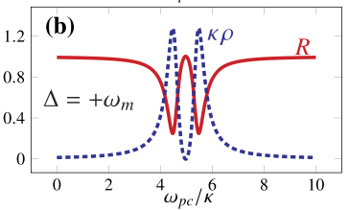
Spectral Function (Density of States)
NMS
OMIT
[Ali Motazedifard, A. Dalafi, M.H Naderi,”A Green’s function approach to the linear response of a driven dissipative OMS”
J. Phys. A: Math. Theor. 54 215301 (2021)]

Slide 18
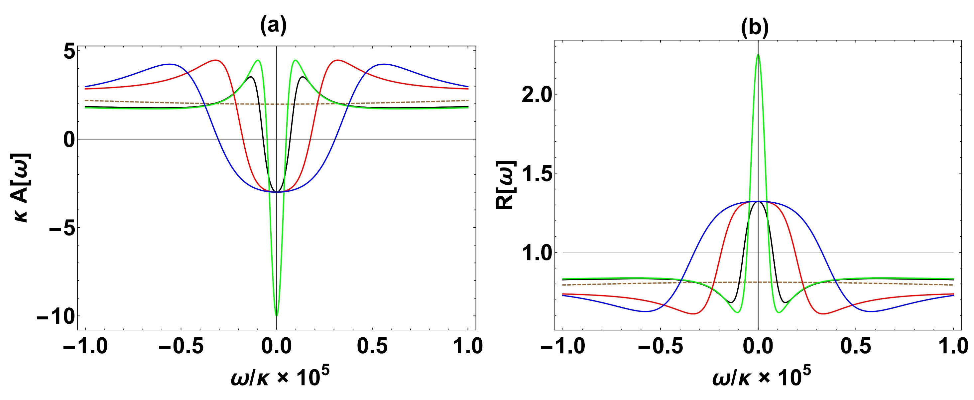
Negative Spectral Function and OMIG
[Ali Motazedifard, A. Dalafi, M.H Naderi,” Negative cavity photon spectral function in an optomechanical system with two parametrically-driven mechanical oscillators” To be submitted]

Slide 19
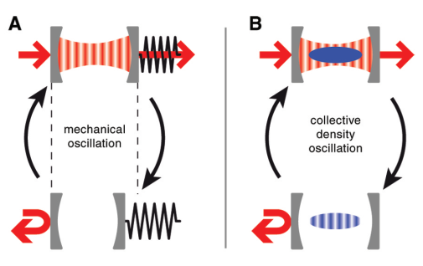
Hybrid OMS consisting of BEC
[Brennecke, F., Ritter, S., Donner, T. & Esslinger, T., Science 322, 235–238 (2008).]

Slide 20
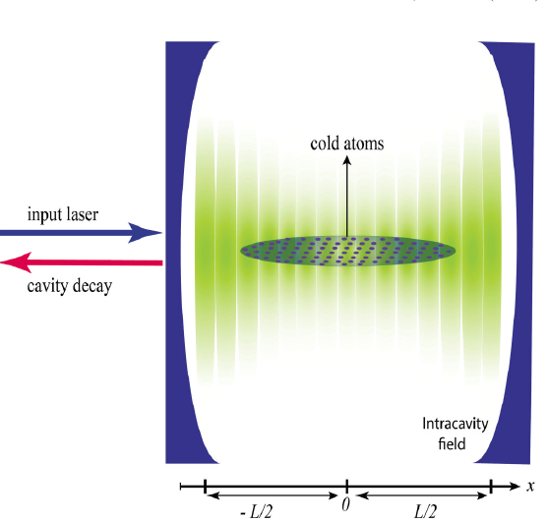
Realization of optomechanical coupling in
hybrid OMS consisting of BEC
[A. Dalafi, M. H. Naderi, M. Soltanolkotabi, and Sh. Barzanjeh, Phys. Rev. A 87, 013417 (2013).]

Slide 21
Realization of Atomic Parametric Amplifier
Degenerate Optical Parametric Amplifier
DOPA
[A. Dalafi, M. H. Naderi, and M. Soltanolkotabi, J. Mod. Opt.46, 235502 (2013).]

Slide 22
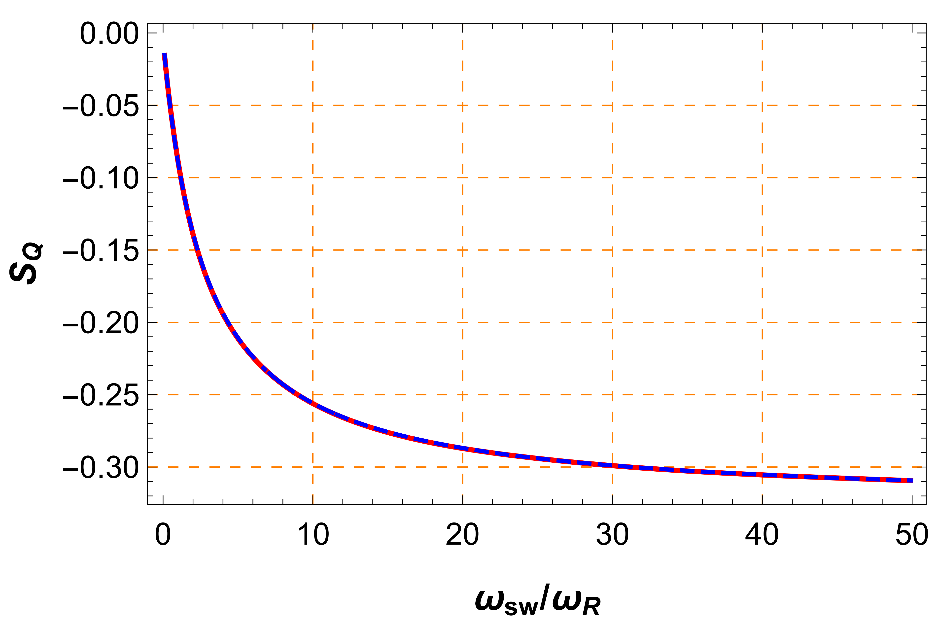
Generation of Squeezing in the atomic mode
[A. Dalafi, M. H. Naderi, Phys. Rev. A 95, 043601 (2017).]

Slide 23
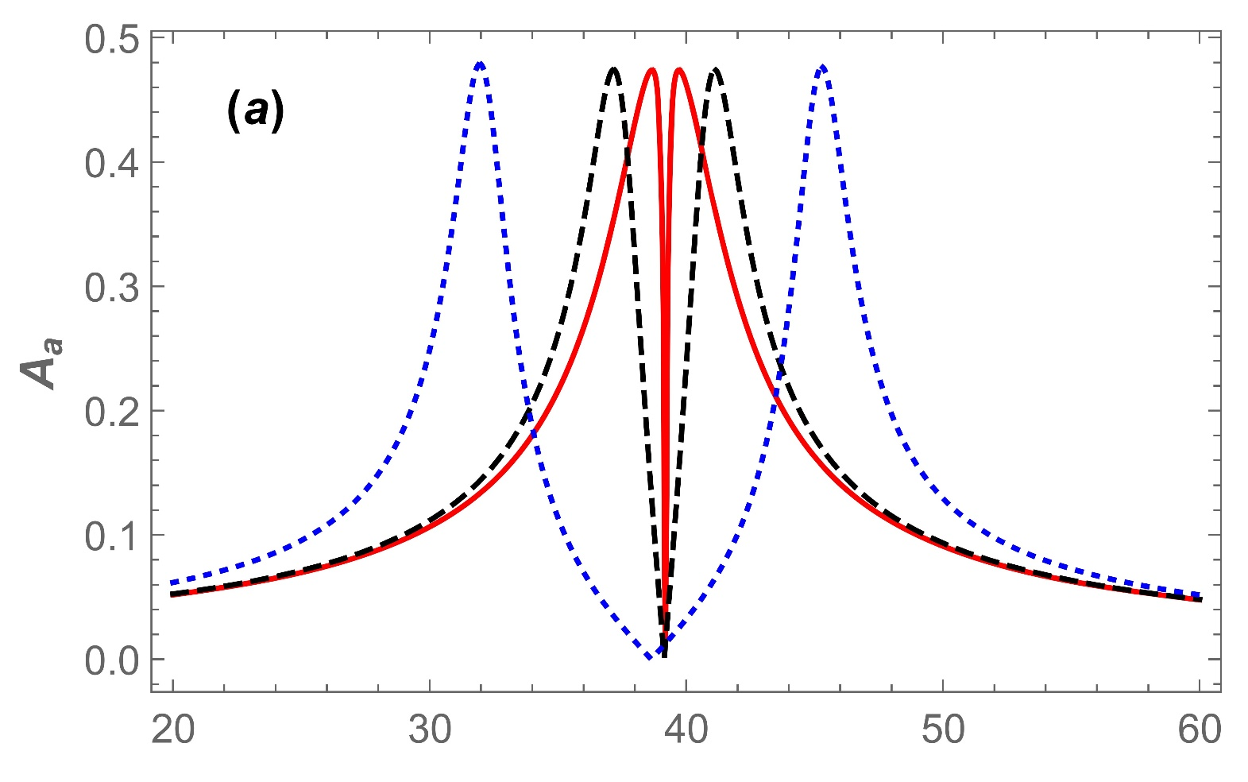
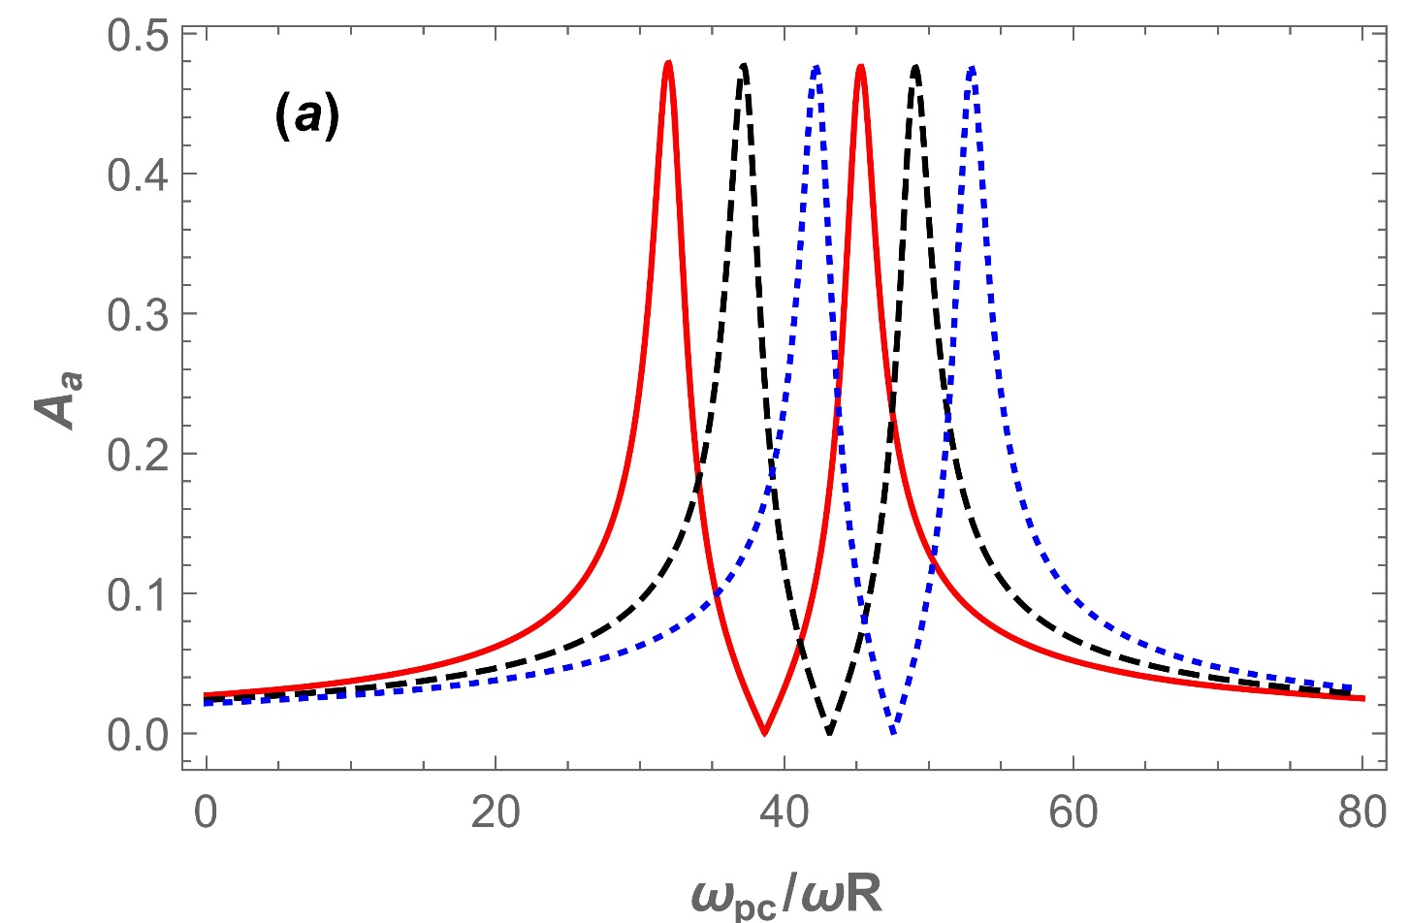
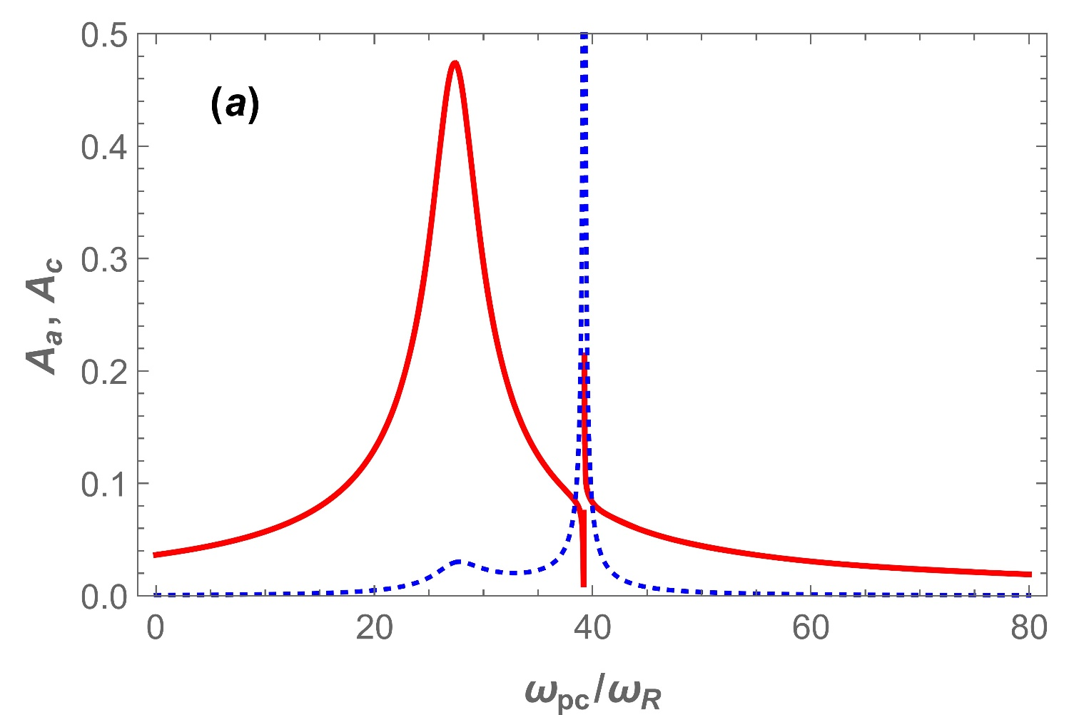
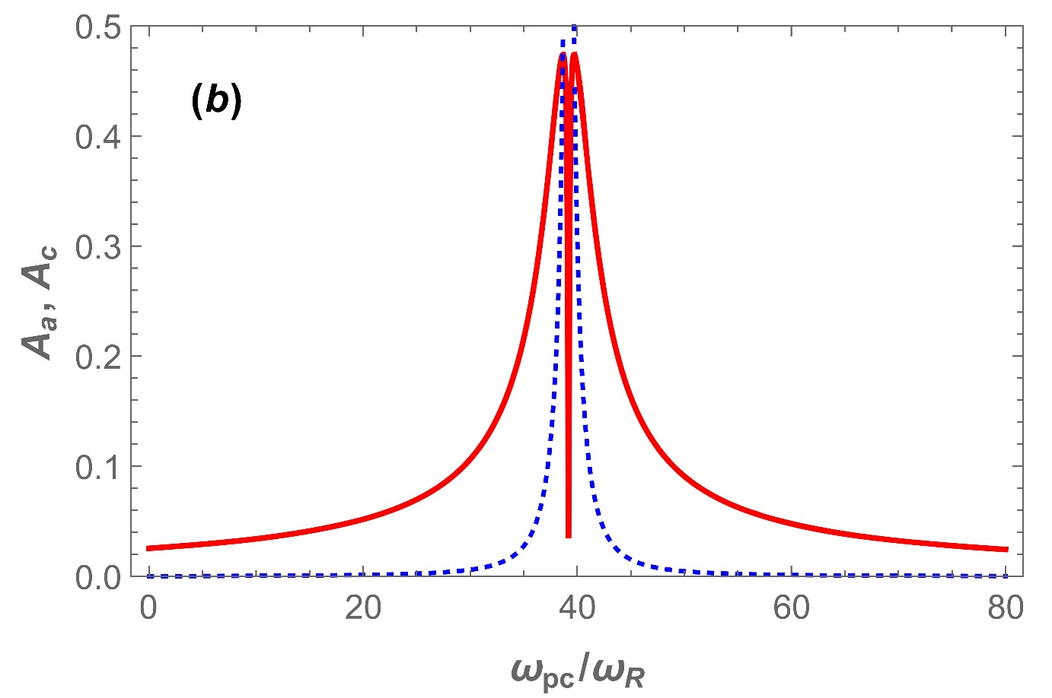
OMIT, NMS & Fano Resonance in Hybrid OMS
[B. Askari , and A. Dalafi,” Dynamics of a hybrid optomechanical system in the framework of the generalized linear response theory ”,
J. Phys. A: Math. Theor. 55 035301 (2022) .]

Slide 24
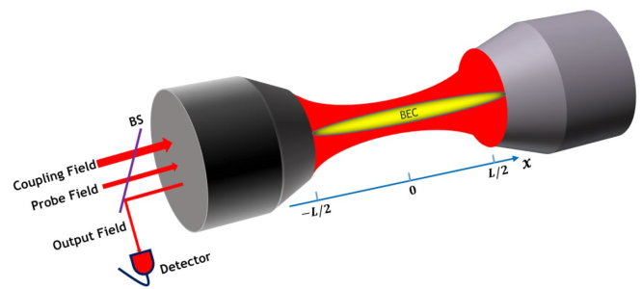
Ultraslow Light in Hybrid OMS Consisting of BEC
Realization of an ultraslow light with a group velocity about 1 mm/s
[H. Mikaeili, A. Dalafi, M. Ghanaatshoar & B. Askari, ,”Ultraslow light realization using an interacting Bose–Einstein condensate trapped in a shallow optical lattice”, Sci. Reports 12, 1–10 (2022).]

Slide 25
OMIG in hybrid OMS consisting of BEC
Realization of an optical transistor with a gain as large as ${10}^{8}\%$
In the URSBR, where $ω_{m}<κ$
[H. Mikaeili, A. Dalafi, M. Ghanaatshoar & B. Askari, ,”Optomechanically induced gain using a trapped interacting Bose‑Einstein condensate ”, Sci. Reports 13, 3659 (2023).]

Slide 26
Thanks for your attention!

