Slide 1


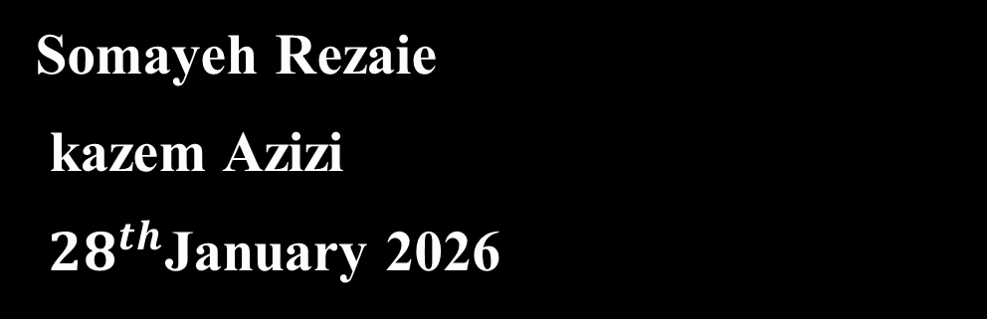
The nuclear transverse momentum dependent parton distribution functions of the MRW method
16th Conference on Particle and Field Physics
Somayeh Rezaie
kazem Azizi
${ 28}^{th}$January 2026

Slide 2

Introduction

Slide 3
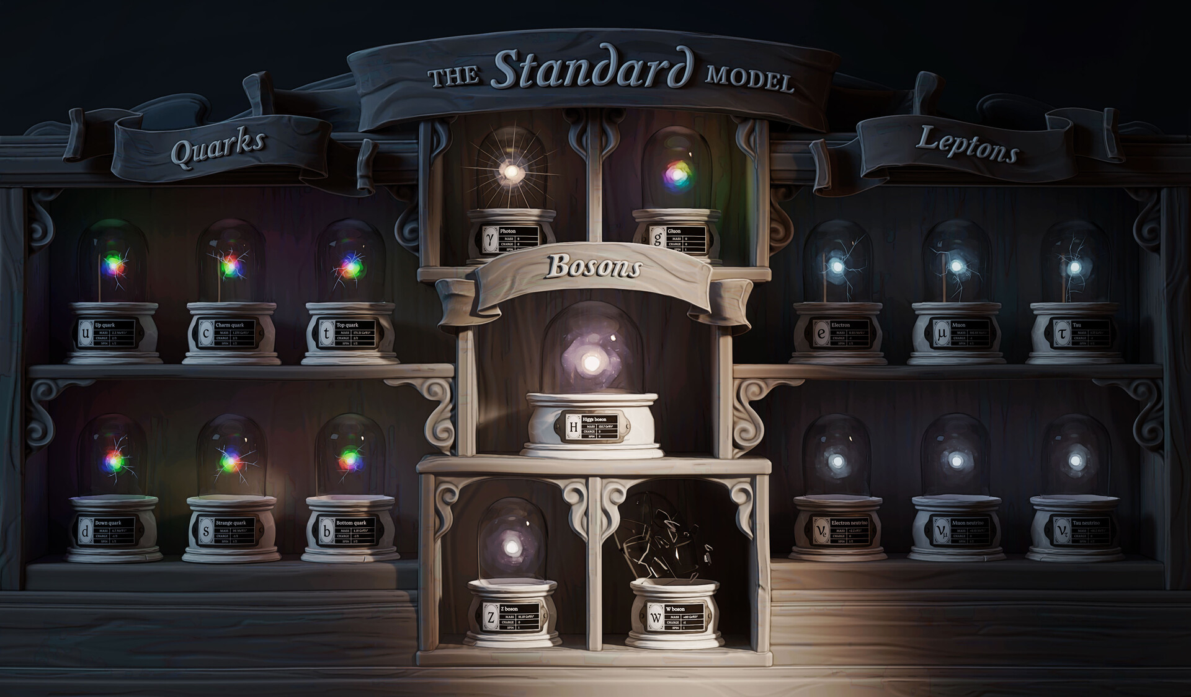

Slide 4
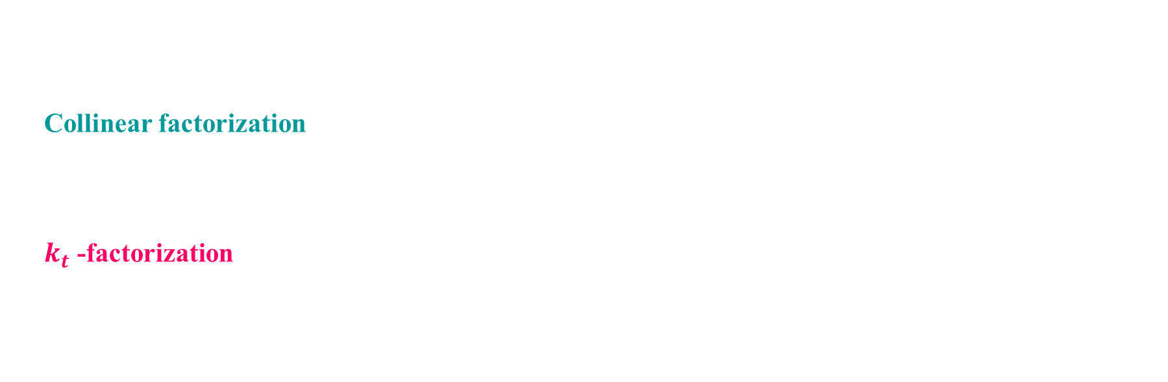
Factorization Theorem
Factorization Theorem: Factorization means the ability to separate a hadronic cross section into the convolution of parton distribution functions (PDFs) and partonic cross section.
1. Collinear factorization: This framework assumes the elementary constituents of the hadrons, partons (quarks and gluons), move collinear to the hadron, i.e. : In this framework for hadronic cross section one needs what we call collinear PDFs.
2. $k_{t}$ -factorization: This framework assumes the elementary constituents of the hadrons also have transverse momentum in addition to the momentum along the hadron, i.e.: . In this framework for hadronic cross section needs Transverse Momentum Dependent PDFs (TMD-PDFs) or Unintegrated Parton Distribution Functions (UPDFs).

Slide 5
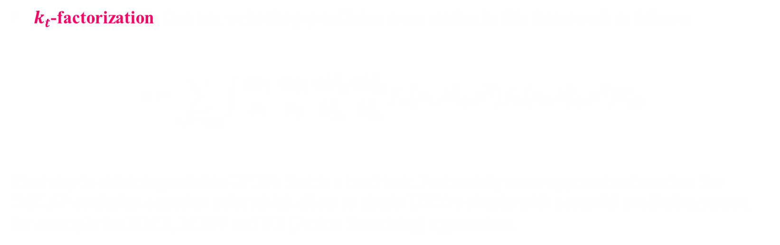
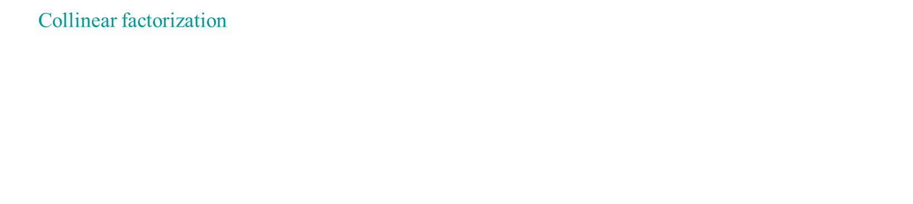

${\text{Collinear} \text{@} k}_{t}$-Factorization Frameworks
Collinear factorization : in the collinear factorization, it is assumed that the parton moves collinear to the proton and enters into the hard collision. One can write the p-p collision cross section in this framework as follows :
$$σ=\sum_{i,jεq,g}{\int{\frac{dx_{1}}{x_{1}}}} \frac{dx_{2}}{x_{2}}{ f}_{i}\left(x_{1},μ^{2}\right){ f}_{j}\left(x_{2},μ^{2}\right){\hat{σ}}_{ij}$$
$k_{t}$-factorization: One can write the p-p collision cross section in this framework as follows:
$$σ=\sum_{a,b=q, g}{\int{\frac{\text{d}x_{1} }{x_{1}}\frac{\text{d}x_{2} }{x_{2}}\frac{\text{d}k_{1t}^{2}}{k_{1t}^{2}}\frac{\text{d}k_{2t}^{2}}{k_{2t}^{2}}f_{a}\left(x_{1},k_{1t}^{2},μ^{2}\right)}}f_{b}\left(x_{2},k_{2t}^{2},μ^{2}\right){\hat{σ}}_{ab}^{∗}$$
First step is obtaining suitable UPDFs that is a hard task. Fortunately some approaches based on the DGLAP evolution equation exist which allow to obtain UPDFs simply with powerful predicting power, for example the KMR, MRW and PB (Parton Branching) approaches.

Slide 6
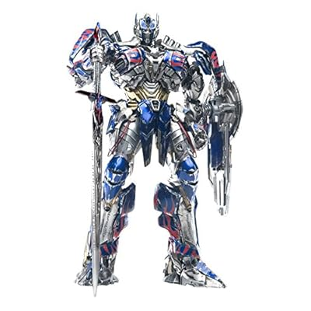

KaTie parton level event generator
KaTie is the first parton level event generator which calculates cross section for different parton level processes in collinear and $k_{t}$-factorization frameworks.
One can use TMDLib libraries for input UPDFs. However, when UPDFs are not available in TMDLIB, one should generate grid files for those UPDFs.
KaTie can also generate LHEF event files, which late can feed into CASCADE to generate hadronic events.
https://doi.org/10.1103/PhysRevD.100.054023

Slide 7

Numerical Methods
We study the Z boson production via the proton-lead collisions within the $k_{t}$-factorization frameworks, using the
Martin-Ryskin-Watt (MRW) TMDs .
For cross section calculations, we generally use the KaTie parton level event generator.
We perform these calculations for the first five quark flavors, i.e., up, down, strange, charm, bottom and their anti-quarks.
$μ_{f}= μ_{r}=$ $\sqrt{{p_{t}^{ll}}^{2}+ {m^{ll}}^{2}}$ as the factorization and renormalization scales is chosen, in which $p_{t}^{ll}$and $m^{ll}$ are the transverse momentum and the invariant mass of the output dilepton, respectively.
We use CT18NLO PDFs as inputs for the MRW formalisms for protons, and nCTEQ15FullNuc 208 82 PDF sets for lead, utilizing the LHAPDF C++ library package
We also take into account the experimental cuts and compare our results with the 8.16 TeV data from the CMS experiments in our analysis..

Slide 8
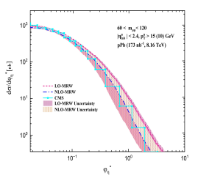
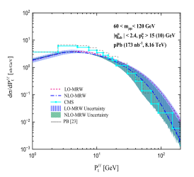
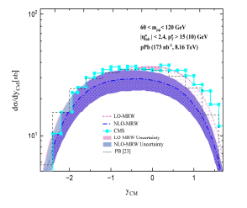


60 < $M_{jj}$ < 120
All predictions of different TMD models generally agree well with CMS experimental data. However, in some regions, such as large ${\text{ϕ}}_{\text{η}}^{\text{∗}}$ and $P_{t}^{ll}$ , the LO-MRW TMD model overestimates experimental data, while the NLO-MRW model aligns better in those regions with the data.

Slide 10
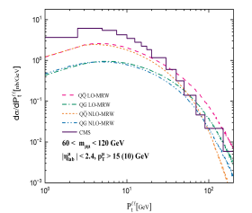
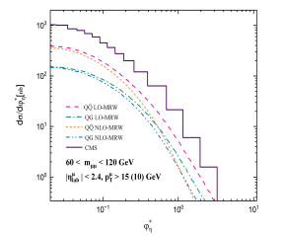
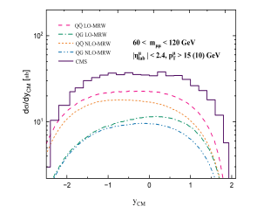


60 < $M_{jj}$ < 120
In this slide, different subprocess contributions for both the LO-MRW and NLO-MRW TMD models are compared with respect to $P_{t}^{ll}$, ${\text{ϕ}}_{\text{η}}^{\text{∗}}$ , and ${\text{y}}_{\text{CM}}$ kinematic variables in the 60 < ${\text{m}}_{\text{µµ}}$ < 120 GeV limit. The qq → ${\text{ℓ}}^{\text{+}}$ + ${\text{ℓ}}^{\text{−}}$ subprocess has a much larger contribution compared to q + g → ${\text{ℓ}}^{\text{+}}$ + ${\text{ℓ}}^{\text{−}}$+ q. In large ${\text{ϕ}}_{\text{η}}^{\text{∗}}$ and $P_{t}^{ll}$, the LO-MRW TMD model has larger contributions relative to the NLO-MRW model.

Slide 12
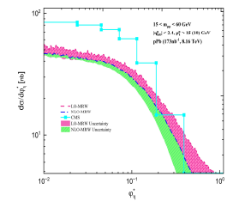
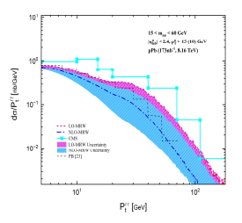
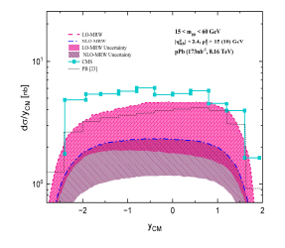


15 < $M_{jj}$ < 60
In this slide, we present a comparison of the differential cross section predictions using LO-MRW, NLO-MRW, and PB TMD models with respect to $P_{t}^{ll}$, ${\text{ϕ}}_{\text{η}}^{\text{∗}}$ , and ${\text{y}}_{\text{CM}}$ kinematic variables in the 15 < ${\text{m}}_{\text{µµ}}$ < 60 GeV region. In the small dilepton mass region, higher order subprocesses are critical, but we only consider two lower order subprocesses, so we do not expect great results. It can be seen from these figures that the LO-MRW formalism prediction seems closer to the experimental data, while the NLO-MRW approach significantly undershoots it. Even the PB approach does not show good predictive power and undershoots experimental data, especially at low dilepton transverse momenta.

Slide 14
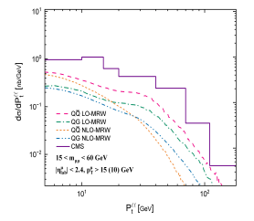
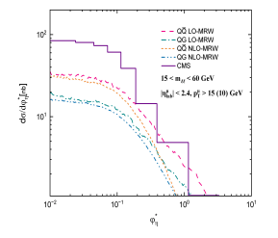
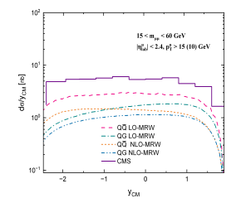


15 < $M_{jj}$ < 60
in this slide, where subprocesses of LO-MRW and NLO-MRW TMDs models are compared with respect to $P_{t}^{ll}$, ${\text{ϕ}}_{\text{η}}^{\text{∗}}$, and ${\text{y}}_{\text{CM}}$ kinematic variables in the 15 < ${\text{m}}_{\text{µµ}}$ < 60 GeV limit, a similar behavior for the TMD models predictions like what we discussed for the 10 slide are observed.

Slide 16

Conclusion
Overall, our study underscores the effectiveness of the MRW approach in describing Z boson production in proton-lead collisions, while also highlighting the need for further refinement in TMD modeling, particularly in the low mass region.
In my future research, I will focus on lead-lead collisions, specifically examining nuclear MRW TMDs method. Utilizing the MRW method, I will analyze how the nuclear TMDs evolve in the context of lead-lead collisions and how these distribution influence key observables.
somayeh@ipm.ir

Slide 17

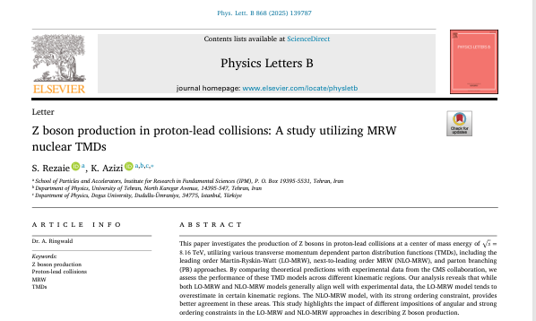
https://doi.org/10.1016/j.physletb.2025.139787

Slide 18


Slide 19

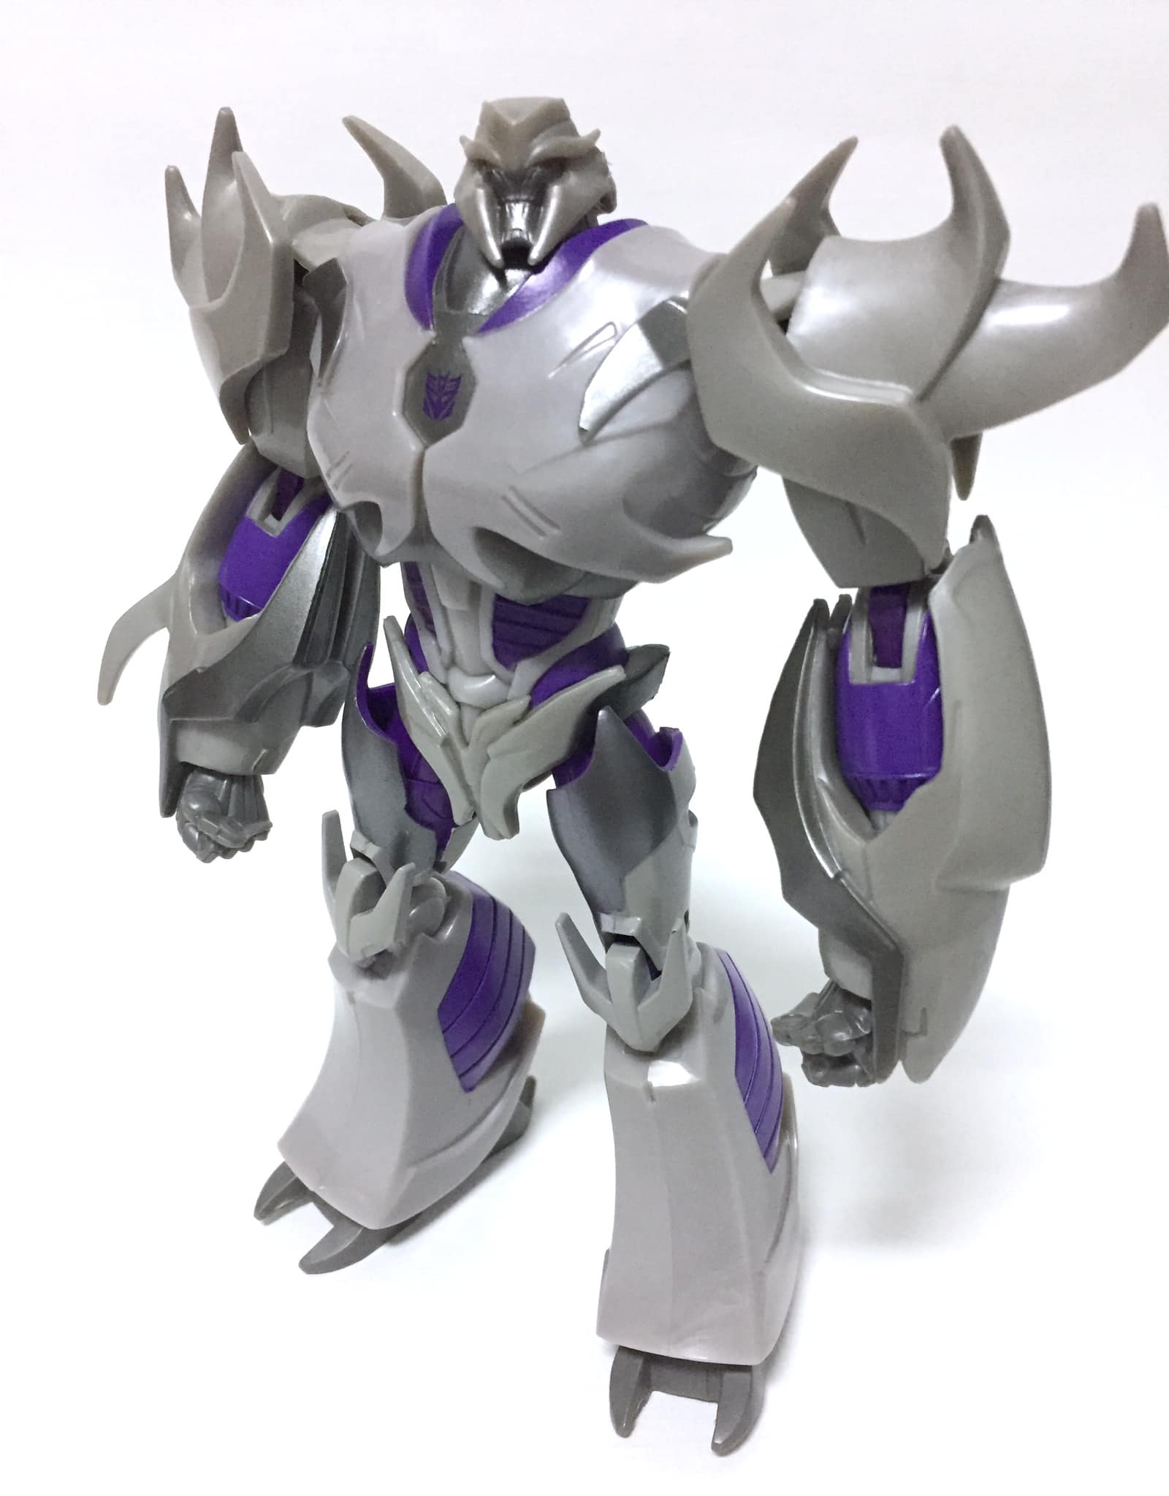
Backup

Slide 20
TMDs

Slide 21



KMR
KMR is based on LO DGLAP evolution equation. The main assumption of the DGLAP evolution (Strong Ordering) has been altered on the “last step emission”, i.e.
$$f_{q}^{KMR}\left(x,k_{t}^{2},μ^{2}\right)=T_{q}^{KMR}\left(k_{t}^{2},μ^{2}\right)$$
$$\frac{α_{s}\left(k_{t}^{2}\right)}{2π}\int_{x}^{1−Δ}{\left[P_{qq}^{LO}\left(z\right)\frac{x}{z}q^{LO}\left(\frac{x}{z},k_{t}^{2}\right)+P_{qg}^{LO}\left(z\right)\frac{x}{z}g^{LO}\left(\frac{x}{z},k_{t}^{2}\right)\right]} dz$$
$$f_{g}^{KMR}\left(x,k_{t}^{2},μ^{2}\right)=T_{g}^{KMR}\left(k_{t}^{2},μ^{2}\right)$$
$$\frac{α_{s}\left(k_{t}^{2}\right)}{2π}\int_{x}^{1−Δ}{\left[P_{gg}^{LO}\left(z\right)\frac{x}{z}g^{LO}\left(\frac{x}{z},k_{t}^{2}\right)+\sum_{q}{{ P}_{gq}^{LO}\left(z\right)\frac{x}{z}q^{LO}\left(\frac{x}{z},k_{t}^{2}\right)}\right]} dz$$
$T_{q}^{KMR}\left(k_{t}^{2},μ^{2}\right)=exp\left(−\int_{k_{t}^{2}}^{μ^{2}}{\frac{dκ_{t}^{2}}{κ_{t}^{2}}}\frac{α_{s}\left(k_{t}^{2}\right)}{2π}\int_{0}^{1−Δ}{P_{qq}^{LO}\left(ξ\right)dξ}\right)$
$$T_{g}^{KMR}\left(k_{t}^{2},μ^{2}\right)=exp\left(−\int_{k_{t}^{2}}^{μ^{2}}{\frac{dκ_{t}^{2}}{κ_{t}^{2}}}\frac{α_{s}\left(k_{t}^{2}\right)}{2π}\int_{0}^{1−Δ}{\left( [ξP_{gg}^{LO}\left(ξ\right)+n_{f}P_{qg}^{LO}\left(ξ\right)]\right)dξ}\right)$$

Slide 22


LO-MRW
$$f_{q}\left(x,,k_{t}^{2},μ^{2}\right)=T_{q}\left(k_{t}^{2},μ^{2}\right)\frac{α_{s}\left(k_{t}^{2}\right)}{2π}\int_{x}^{1}{\left[P_{qq}\left(z\right)f_{q}\left(\frac{x}{z},k_{t}^{2}\right)Θ\left(z−1+Δ\right)+P_{qg}\left(z\right)f_{g}\left(\frac{x}{z},k_{t}^{2}\right)\right]} dz$$
$$f_{g}\left(x,k_{t}^{2},μ^{2}\right)=T_{g}\left(k_{t}^{2},μ^{2}\right)\frac{α_{s}\left(k_{t}^{2}\right)}{2π}\int_{x}^{1}{\left[P_{gg}\left(z\right)f_{g}\left(\frac{x}{z},k_{t}^{2}\right)Θ\left(z−1+Δ\right)+\sum_{q}{P_{gq}\left(z\right)f_{q}\left(\frac{x}{z},k_{t}^{2}\right)}\right]} dz$$
In the above equations, the cutoff $Θ\left(z−1+Δ\right)$ is imposed in order to avoid soft gluon emissions. This cutoff can be determined according to the angular ordering in the last evolution step, i.e.:
$$Δ=\frac{k_{t}}{μ+k_{t}}$$
$$T_{q}\left(k_{t}^{2},μ^{2}\right)=exp\left(−\int_{k_{t}^{2}}^{μ^{2}}{\frac{dκ_{t}^{2}}{κ_{t}^{2}}}\frac{α_{s}\left(κ_{t}^{2}\right)}{2π}\int_{0}^{1}{P_{qq}^{LO}\left(ξ\right)Θ\left(ξ−1+Δ\right)dξ}\right)$$
$$T_{g}\left(k_{t}^{2},μ^{2}\right)=exp\left(−\int_{k_{t}^{2}}^{μ^{2}}{\frac{dκ_{t}^{2}}{κ_{t}^{2}}}\frac{α_{s}\left(κ_{t}^{2}\right)}{2π}\int_{0}^{1}{[{ξP}_{gg}^{LO}\left(ξ\right)Θ\left(ξ−1+Δ\right)Θ\left(ξ−Δ\right){+n_{f}P}_{qg}^{LO}\left(ξ\right)]dξ}\right)$$

Slide 23


NLO-MRW
In the NLO-MRW scale is set: $k^{2}=−\frac{k_{t}^{2}}{1−z}.$
Can be approximated with the LO splitting functions.
$$f_{q}^{NLO−MRW}\left(x,k_{t}^{2},μ^{2}\right)=$$
$$\int_{x}^{1}{{\frac{α_{s}^{NLO}\left(k^{2}\right)}{2π}T}_{q}^{NLO−MRW}\left(k^{2},μ^{2}\right)\left[P_{qq}^{LO}\left(z\right)\frac{x}{z}q^{NLO}\left(\frac{x}{z},k^{2}\right)Θ\left(z−1+Δ\right)+P_{qg}^{LO}\left(z\right)\frac{x}{z}g^{NLO}\left(\frac{x}{z},k^{2}\right)\right]}Θ\left({μ^{2}−k}^{2}\right) dz$$
$$f_{g}^{NLO−MRW}\left(x,k_{t}^{2},μ^{2}\right)=$$
$$\int_{x}^{1}{{\frac{α_{s}^{NLO}\left(k^{2}\right)}{2π}T}_{g}^{NLO−MRW}\left(k^{2},μ^{2}\right)\left[P_{gg}^{LO}\left(z\right)\frac{x}{z}g^{NLO}\left(\frac{x}{z},k^{2}\right)Θ\left(z−1+Δ\right)+\sum_{q}{P_{gq}^{LO}\left(z\right)\frac{x}{z}q^{NLO}\left(\frac{x}{z},k^{2}\right)}\right]}Θ\left({μ^{2}−k}^{2}\right) dz$$
$$T_{q}^{NLO−MRW}\left(k^{2},μ^{2}\right)=exp\left(−\int_{k^{2}}^{μ^{2}}{\frac{dκ^{2}}{κ^{2}}}\frac{α_{s}^{NLO}\left(κ^{2}\right)}{2π}\int_{0}^{1}{ξ[P_{qq}^{LO}\left(ξ\right)Θ\left(ξ−1+Δ\right)+P_{gq}^{LO}\left(ξ\right)]dξ}\right)$$
$$T_{g}^{NLO−MRW}\left(k^{2},μ^{2}\right)=exp\left(−\int_{k^{2}}^{μ^{2}}{\frac{dκ^{2}}{κ^{2}}}\frac{α_{s}^{NLO}\left(κ^{2}\right)}{2π}\int_{0}^{1}{ξ[P_{gg}^{LO}\left(ξ\right)Θ\left(ξ−1+Δ\right)+2n_{f}P_{qg}^{LO}\left(ξ\right)]dξ}\right)$$

Slide 24
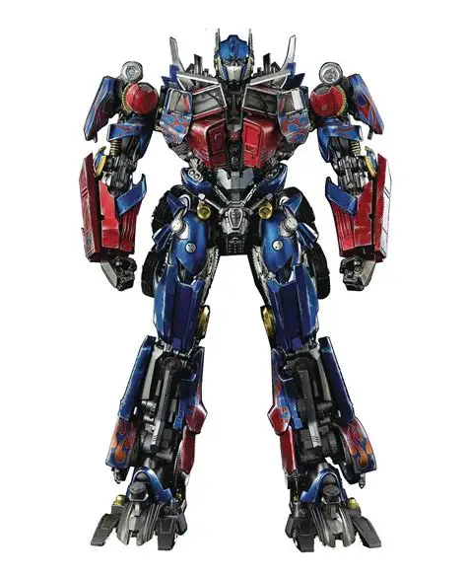
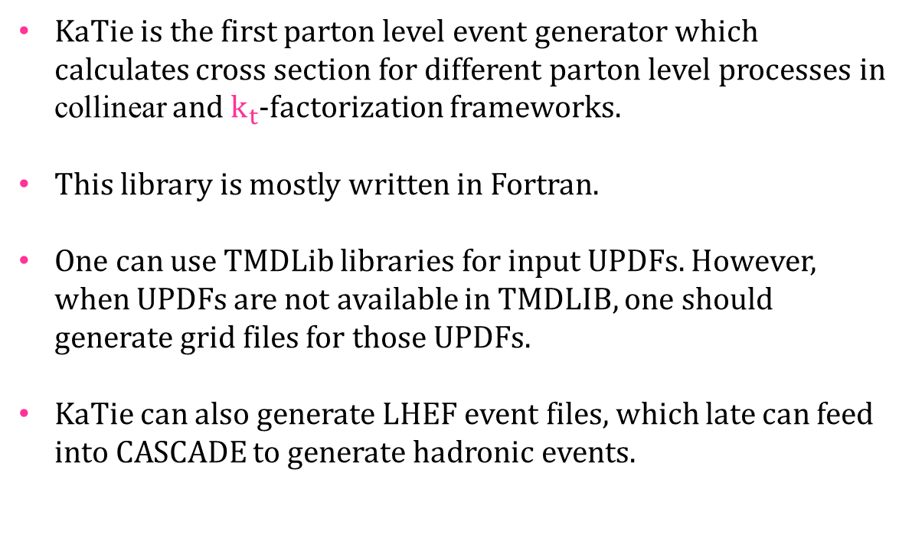
KaTie parton level event generator
KaTie is the first parton level event generator which calculates cross section for different parton level processes in collinear and $k_{t}$-factorization frameworks.
This library is mostly written in Fortran.
One can use TMDLib libraries for input UPDFs. However, when UPDFs are not available in TMDLIB, one should generate grid files for those UPDFs.
KaTie can also generate LHEF event files, which late can feed into CASCADE to generate hadronic events.

Slide 25


The End

